Slide 1
Chicxulub: a Planetary Catastrophe
Report by the Earth Science group
Alex Aldridge, Jacob Roe, Sydney Smith, Matthew Taylor, Ivy Waring, Wakana Hoshi, Sayuki Imanaka, Shin Kanda, Anzu Kato, Ayana Munakata, Simon Crowhurst, Dr Auriol Rae and Ryo Mizuta

Slide 2
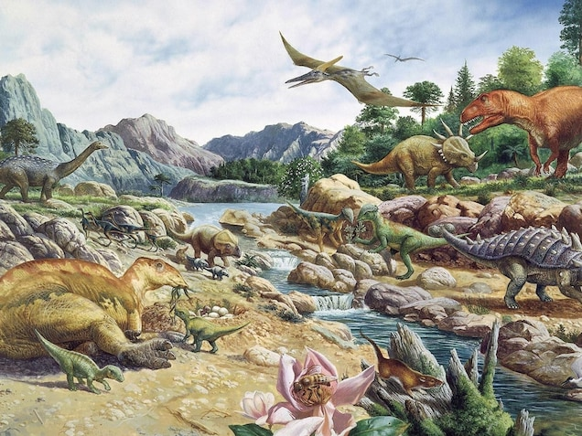
Importance of investigation 調べの重要さ
Explore the relationship between natural disasters, climatically active gases and mass extinction events.
This is important as it can be applied to the potential planetary catastrophes in the near future.
自然災害、気候的活性ガス、大量絶滅の出来事の関連性を探ること
これらは現在の地球規模の災害と適用して考えることができるので重要です。
Notes:
66 million years ago, an asteroid impact occurred which caused geographic catastrophes including the extinction of the dinosaurs. This event saw the end of the Cretaceous period which made approximately 75% of the species on Earth extinct.
In this investigation we explore the relationships between natural disasters, climatically active gases and the mass extinction events we saw at the end of the Cretaceous, using geological techniques. These can be applied to current threats we face today such as global warming (where gases are being produced by anthropogenic (manmade) sources which we have the power to prevent). This investigation is therefore important as it not only enables us to make further discoveries regarding Earth’s History but can be seen as informing us of the consequences of possible future planetary catastrophes.

Slide 3
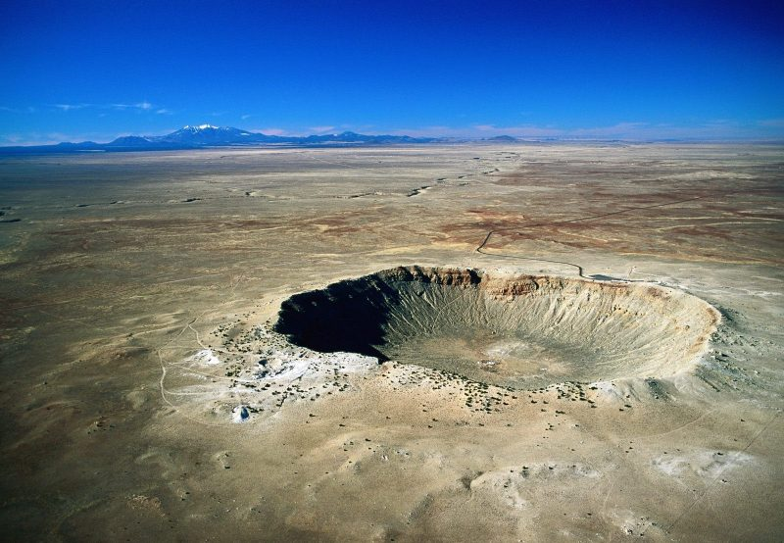
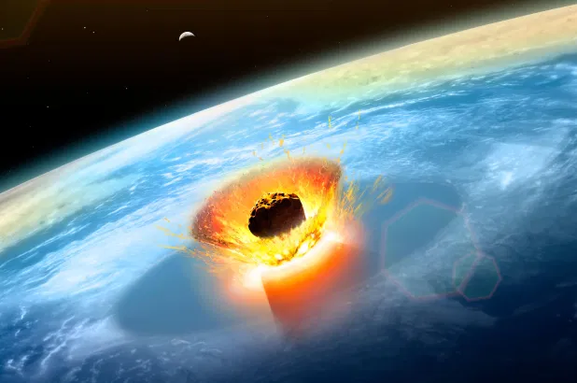
Aim目的
How can we explore the effects of major asteroid impact events on Earth?
数千年前、地球に隕石が落ちたことによる影響はどのようなものか？
Notes:
Our aim was to look at the effects of major impact events on Earth through experimentation and computational modelling. We focused on the asteroid that caused the Chicxulub crater in modern day Mexico - more commonly known as the asteroid that wiped out the dinosaurs.
To do this we modelled an impact using mayonnaise and a marble, used online tools to see what affect crater formation, used python (a computer programming language) to model the specific chicxulub event and investigated methods for geological sampling. In this presentation, we will go over each of these steps saying what we discovered.

Slide 4
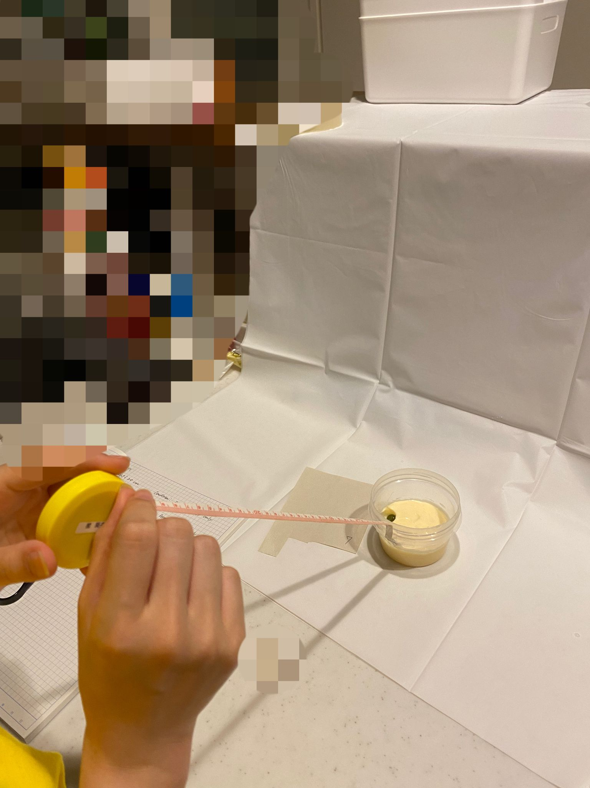
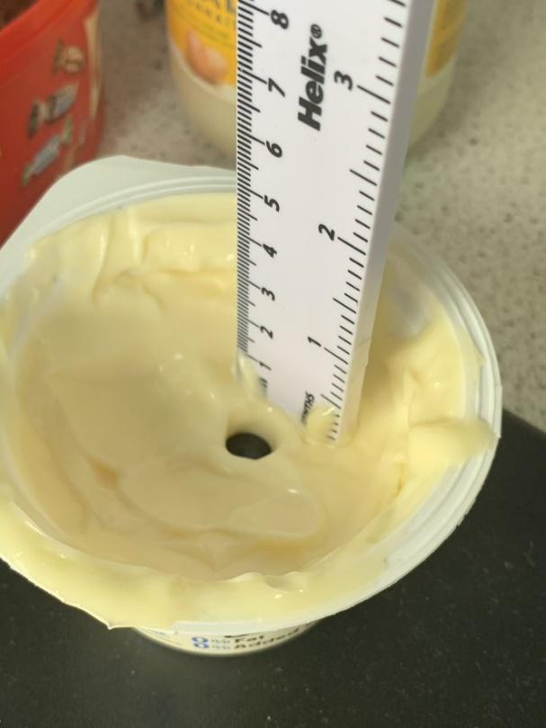
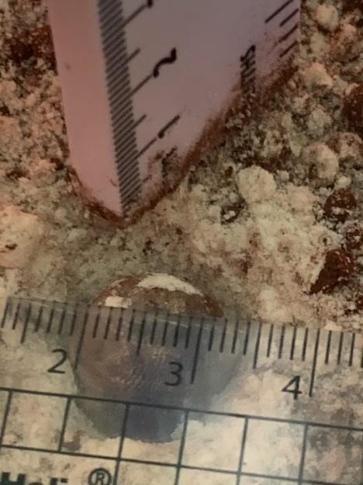
Day 1:１日目
The Mayonnaise Experiment
Aim: To use mayonnaise and marbles to model the effect of asteroid impacts
マヨネーズを用いた実験
目的：マヨネーズとビー玉を用いて隕石衝突時の影響についてモデル実験をするため
Notes:
ENGLISH: So on the first day, we did an experiment using mayonnaise and marbles to model the effect that asteroids can have on the Earth, specifically in forming craters with different depths, diameters, shapes and rims.

Slide 5
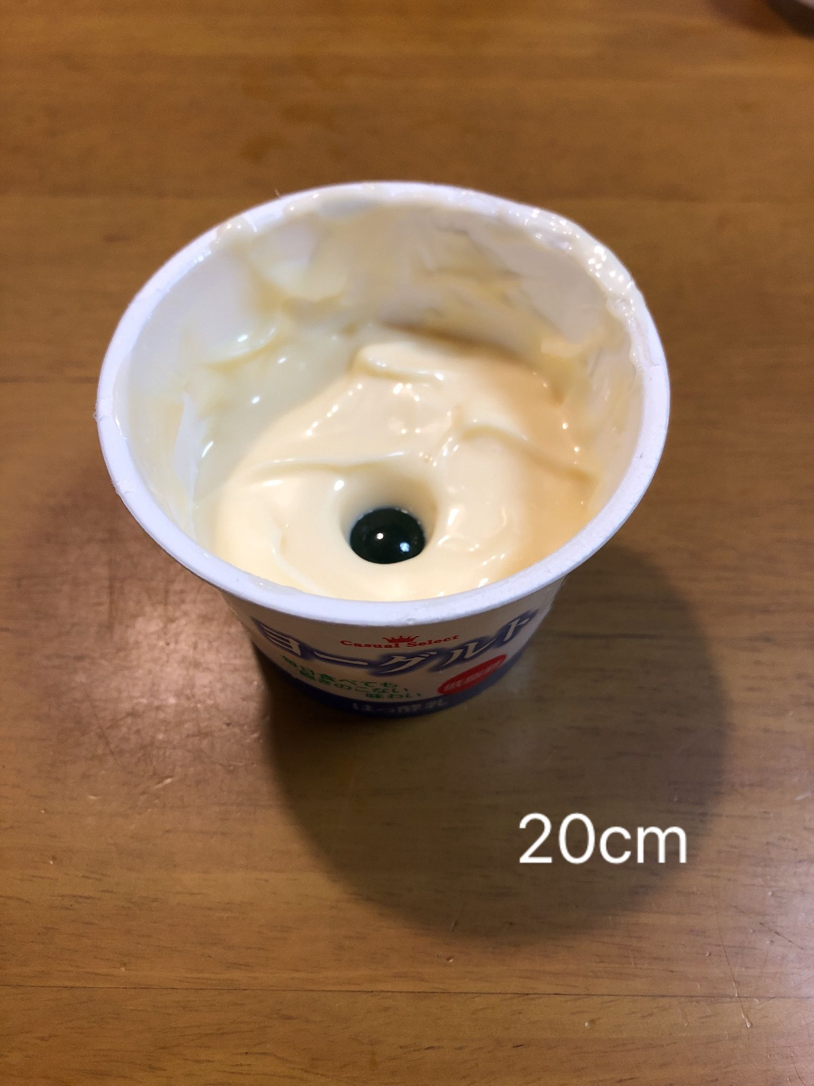
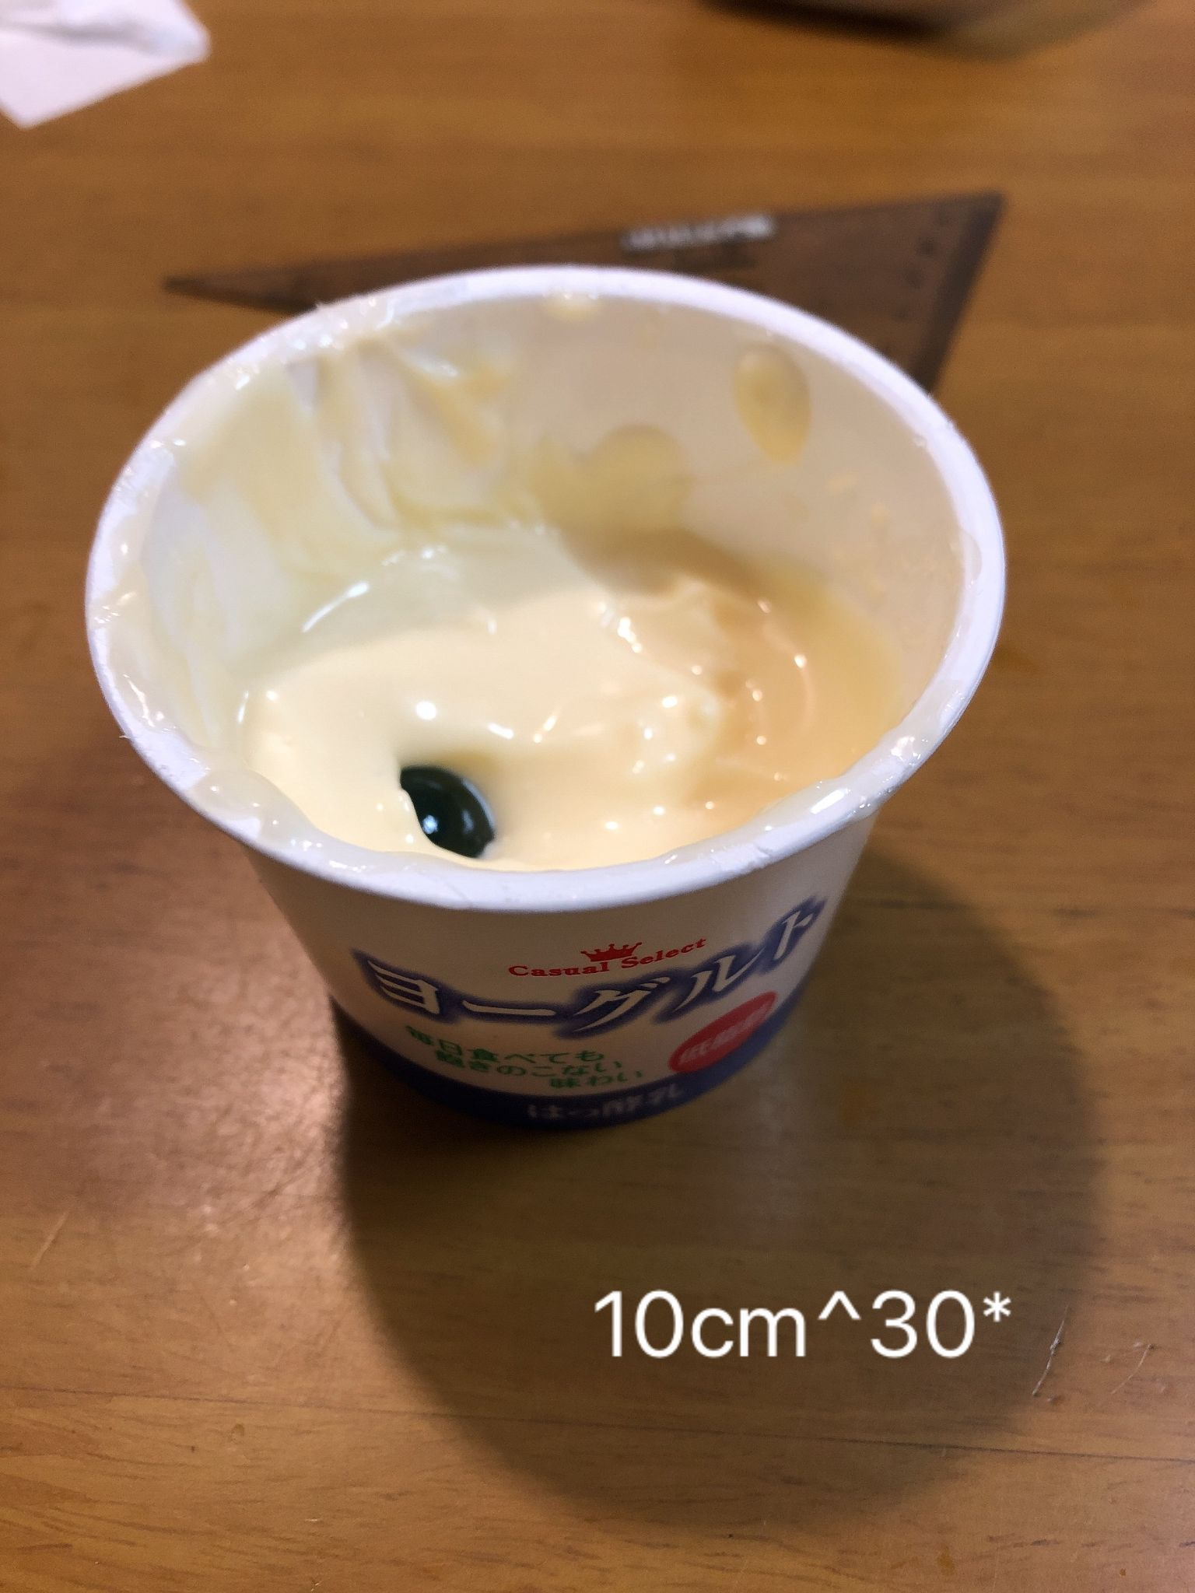
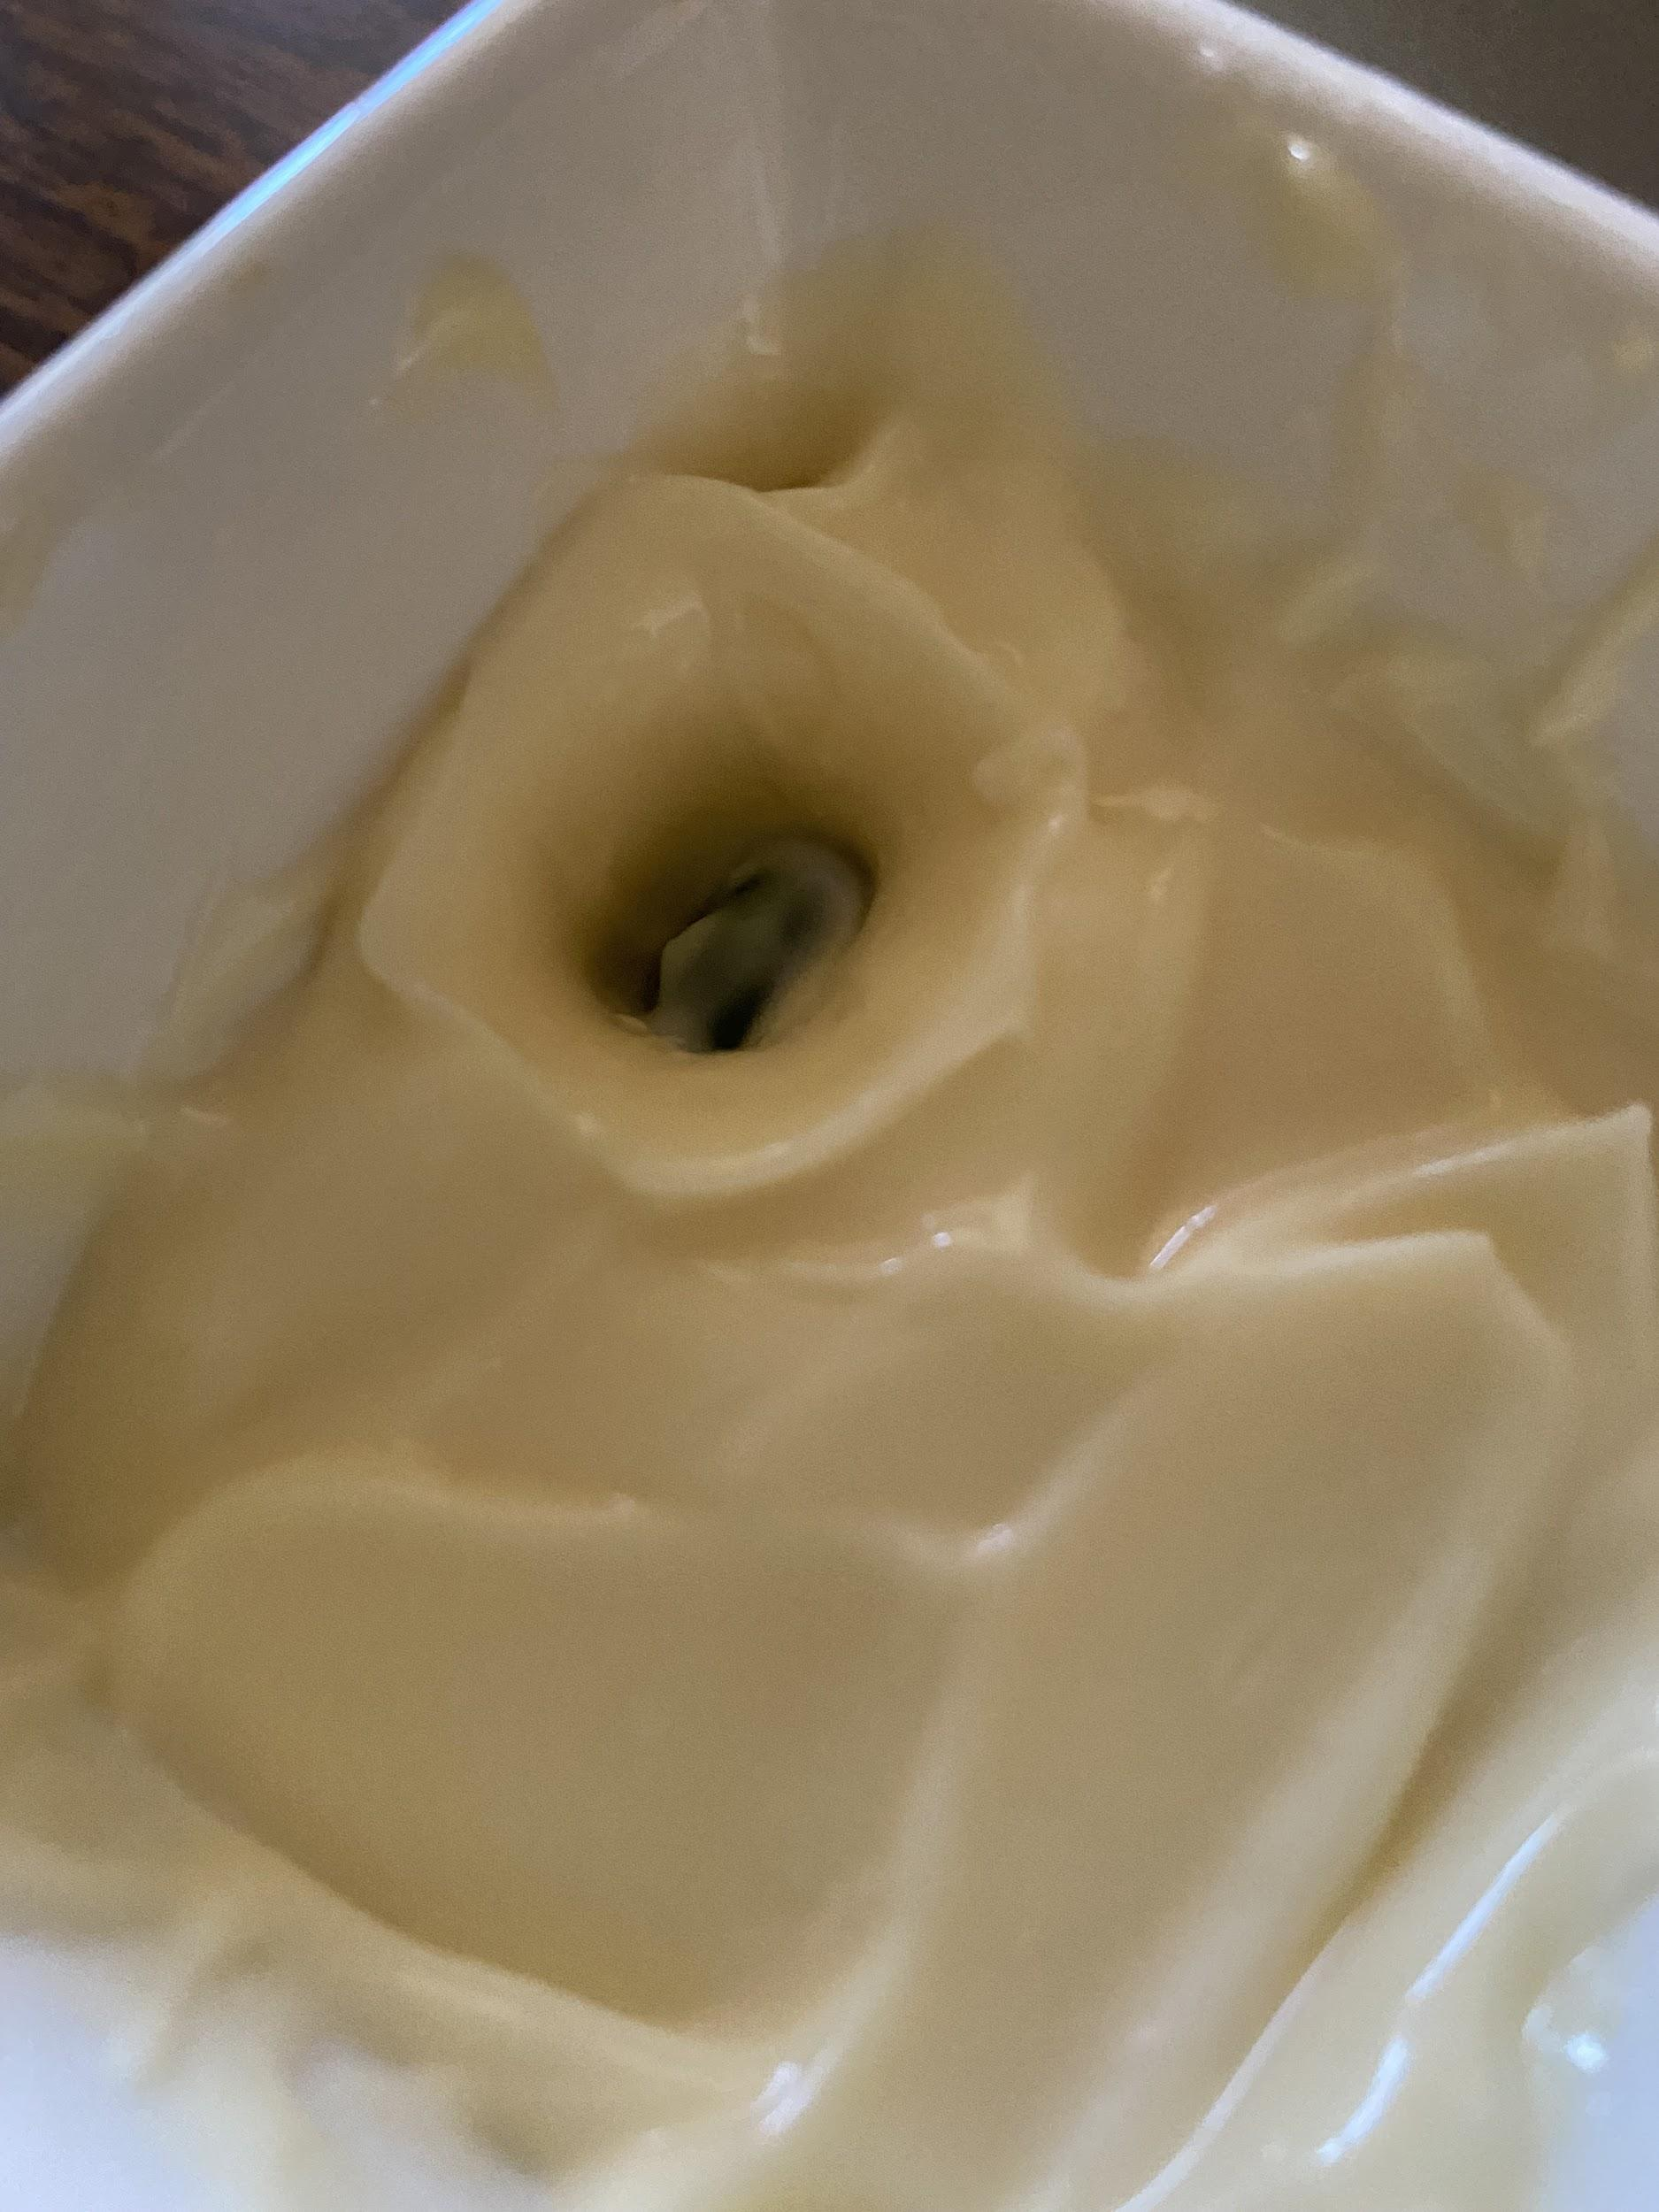
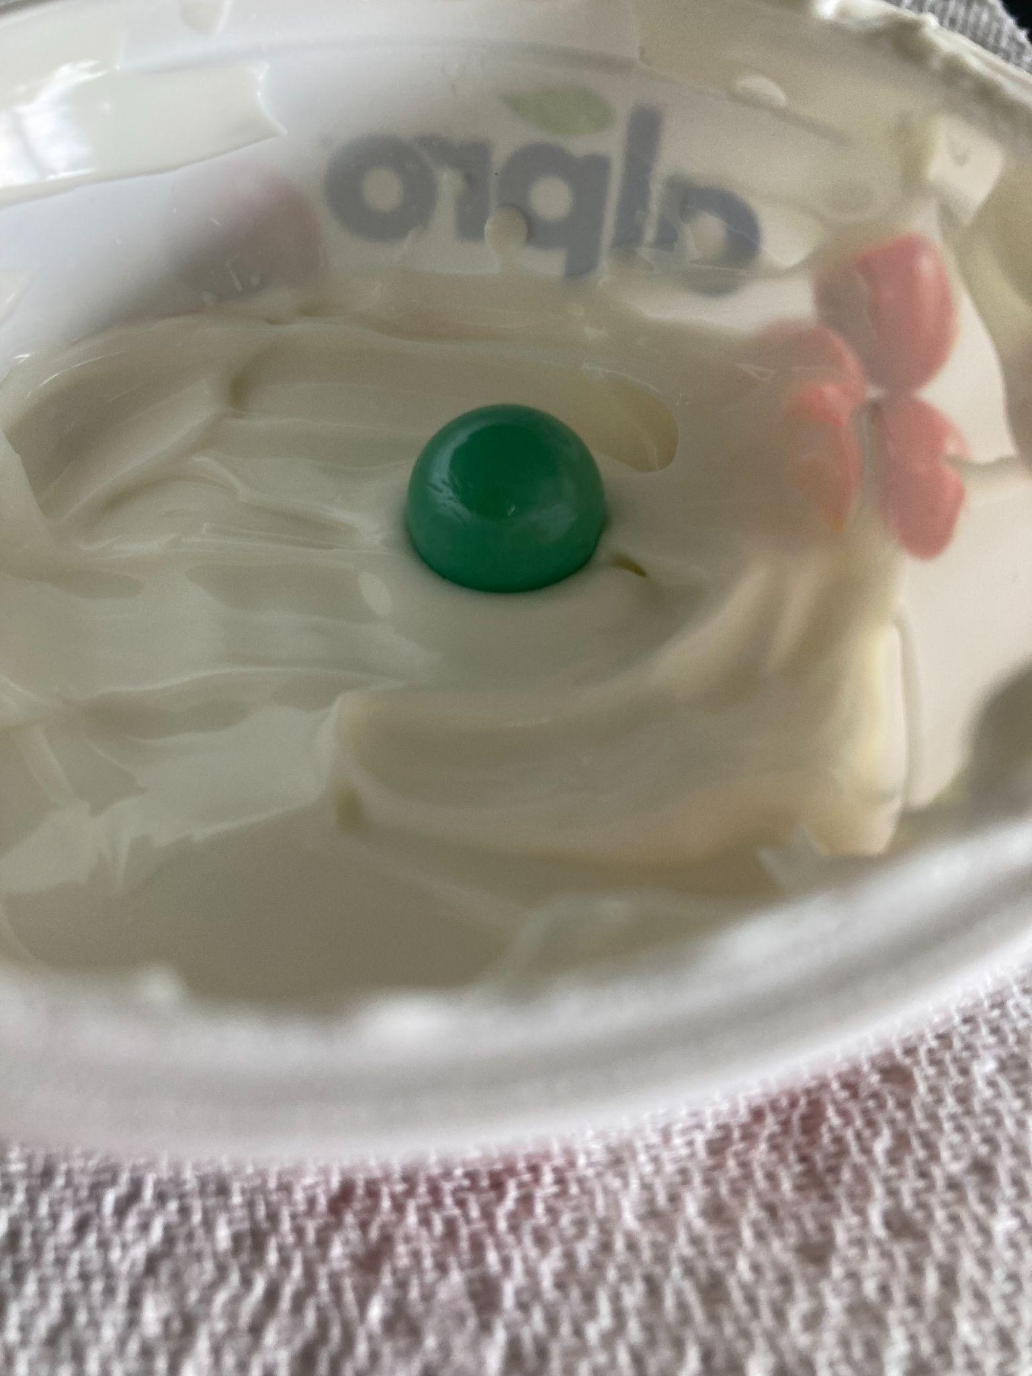
Day 1:１日目
Method:
Drop a marble (the asteroid) into a pot of mayonnaise (the surface of the Earth) and measure the diameter of the crater formed
Repeat with different heights and angles to vary the marbles impact velocity
We can then calculate the velocity of the marble as it hits the mayonnaise, and therefore its kinetic energy
方法：
1．ビー玉(隕石）をカップの中のマヨネーズ(地球の表面)に落とし、生じたクレーターの直径を測定
2．角度及び高さを変えて実験を繰り返す
3．マヨネーズ衝突時のビー玉の速さ、運動エネルギーを求める
Notes:
ENGLISH: To do this experiment, we added about a 3cm depth of mayonnaise, acting as the surface of the Earth, to a pot and dropped a marble, which acted as the asteroid, into it. We then measured the diameter of the craters formed when the marble was dropped from the different heights and angles.
Using the measured heights and masses of the marbles, we calculated their kinetic energy just before their impact. We compared each marbles kinetic energy to the diameter of the crater they formed.

Slide 6
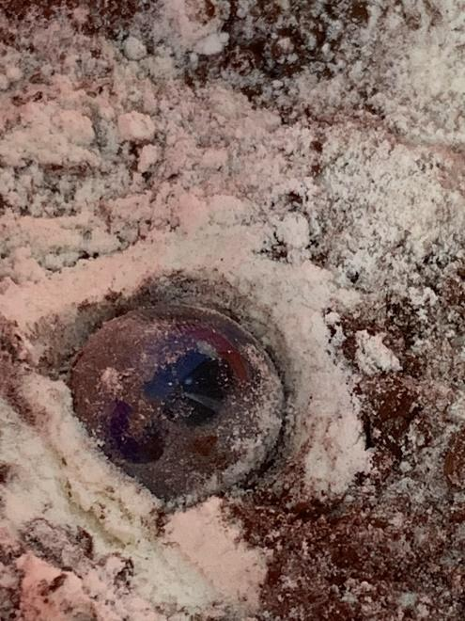
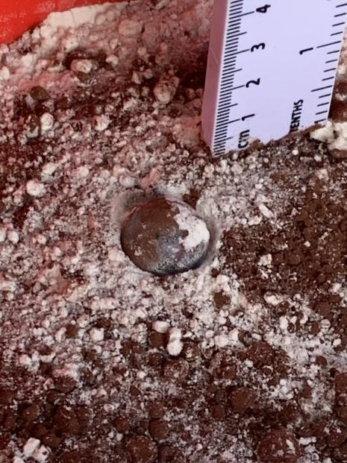
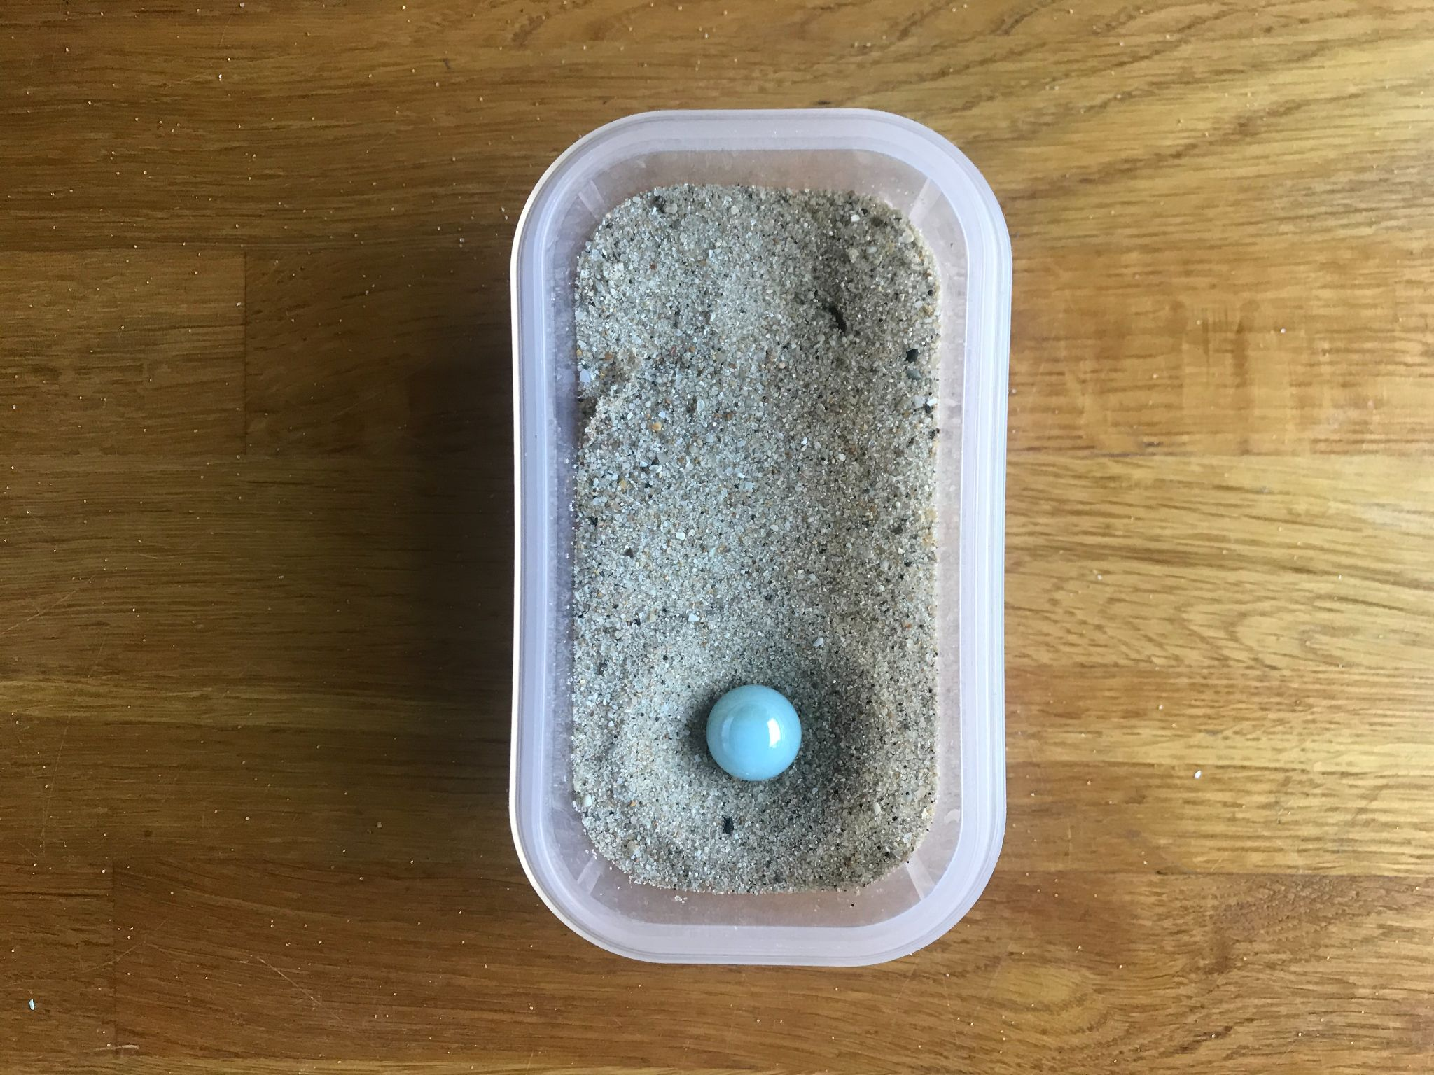
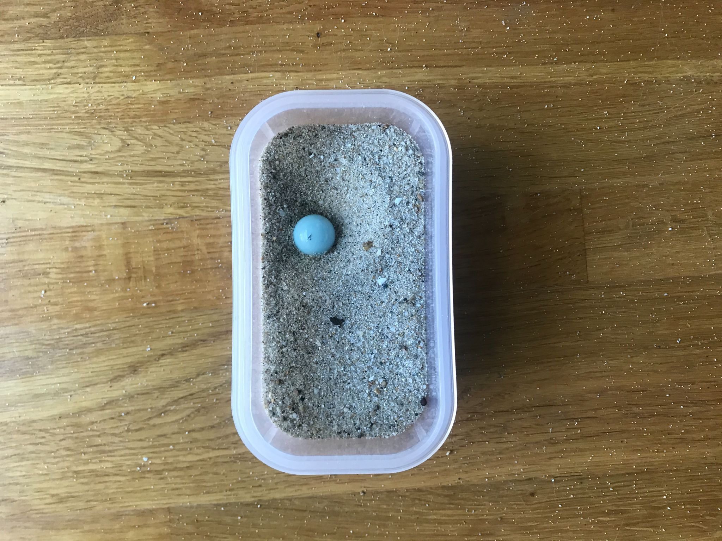
Day 1:１日目
Conclusions:
Generally, the higher the marble was dropped, the deeper and the larger the diameter of the crater formed
We also tried varying what surface we dropped the marble onto, and instead used sand, flour and cocoa powder
This was because the mayonnaise wasn’t showing a crater with a good rim, but the new materials showed this better
結論
・概してビー玉を落とす高さにが高くなるほど、クレーターの直径は大きく、かつ深くなった
・ビー玉を落とす物質の材料を土、小麦粉、及びココアパウダーに変える実験も行った
・上記の実験はマヨネーズを用いた実験では正確な値が得られなかったためである。新素材ではこの問題は解決した。
Notes:
ENGLISH: But with the many marbles dropped, some didn’t produce a good rim around the crater or hold their shape. So to combat this, we tried the experiment using sand, flour and cocoa powder instead of mayonnaise, this worked better. Overall, we found that all the craters formed were simple, as the marbles were not big enough and did not travel fast enough to form complex craters.

Slide 7
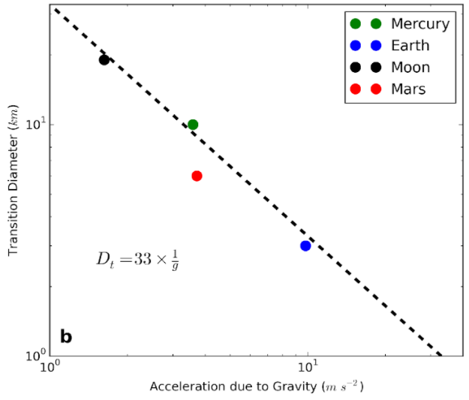
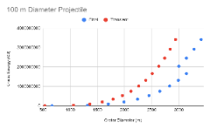
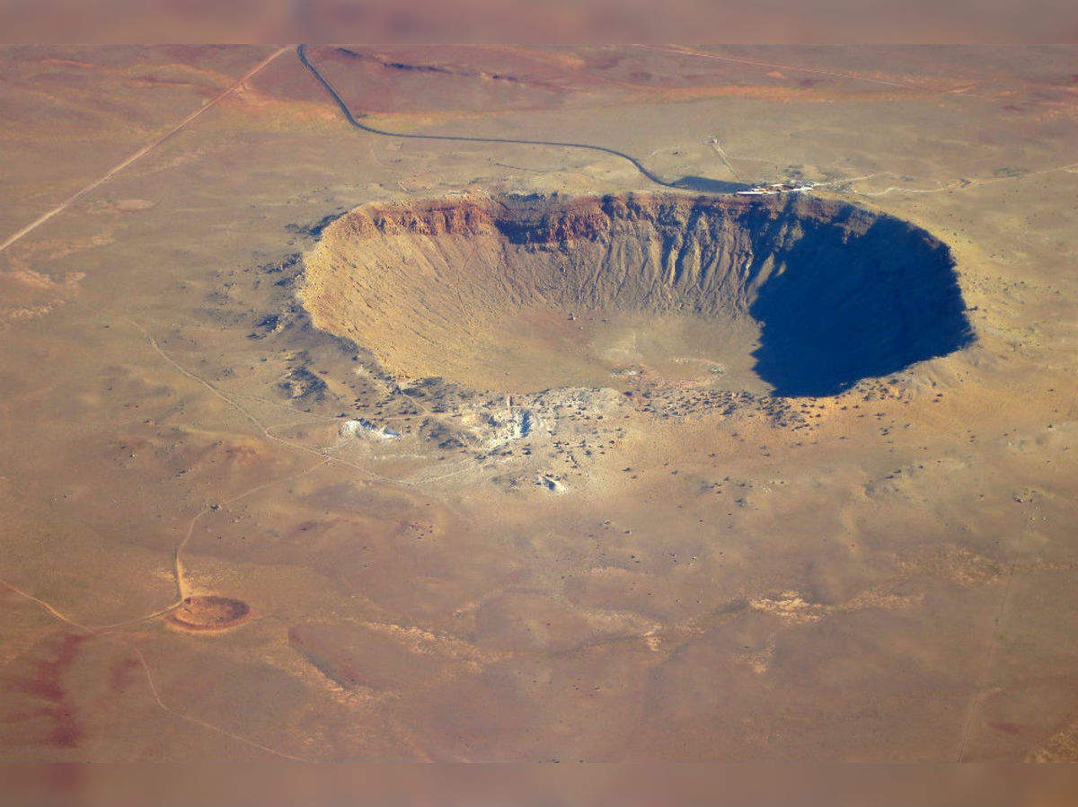
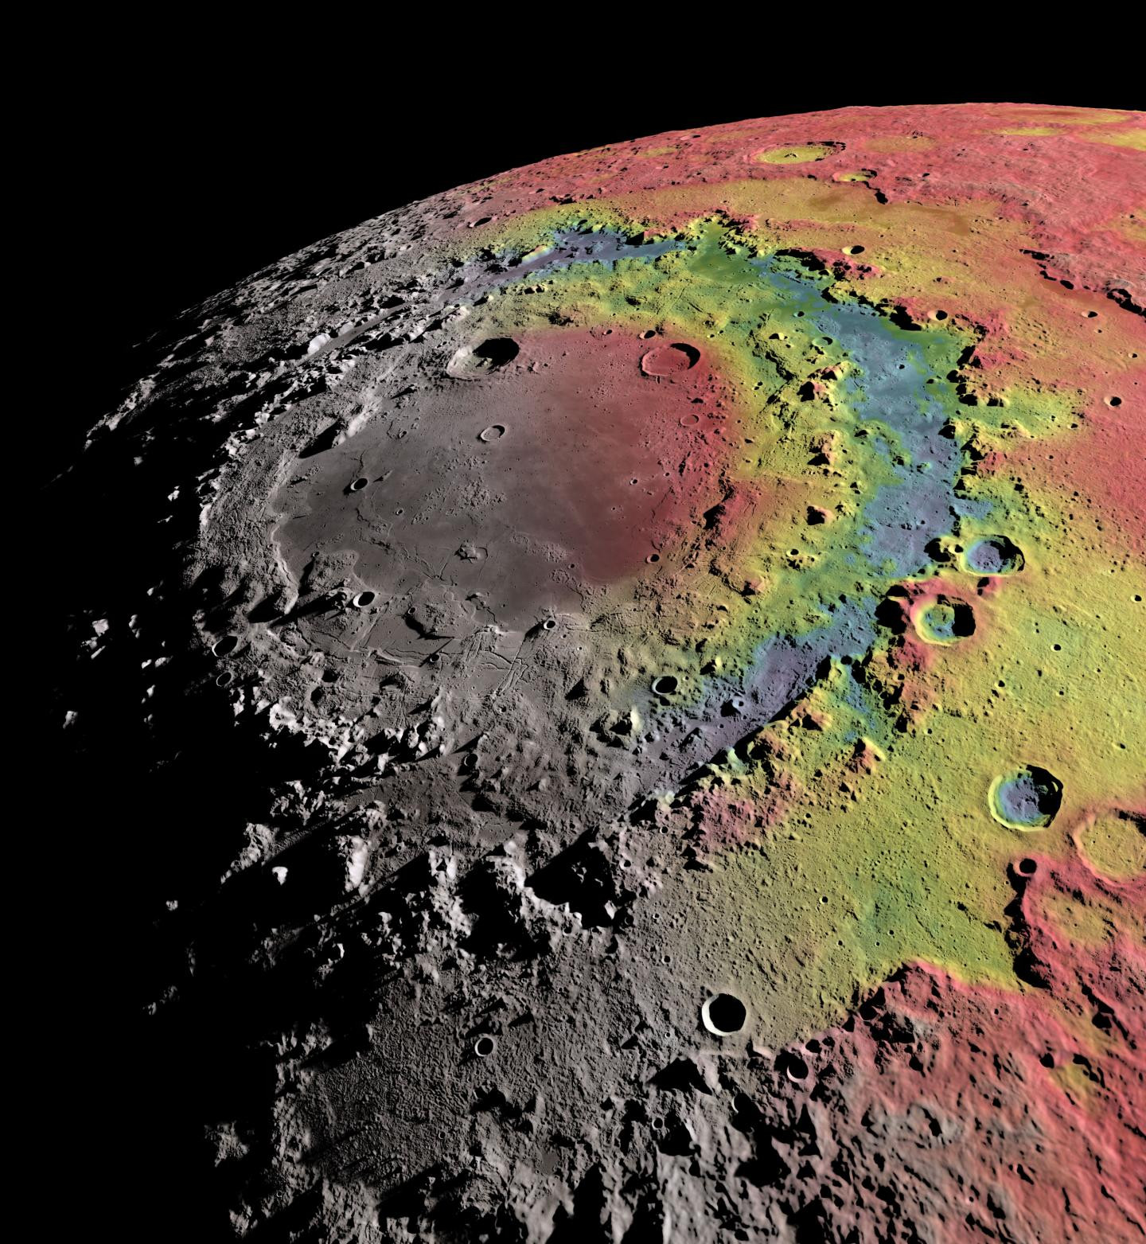
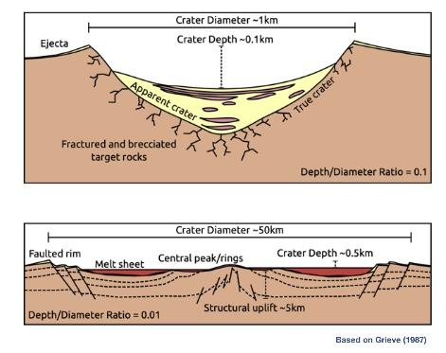
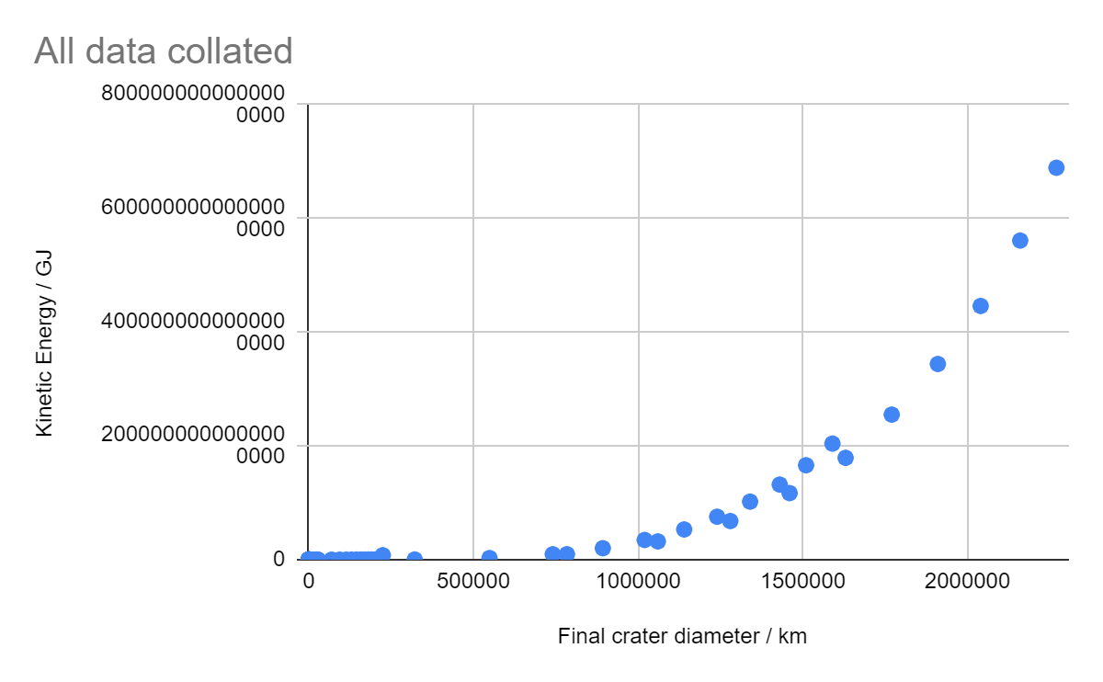
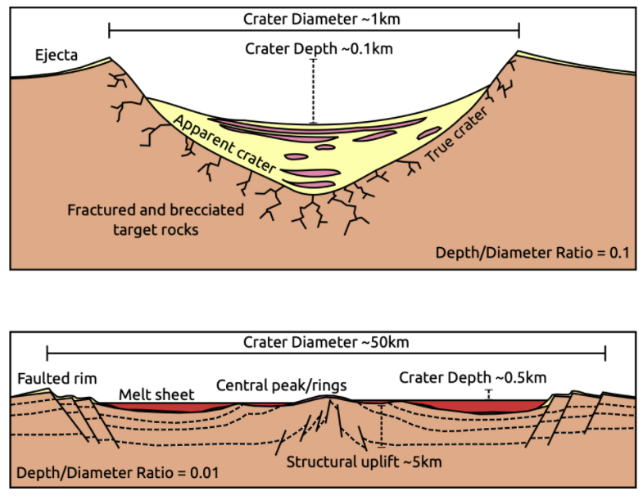
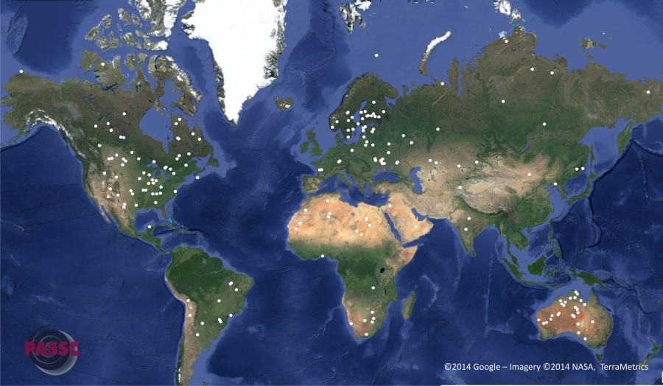
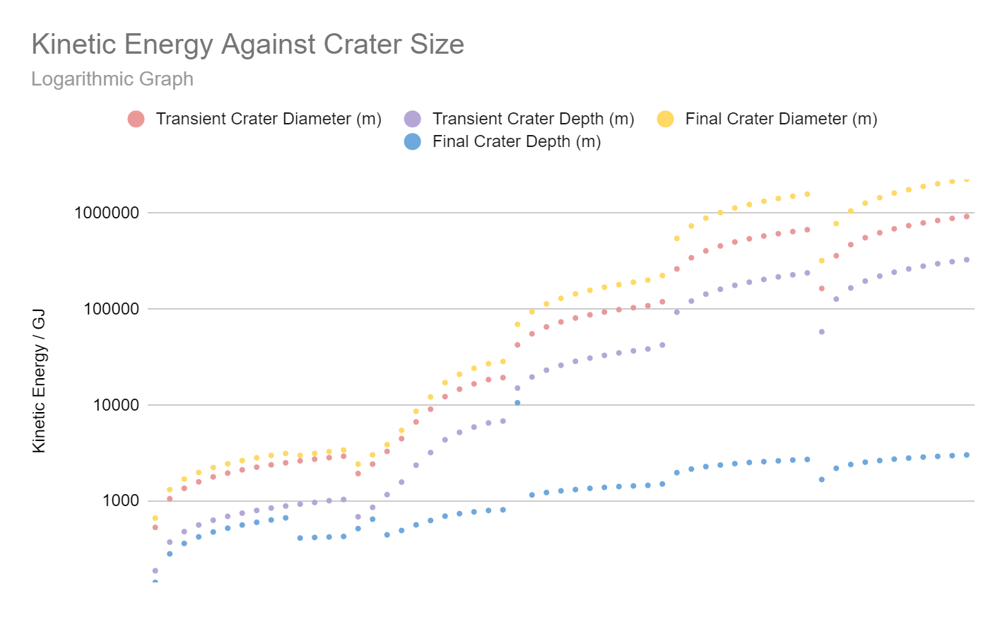
Day 2：２日目
simple craters 単純形のクレーター
Bowl shaped holes ボウル型の穴
A Simple Crater
Barringer Crater (Arizona, USA)
D = 1.2 km
単純形のクレーター
バリンジャークレーター(アリゾナ州) 直径1.2km
A Complex Crater
Orientale Crater (Moon)
D = 930 km
複雑形のクレーター
オリエンタル衝突盆地(月) 直径930km
complex craters 複雑形のクレーター
クレーターの縁の土砂が内側に崩れることによって直径が大きく、浅いクレーターができる。
Locations of all Currently known craters on Earth
地球上の現在発見されているクレーターの分布
Notes:
On the second day we learnt about the craters asteroid impacts cause on Earth and other planets in the solar system
On day 2, we were learning about
Two types of craters can be formed - simple and complex. Larger asteroids with higher velocities tend to form complex craters
We used the ‘Earth Impact Effects Programme’ to compare the diameters and depth of craters that different sized asteroids with different kinetic energies form
On the second day we learnt about the craters asteroid impacts cause on Earth and other planets in the solar system.
190 craters have been found in the world.
There are variations among countries depending on the progress of research.
For example, the Indian subcontinent is old, but only two Impact craters have been discovered.
There are two main types of crater, simple and complex. Simple craters are bowl shaped holes in the ground formed by relatively small impacts. Complex craters are formed by larger impacts where the rim of the crater collapses inwards which in turn forces rock from the floor up, resulting in a shallower but wider crater with a raised central peak or ring.

Slide 8
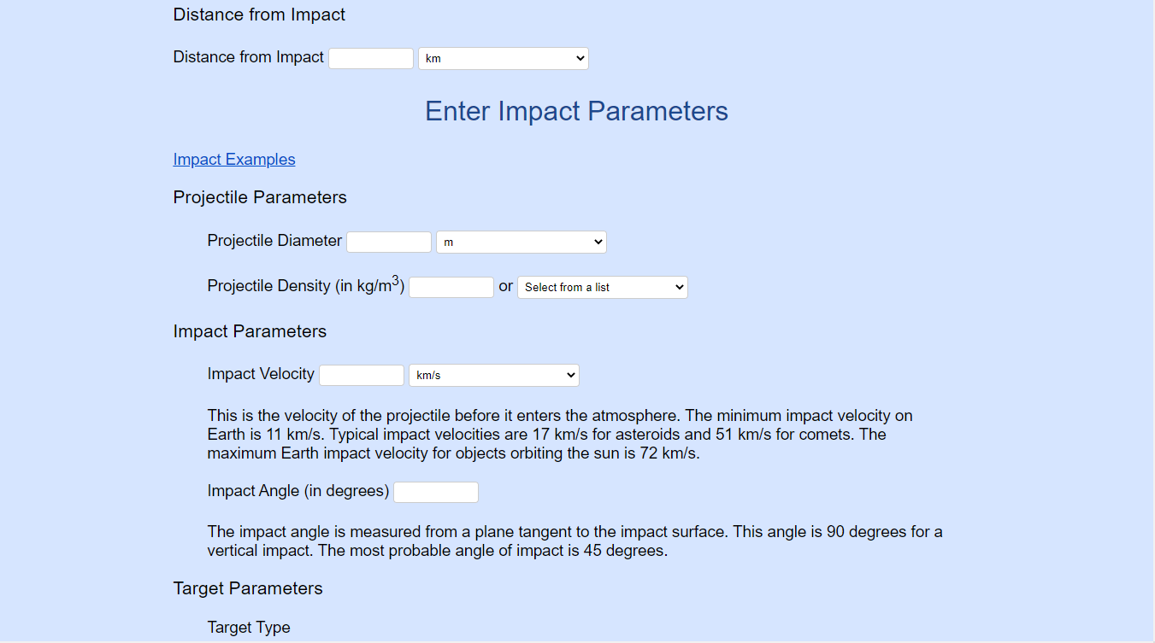
Day 2：２日目
Notes:
We began to experiment using an online calculator called the Earth Impacts Effects program, which allowed us to control many different variables that could affect an asteroid impact including size and density of the projectile to the angle and material that it hits. We could then record data on the dimensions of the transient crater (before rock flows back into the center) and the final crater. This gave us the ability to collect data on asteroid impacts that we otherwise couldn’t collect ourselves, including being able to analyze complex craters. The UK students began analysing how the size and velocity of an asteroid will affect the dimensions of craters formed and how this varies between simple and complex craters.

Slide 9
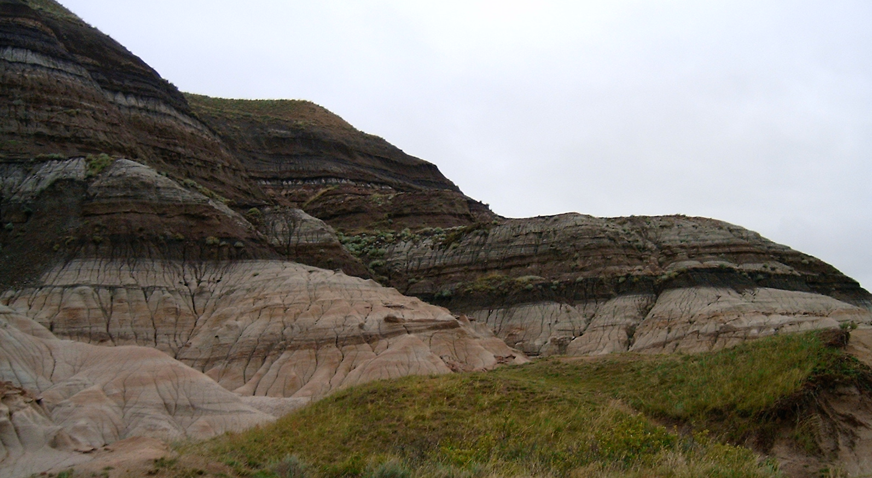
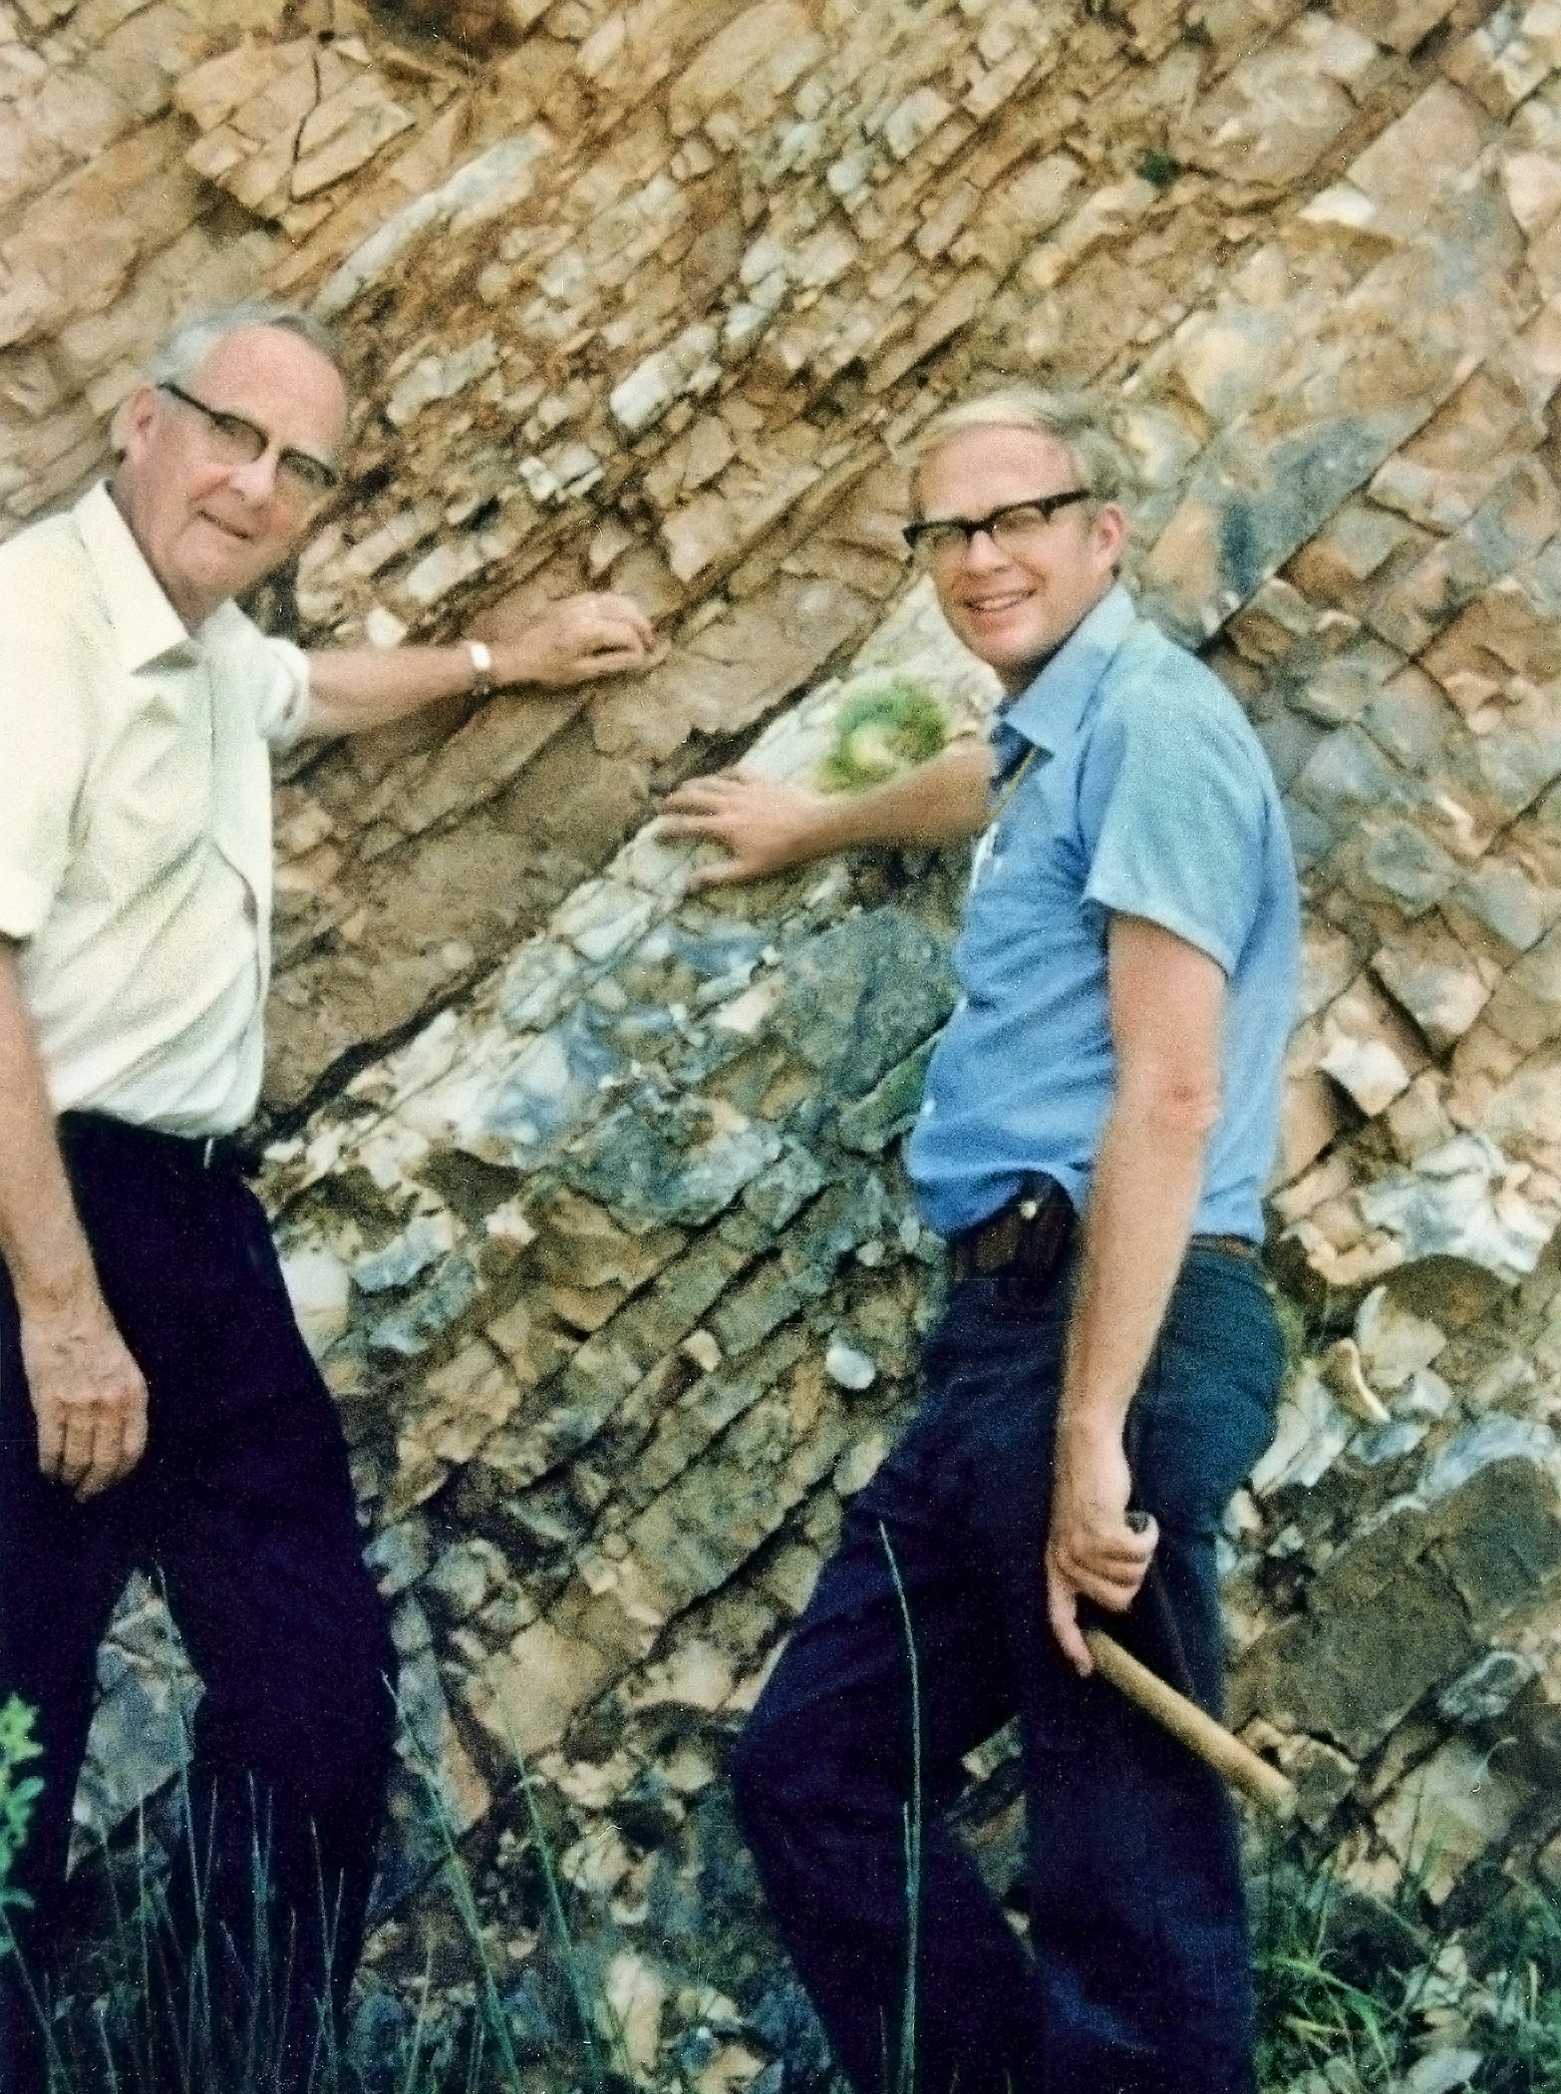
Day 3:３日目
K-Pg boundary in Umbria, Italy
K-Pg boundary in Canada
ｋ-Pg境目
in イタリアのアンブリア
Ｋ-Pg 境目
in カナダ
ドットはK-Pgの境目が見つかった位置を示す
Dots represent where the K-Pg boundary was found.
We explored how we know a mass extinction event happened at the end of the cretaceous period. We then looked into the impact the Chicxulub asteroid caused. These are the mechanisms that cause mass extinction.
5 causes of mass-extinction
① Impact winter
② Firestorm
③ Natural disasters
④ Thermal radiation
⑤ Production of climatically active gases
白亜紀末期に大量絶滅が起きたことがなぜ分かったのかをしらべた。そして、チクシュルブに小惑星がもたらした衝撃について調べた。これらが大量絶滅を起こすメカニズムである。
大量絶滅についての５つのメカニズム
①隕石落下後に作られたガスが太陽光を遮断して起こる氷河期
②火災旋風
③自然災害
④熱放射
⑤気候的に活性なガスの生産
Notes:
On day 3 we explored the end of the cretaceous and how we know what caused this mass extinction. Iridium is very rare on Earth’s surface with only one part per billion found. At the K-Pg boundary (between the cretaceous and paleogene eras) scientists discovered an enrichment in iridium. With 12 ppb, this anomaly made it clear that the K-Pg mass extinction had an extraterrestrial cause as asteroids have a similar composition to early Earth. Sites closer to the impact site have thicker layers of K-Pg boundary event deposit, leading to the discovery of the Chicxulub crater in Mexico.

Slide 10
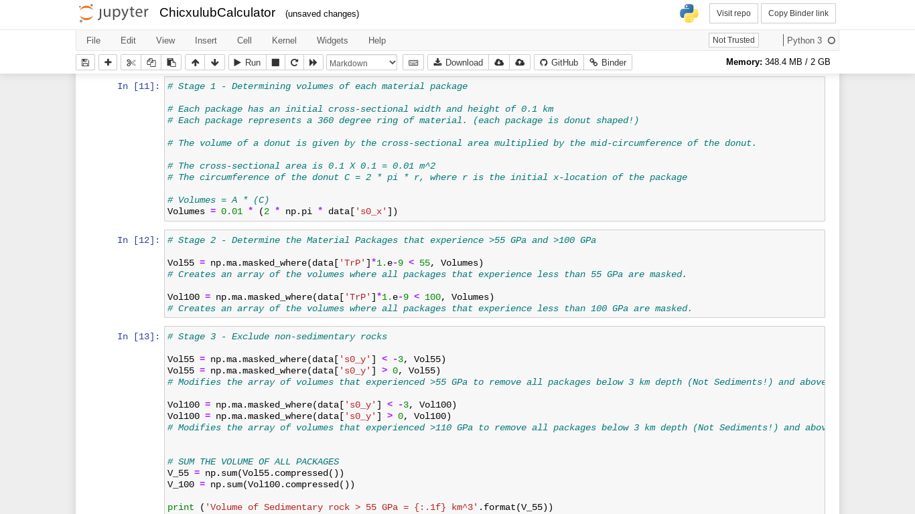
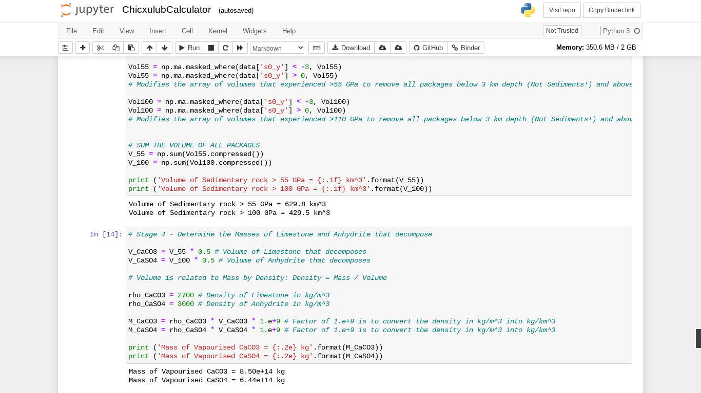
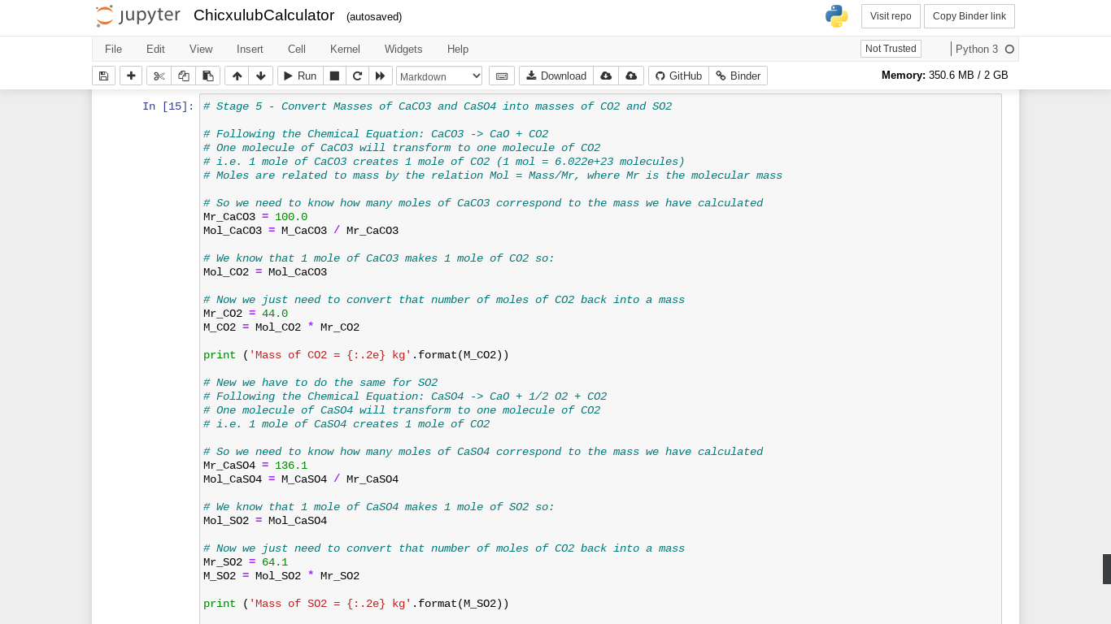
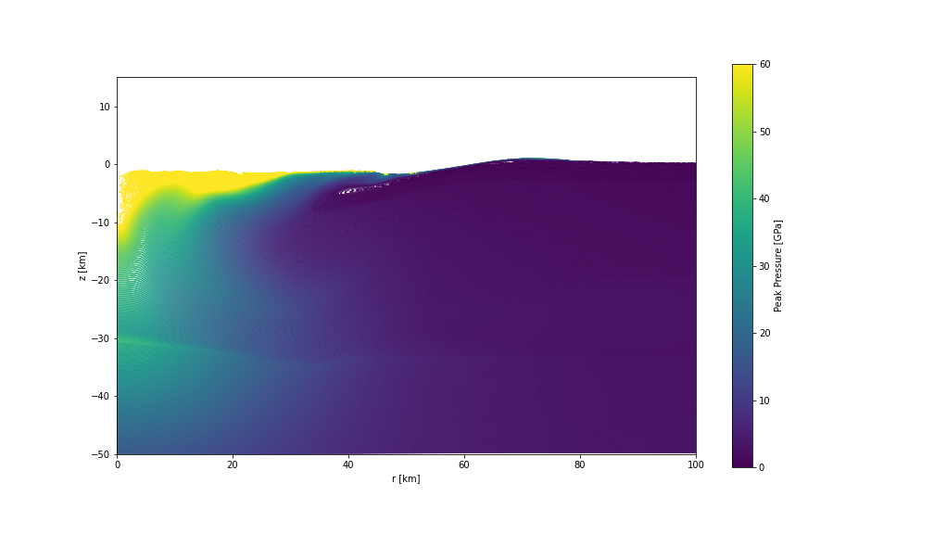
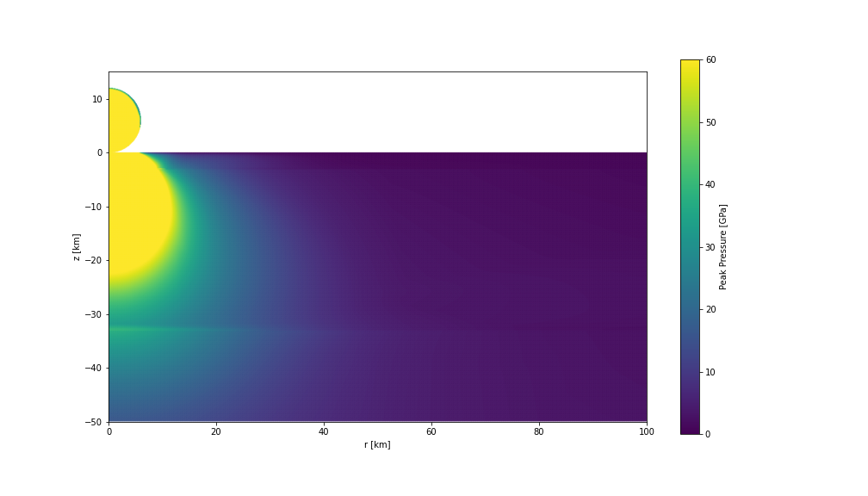
Day 3:３日目
Python codes used
使用したパイソンコード
we focused on the production of climatically active gases. We used a series of python codes to calculate the mass of CO₂ and SO₂ and explore how we can simulate major impacts like Chicxulub.
気候変動に影響を与えるガスの生産に注目した。パイソンを使い二酸化炭素や二酸化硫黄の質量を計算し、どうやってチクシュブールのような大きな衝突をシュミレーションするか考えた。
Simulations showing the pressure on the rocks.
衝突の際に起こる圧力のシュミレーション
Notes:
We looked at the impact this asteroid caused; focusing on the production of climatically active gases which are produced when rocks are vaporised by the pressure of the impact. The question we had to answer was: How much mass of CO2 and SO2 was produced from the Chicxulub impact? To answer this we used a series of python codes to calculate the mass of the gases.Here is the image of simulation how the pressure on the rocks.

Slide 11
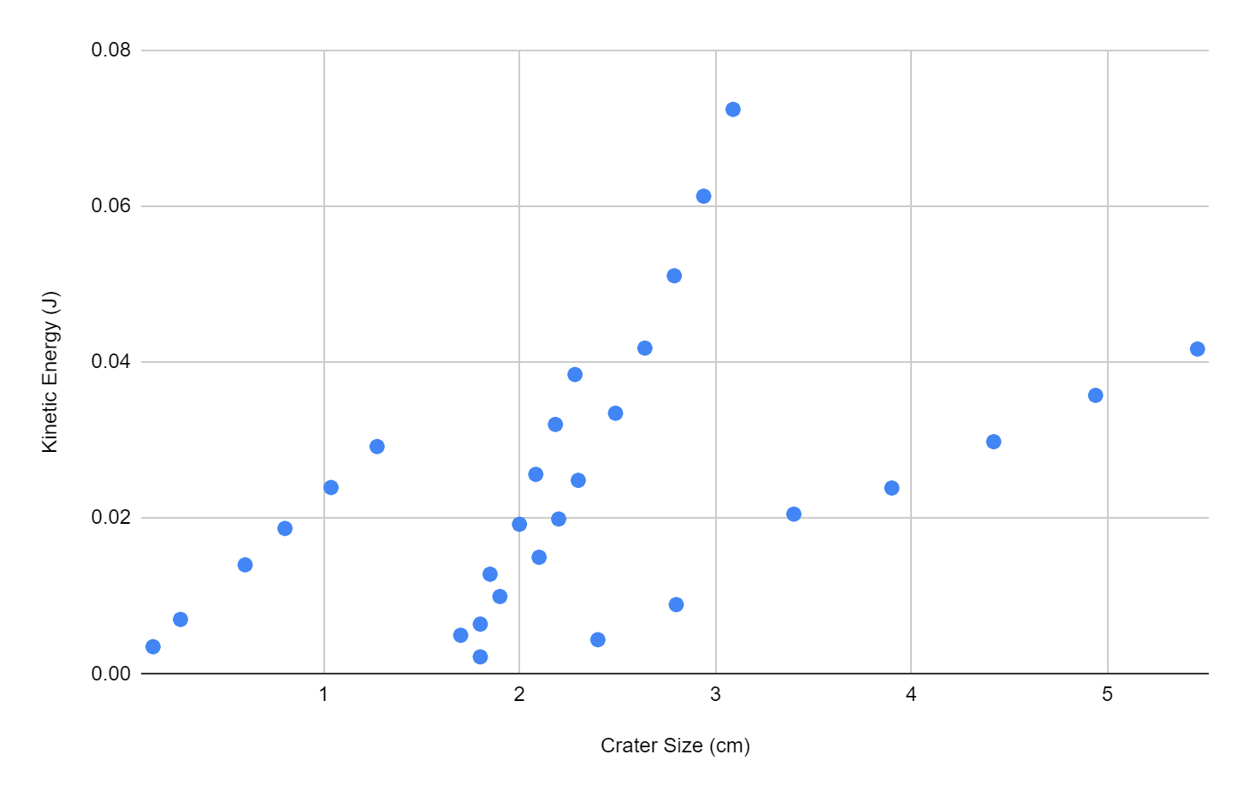
Results-Day 1, 2: １,２日目の結果
The Crater Experiment(small scale)
Earth Impacts Event Calculator(big scale)
Flour 小麦粉
運動エネルギ｜
Mayonnaise
マヨネーズ
運動エネルギ｜
Sand 砂
クレーターの直径
最終クレーターの直径
【 Difference 】
【 Similarity】
Left graph shows three distinct groups
左側のグラフは、１つのグラフの中でも
３つのグループに分かれている。
→It could be concluded to be the three different impact materials used in the experiment.
私たちが行った実験では、衝撃を与える対象物として、異なる３つの材料を使用したことが現れている。
Both of the two graph show a similar upwards trend between crater size and kinetic energy.
どちらのグラフでもクレーターサイズと運動エネルギーの間で同様の上昇傾向が見られる。
Notes:
The Crater Experiment and the Earth Impacts Event Calculator both show a similar upwards trend between crater size and kinetic energy. The Crater Experiment graph shows three distinct groups which could be concluded to be the three different impact materials used in the experiment. The steeper the curve, the more energy is needed to create a larger crater hence suggesting a denser impact material. The impact effect calculator shows an increasing gradient curve, where the bigger craters need exponentially more energy.

Slide 12
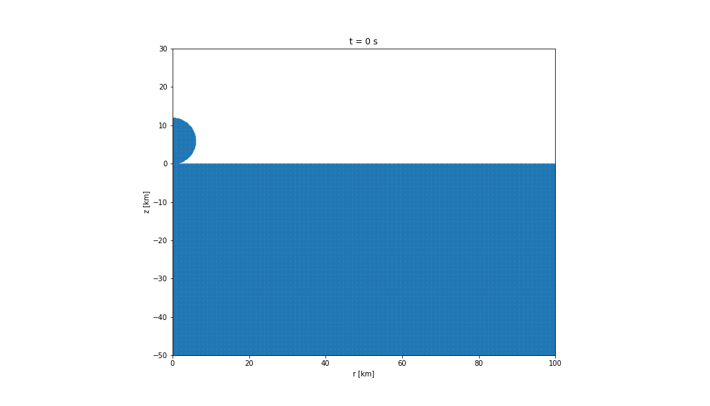
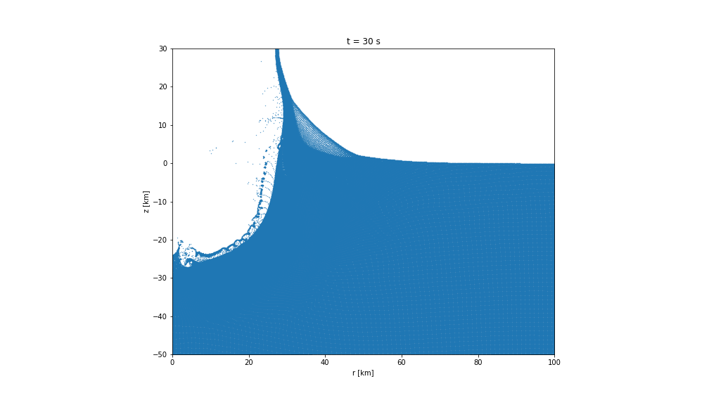
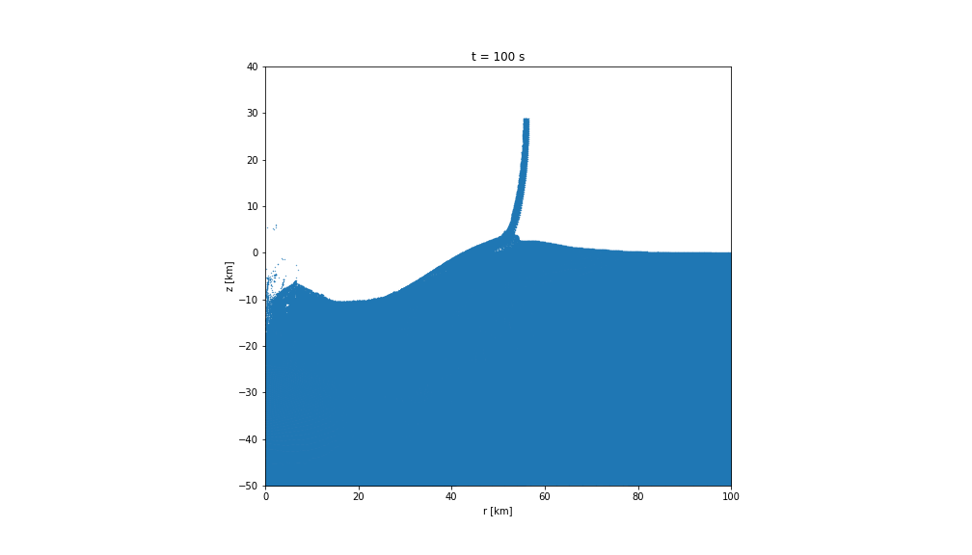
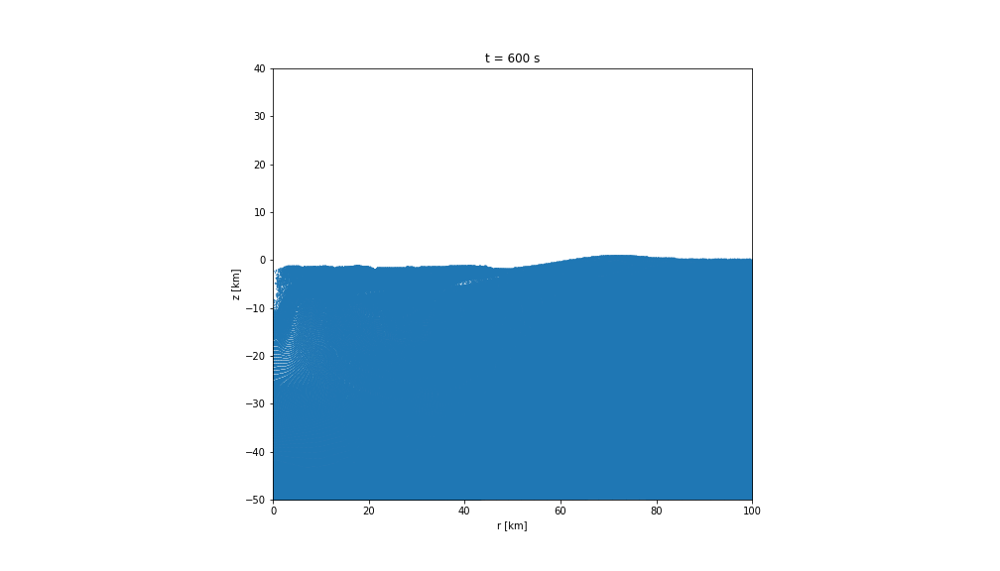
Results - Day 3: ３日目の結果
CaCO3 (s) → CO2 (g) + CaO (s)
2 CaSO4 (s) → O2 (g) + 2 SO2 (g) + 2 CaO (s)
3.74e+14 kg of CO2 | 3.03e+14 kg of SO2
Same as 11 years of CO2 released by anthropogenic sources.
15,000 times the amount of SO2 released in the Krakatoa eruption.
人間が放出する11年分の二酸化炭素量と等しい
クラカトア火山の噴火で放出された二酸化硫黄の15,000倍
温度を下げる効果のある二酸化硫黄の大量放出によって、地球の表面温度は26度も下がり、その状況が約3年間続いた。温度を上げる効果のある二酸化炭素の放出よりもはるかに大きな影響をもたらした。
温度低下は大量絶滅の要因の一つである。
Notes:
The impact of the Chicxulub asteroid forces Calcium Carbonate undergoes thermal decomposition due to the high temperatures and pressure forming Carbon Dioxide and Calcium Oxide.
Calcium Sulfate also undergoes thermal decomposition forming Oxygen, Sulfur Dioxide and Calcium Oxide.
Mass of CO2 = 3.74e+14 kg in simulated Chicxulub crater event. In comparison 3.25e+13 kg of CO2 is released by anthropogenic sources. This means that the impact event is the same as 11 years of CO2 release today.
Mass of SO2 = 3.03e+14 kg in simulated Chicxulub crater event. In 1883, Krakatoa erupted dispersing 1.8e+10 kg of SO2. At the time, this caused a 5-year drop of temperatures by 1.2°C. The amount released by the Chicxulub crater event was 15,000 times the amount released by Krakatoa. Surface temperatures dropped by as much as 26°C, and the dramatic effects lasted for about 3 years. Overall this shows that the SO2 release would be far more significant than the CO2 release. The temperature drops is one off the causes of a mass-extinction.
The pic plots on the right show the a model simulation of an impact event done using python. The picture is a slice of the actual impact event, where if it was rotated around the y-axis than a crater shape would be formed. The four frames are t=0,30,100,200 seconds respectively. Picture plot 2 shows the transient crater before the collapse of material creating the final crater.
The Chicxulub impact was equivalent to 2.06e+8 Megatons of TNT and had a visible fireball radius of 185 km, this would’ve caused a mass-extinction event in the radius.

Slide 13
Conclusions:結論
地球の歴史を変えた出来事について様々な方法でより深い研究を行う
気候的活性ガスの影響による被害の警告
Successfully used methods to discover more about this impact event that has shaped Earth’s history.
Warning about the impacts of Climatically active gases.
Notes:
Using the methods described throughout this presentation we were able to discover what happened in this event that drastically changed Earth’s history.(and even allowed for the age of mammals).
The mass of CO2 and SO2 were extremely high but they give an indication of the potential consequences of the way we’re heading with global warming etc… Equally, we discovered that about 30,000 years after the event, a normal ecosystem began to return to the impact site. This is a therefore also a testament to the strength of the biosphere and its ecosystems.

Slide 14
What next?: これらのことから…
より深い探求へ足を踏み入れる
条件を変えていろいろな実験をしてみる
Experiment with other variables
Future research
Notes:
When studying craters we mainly looked at the impacts of velocity, impactor size and angle of projection. It would be good to experiment with other variables such as rock type and porosity etc…
Furthermore, The research into the K-Pg boundary layer is still ongoing. With further investigations there could be new findings and it would be interesting to see what is discovered in the future.

Slide 15
Thank you!
Please ask any Questions.

