Slide 1
Climate Change Mitigation Role For Nuclear Energy
-Yes or No?
気候変動緩和のための原子力の役割
ーイエスかノーか？
Finn Barber, Freddie Watkins, Jo Orrell, Joshua Ward, Kokone Matsuura, Maya Rowles, Saori Taya, Shiori Tokiwa, Sota Sato
Facilitator: Wilf Harvey
Scientist: Professor Geraldine Thomas
Notes:
[Josh]

Slide 2
Table of Contents
１、 Personal Goals＋Aim 個人の目標と目的
２、 Climate Change 気候変動
３、 Introduction To Nuclear Energy 原子力入門
４、 Nuclear Energy Policies 原子力政策
５、 More On Nuclear? 原子力をもっと知ろう
６、 4 Kinds Of Renewable Energy 4種類の再生可能エネルギー
７、 Nuclear Fusion 核融合
８、 Renewable Energy Sources 再生可能エネルギー源
９、 Conclusion 結論
１０、Bibliography 参考文献
１１、Questions 質問

Slide 3
Personal Goals + Aim 個人の目標と目的
Our Goal: Communicate across cultures in a scientific environment, and try hard to express our own opinions beyond the language barrier. 科学的な環境の中で、文化を超えたコミュニケーションを行い、言葉の壁を越えて自分の意見を表現することを心がけます。
Our Aim: Extend our knowledge of nuclear energy, compare it to alternative energy sources and advise a government minister to agree to building more nuclear power plants as a suitable solution for climate change. 原子力に関する知識の幅を広げ、代わりになるエネルギー源と比較し、政府大臣に、適切な一時的解決策として、より多くの原子力発電所の設置に同意するよう説得します。
Notes:
[Josh and Shiori] Firstly, our goal was to consider the problem in the field of science and work together regardless of our different backgrounds, like nationality or character. Secondly, it was our aim that we increase knowledge of nuclear energy and advise a government minister to be in favor of building more nuclear power plants as a suitable solution for climate change. Now Josh and I are going to talk about our own personal goals on behalf of our team. During this workshop, my own goal was to use English actively and get correct information about nuclear energy and radiation. It was very difficult for me to communicate in English online.
Josh Goal: My goal was to meet new people who have similar interests to me and learn more about nuclear energy.

Slide 4
Climate Change 気候変動
The burning of fossil fuels causes environmental and health problems. These include sea level rise, air pollution and increased frequency of extreme weather events. To reduce this governments need to replace them with lower carbon methods. 化石燃料の燃焼は、環境問題や健康問題を引き起こします。例えば、海面上昇、大気汚染、異常気象の発生頻度の増加などです。この問題を解決するために、政府は化石燃料をより低炭素な方法に置き換える必要があります。
UK
41% low carbon
15% nuclear
Japan
Kyushu Kansai
40% low carbon 32% low carbon
29% nuclear 23% nuclear
Electricity Map (2021). A map of live energy consumption sources worldwide. (online) Available at: https://www.electricitymap.org/map. Accessed: 21st July 2021
世界各国の様々な発電方法、その割合を見ることができるマップ（2021年版） 現在世界で使われているエネルギーの消費源をマップで紹介
Before 2011, Japan sourced 30% of its energy from nuclear and had policies in place to increase this to 40% by 2017. However in 2019 nuclear only contributed 7.5% of energy.
2011年以前、日本はエネルギーの30％を原子力でまかなっており、2017年までに40％に引き上げる政策をとっていました。しかし、2019年には原子力のエネルギー貢献度は7.5％にとどまりました。
Notes:
[Jo] Both the UK and japan have common climate change concerns for example there is a risk to island nations as sea levels continue to rise.It would be difficult to ignore the heatwave this week in the UK, the hundreds still missing after the floods in central europe or the A-ta-mi landslide in japan earlier in July. These extreme weather events are becoming more frequent putting pressure on governments to take action against climate change. One way is switching to lower carbon methods of energy production.
These pictures are taken from the live electricity map. Data is unavailable for some areas of japan which makes comparing energy sources difficult however the map shows that our countries still heavily rely on fossil fuels. Japan's proportion of nuclear-sourced energy dramatically changed after Fukushima Daiichi. Prior to the accident, 30% of Japan's energy was generated by nuclear power. By 2019 this had fallen to 7.5% following a significant increase in public distrust about government information on radiation.

Slide 5
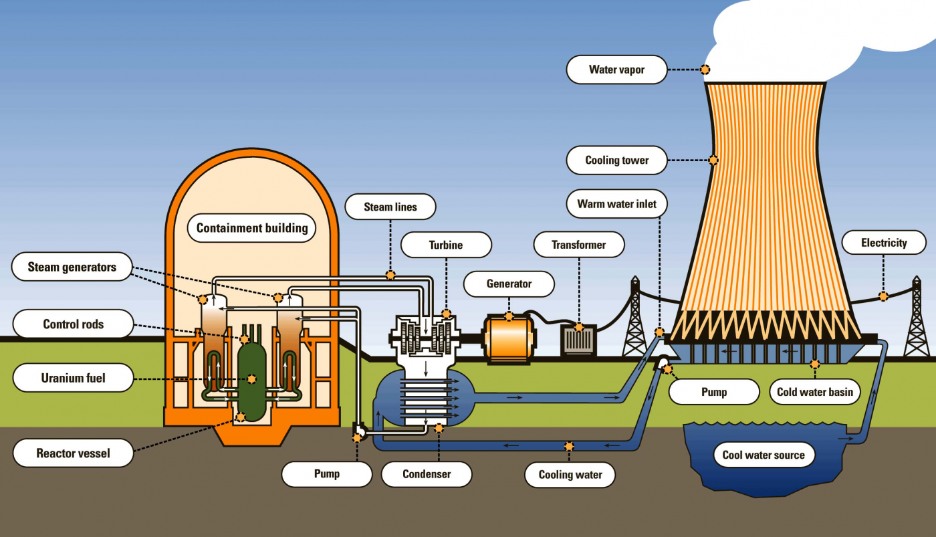
Introduction To Nuclear Energy 原子力入門
Covering how this works and positives and negatives 核エネルギーの長所と短所をどのように補うか
Nuclear power plants use a fissile isotope of Uranium as fuel. As the Uranium undergoes fission within the reactor, the cooling water of the reactor is passed through a heat exchanger and turns water into steam, driving a turbine. It is designed this way so that water that is in contact with the core never enters the environment.
原子力発電所では、核分裂性同位元素であるウランを燃料として使用する。ウランが原子炉内で核分裂を起こすと、原子炉の冷却水が熱交換器を通過して水を蒸気に変え、タービンを回します。このように設計されているので、炉心に接触した水が環境に入ることはありません。
Disadvantages（短所）
Nuclear waste
放射性廃棄物
Very High Upfront Cost
初期費用が非常に高い
Many people feel fear
恐怖を感じている人が多い
Advantages（長所）
Carbon-free
脱炭素
High Energy Conversion Efficiency
高いエネルギー変換効率
Notes:
[Kokonoe]
This slide shows Introduction To Nuclear Energy.
Specifically, Covering how this works and positives and negatives.
First, I explain the mechanism about nuclear power.
Please look at the picture.
Nuclear power uses Uranium as fuel.
As the Uranium undergoes nuclear fission, the cooling water in the reactor is passed through a heat exchanger and change water into steam, turning a turbine.
Because of the design, water touched the reactor core never enters the environment.
Second, the Advantages of Nuclear Energy.
There are two big positives.
Carbon-free, High Energy Conversion Efficiency.
Lastly, the Disadvantages.
It produces Nuclear waste and needs very High Upfront Cost.
Also, to have fear for Nuclear Energy prevent the government from spreading this energy.

Slide 6
Nuclear Energy Policies 原子力政策
Japan 日本
After the Fukushima accident, the Japanese government decided to reduce the amount of reactors. 福島の事故の後、日本政府は原子炉の数を削減することを決めました。
First, two reactors were restarted, with a further eight having restarted since. 16 reactors are currently in the process of restart approval. 最初の2基が再稼働し、その後さらに8基が再稼働しました。現在、16基の原子炉が再稼働の承認を受けています。
UK 英国
The UK government considers nuclear energy as a way to achieve net zero. イギリス政府は、ネットゼロ（温室効果ガスあるいは二酸化炭素（CO2）の排出量から吸収量と除去量を差し引いた合計をゼロにすること)を実現する方法として原子力を考えています。
The UK approved ten sites for nuclear reactors in 2010, including Hinkley Point C, where there are two 1600 MW reactors under construction 英国は2010年に、1600MWの原子炉を2基建設中のヒンクリーポイントCを含む10カ所の原子炉建設を承認しました。
Notes:
[Freddie]The UK and Japanese nuclear policy differs massively. The UK government considers nuclear energy as part of its plan for achieving net zero carbon emissions by 2050 and approved 8 sites for nuclear power plants in 2010, including Hinkley Point C and Sizewell C. However, several of the other sites approved have yet to see any construction due to funding issues.
In contrast, of Japan’s 39 operable reactors, only 9 are currently operating due to public opposition after the Fukushima Daiichi nuclear accident. The Ikata 3 reactor was initially approved to restart but the local government intervened.

Slide 7
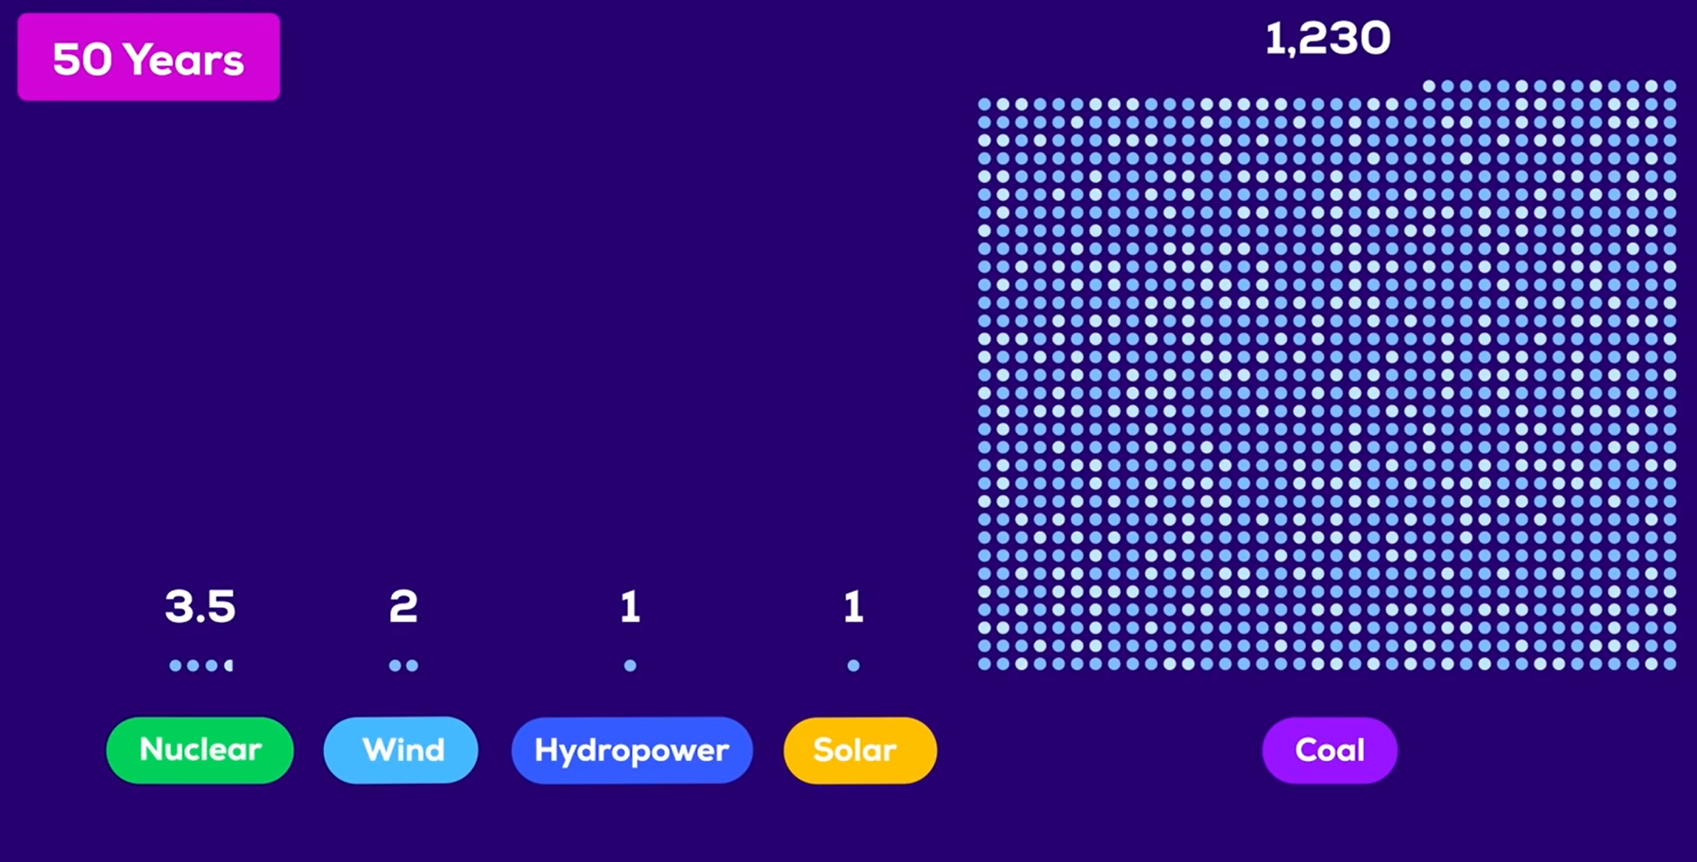
More On Nuclear 原子力をもっと知ろう
The number of deaths every 50 years if 1 Terawatt Hour is produced every year. (20 Terawatt Hours is equivalent to the annual energy consumed by 27000 EU citizens) 毎年1TWhを生産した場合の50年ごとの死亡者数。(20TWhは、EU市民27000人が1年間に消費するエネルギーに相当する）。
A major problem with nuclear is the bad press it has received in the past. 原子力の大きな問題点は、過去に受けた悪評です。
On Monday we played a game where we matched a radiation dose to an activity. 月曜日には、放射線量と活動内容を一致させるゲームを行いました。 No one died directly from the Fukushima Daiichi nuclear disaster. Only 31 emergency workers died in Chernobyl nuclear disaster and we would predict a further 160 deaths from thyroid cancer. 福島第一原発の事故の影響で直接亡くなった人はいません。チェルノブイリ原発事故での緊急作業員の死亡者数は31名に過ぎず、甲状腺がんによる死亡者数はさらに160名に上ると予測されます。
Kurzgesagt - In a Nutshell. (2021). How Many People Did Nuclear Energy Kill? Nuclear Death Toll. [video]. Available at: https://www.youtube.com/watch?v=Jzfpyo-q-RM (Accessed: 21 July 2021)
Notes:
[Josh] As you heard a minute a go one of the major problems with nuclear energy is the general public's opinion that it is too dangerous. However, this isn’t actually true, as you can see in the image on the slide, it kills significantly less people than coal and only fractionally more than renewables. On Monday we played a game where we had to match a radiation dose to an activity, for example the dose given from a return flight to Japan. It turns out that living within 80km of a nuclear power plant for a year only gives you a dose of 0.0009 mSv, whereas living in England for a year on average gives you a dose of 2.4 mSv, where a Sv is a unit that measures the does of radiation you have been exposed to. This further shows how nuclear isn’t as dangerous as people think. Finally, no deaths resulted directly from the Fukushima Daiichi disaster. However, people did die as a result of evacuating from the tsunami and earthquake. Another disaster that puts people off nuclear is the Chernobyl nuclear disaster, which occurred due to human error during a test. In the resulting explosion due to a build up of steam, 2 plant workers died and a following 29 people died in the coming months, 28 of which died from acute radiation sickness. However even though this is bad during the aftermath of the disaster a drug was used to treat the acute radiation sickness, a drug called GM CSF. It saved 106 of the 134 people who had acute radiation sickness, and to this day is used to help cancer patients with bone marrow recovery. So maybe it isn’t so bad after all.

Slide 8
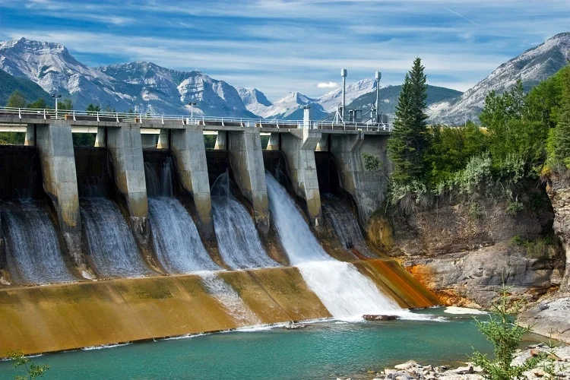
Hydroelectric Energy 水力エネルギー
Hydroelectric power stations use a dam to convert the potential energy of water to electricity. 水力発電所は、ダムを利用して水の位置エネルギーを電気に変換します。
In locations where the geography allows their use they are a preferable type of renewable energy due to their low cost and consistent energy production. 地理的に使用可能な場所では、低コストで安定したエネルギー生産が可能なため、再生可能エネルギーとして好まれています。
Advantages
Renewable 再生可能
Low Ongoing Cost 安い運用費
Consistent energy production 継続的なエネルギー生産
Disadvantages
Limited Plant Locations
建設可能な場所が限られる
Flood Risk 洪水の恐れ
Release carbon dioxide and methane
二酸化炭素やメタンの排出
Notes:
[Shiori and Freddie]
Freddie-Hydroelectric dams are a preferable energy source where they can be built due to their consistent energy production and very low running costs compared to other low carbon options.
Shiori-While there are also disadvantages. For example, dams cannot be located everywhere; only where geography allows. In addition, there risks of flooding and carbon dioxide,methane emission may also be an issue. Construction of dams and reservoirs makes the area full of water, then plants underneath the water begin to rot and release greenhouse gases.

Slide 9
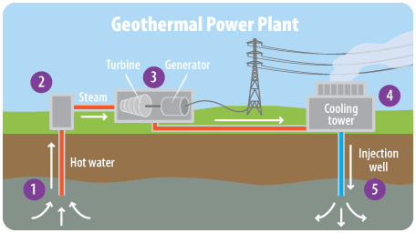
Geothermal Energy 地熱エネルギー
Geothermal energy is produced from below ground heat. This heat can be used to evaporate water which is then used to turn a turbine and generate electricity. 地熱は地下の熱を利用しています。この熱を利用して水を蒸発させ、その水でタービンを回転させて発電することができます。
Advantages (長所）
・Reliable and renewable
安定していて再生可能である
・There is no need to import the energy like you would with coal.
石炭のようにエネルギーを輸入する必要がない。
Disadvantages (短所）
・Specific location required.
地面の振動を引き起こすことがある。
・Destroys natural landscape and can cause tremors.
自然の景観を壊す。
Notes:
Geothermal energy is generated from thermal energy in the ground which is then transferred to electrical energy through the process in the diagram. The hot water is piped up where it enters a low pressure chamber causing it to evaporate and turn the turbine.
[Kokone] I explain the two advantages of geothermal energy. Reliable and renewable. Reliable means that this energy can keep on generating electricity, 365 days, 24 hours, regardless of weather, season, day and night. The second one, renewable. It uses local geotherrnal heat, so there is no need to import the energy like you would with coal.
The disadvantages of geothermal is that a specific location is required, usually on a tectonic plate, so not every country has access to it. Another disadvantage is that if not properly managed the site can lose its heat and water supply. Finally the building and operation of a plant causes habitat destruction and minor earth tremors.

Slide 10
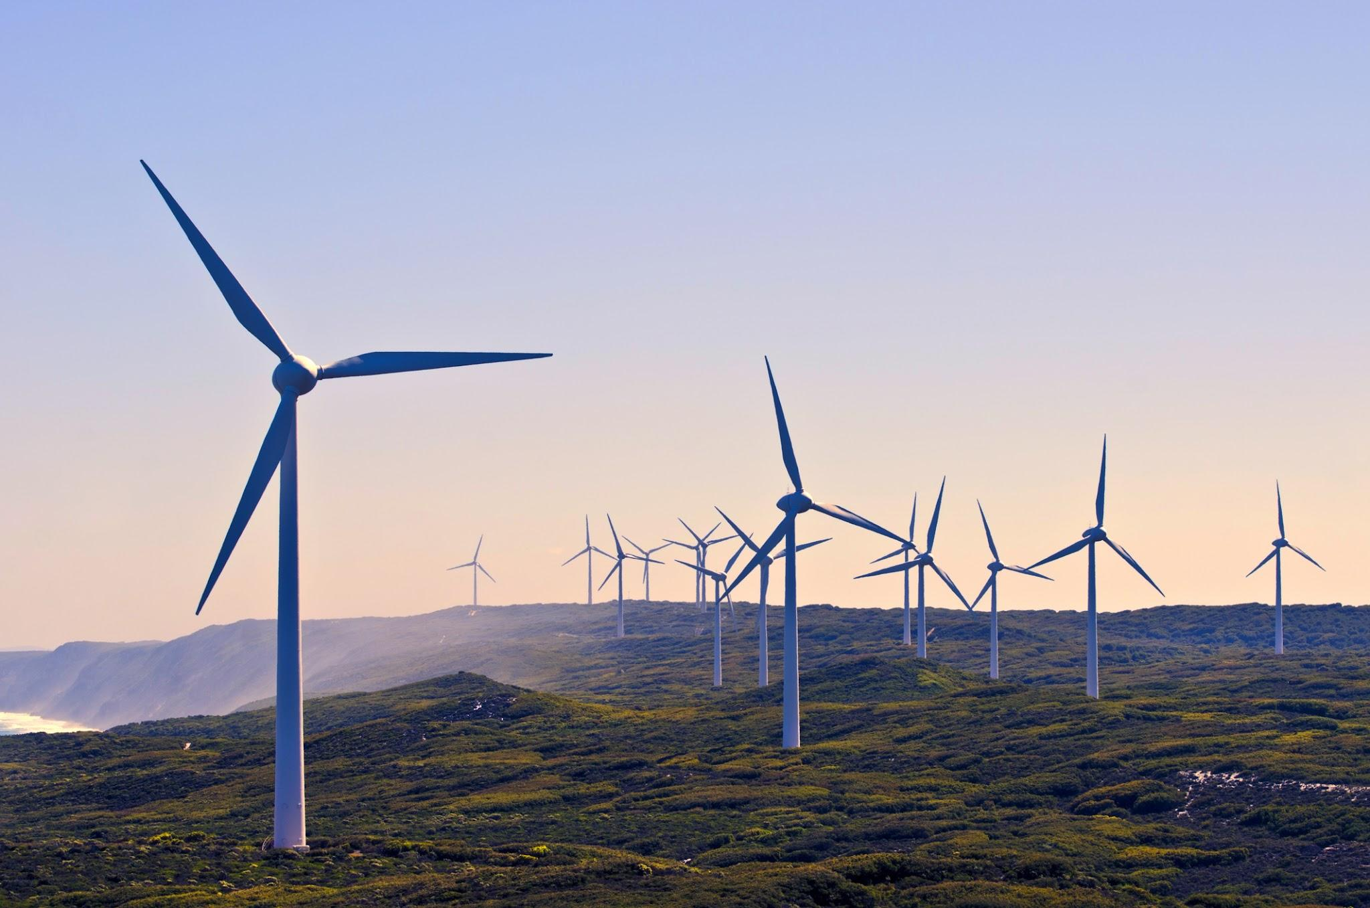
Wind Energy 風力エネルギー
Wind energy can be generated by the turning of turbine blades, rotating a coil and converting the mechanical energy of wind into electrical energy. 風力エネルギーはタービン翼の回転やコイルの回転、風の機械的エネルギーを電気エネルギーに変換することで発生させることができる。
Advantage（長所） ●Doesn't need fuel. 燃料が必要ない。 ●Is an efficient way of converting energy to electricity. 電気への変換効率が良い。
Disadvantage（短所） ●Makes noise when the turbine turns. 羽が回ることによる騒音問題が発生する。 ●​​Unreliable: energy generated is entirely dependent on weather. 安定性に欠ける。 ●Difficult to repurpose 再利用するのが難しい。
Notes:
[Maya and Saori]Takes up a lot of space
overview(maya): wind energy is both renewable and can be sourced relatively locally to those who will eventually consume it. The energy is generated when wind causes wind turbine to rotate, consequently rotating a coil and converting mechanical energy to electrical energy ready for consumption.
（saori）It has two advantages. First,wind energy does not need fuel,because,it can generate electricity from wind only.
Second,it is an efficient way of converting energy to electricity. The efficiency is said to be from 35 to 45％. This figure is relatively high,and it’s second only to hydroelectric energy.
disadvantages: wind turbines themselves are noisy and cause visual pollution making them unpopular to local people, wind farms also take up lots of space, another disadvantage is their reliability- energy generated is dependent on a factor we cannot control.

Slide 11
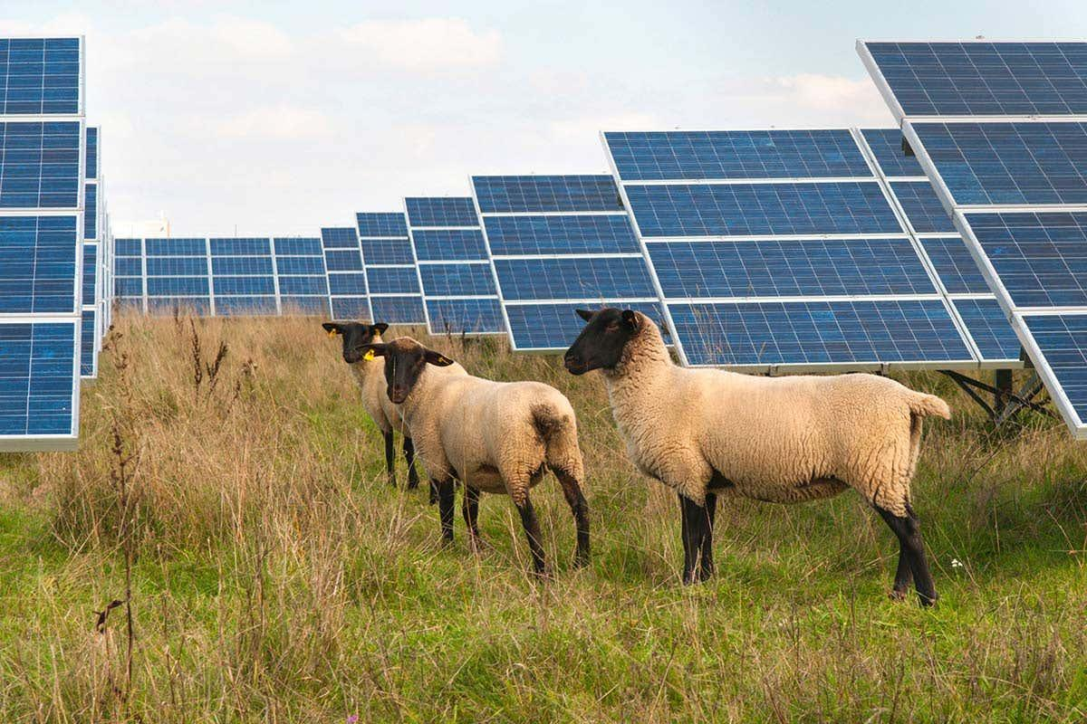
Solar Energy 太陽光エネルギー
Solar panels convert the sun's energy to electricity through exciting electrons in semiconducting materials to produce a current. 太陽電池パネルは、半導体材料中の電子を励起して電流を発生させ、太陽エネルギーを電気に変換します。
Advantage（長所）
・Low carbon and renewable 低炭素かつ再生可能
・Plants and animals grow under the panel
パネルの下で植物や動物を育てられる
・Solar panels can be installed on brownfield site
ブラウンフィールドサイトにもソーラーパネルを設置可能
Disadvantage（短所）
・Many chemicals required for production are toxic.
有毒物質が漏れ出す可能性がある
・Risk of landslides due to loose ground
地盤が緩むことで土砂崩れが起こる
・Unreliable 不安定である
Notes:
Jo - solar energy is another renewable energy source as it is accessible as long as we have the sun. the maintenance costs are low once installed with minimal wear and tear.
Solar panels are obviously restricted to areas with enough sun exposure, however they can be installed in urban areas or unwanted brownfield sites. To increase yield on solar farms it is possible to grow crops or graze animals under panels

Slide 12
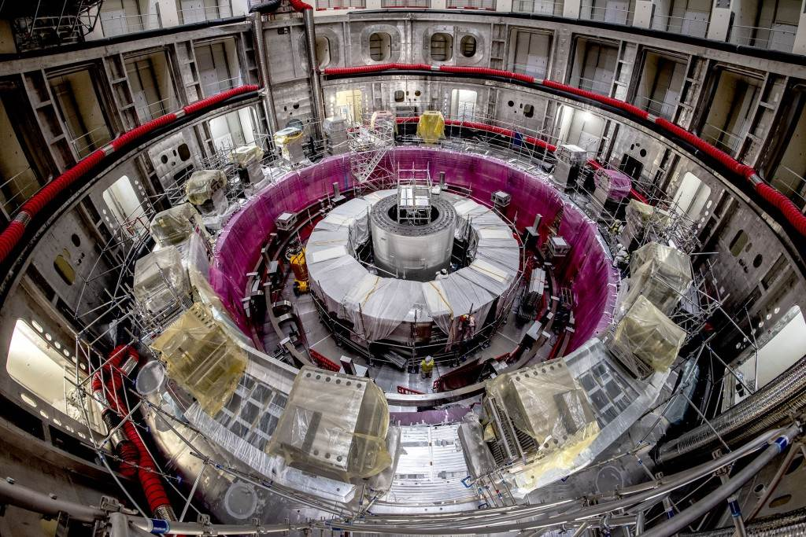
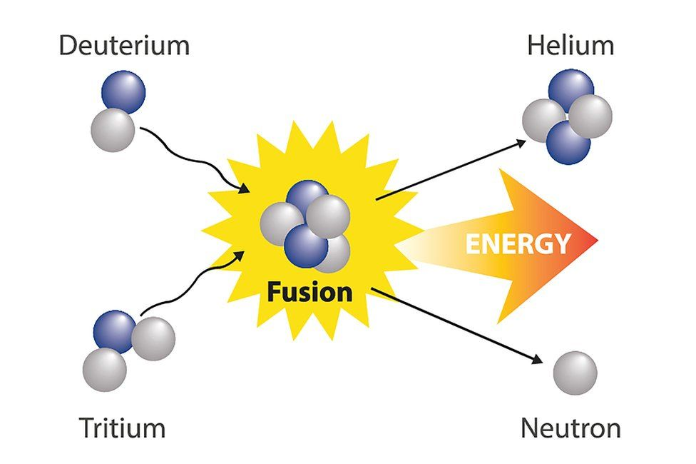
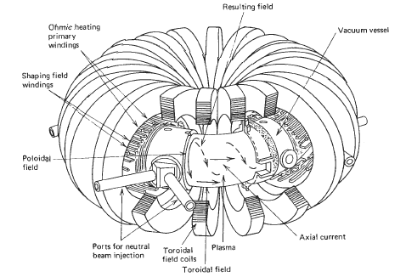
Nuclear Fusion 核融合
Nuclear fusion is the generation of power by fusing light Hydrogen nuclei into heavier Helium nuclei. This is the same process that happens inside stars. 核融合とは、軽い水素の原子核と重いヘリウムの原子核を融合させて発電することです。 これは、星の内部で起こっているのと同じプロセスです。
Advantages:
No carbon dioxide is emitted
二酸化炭素が排出されない
Much safer than nuclear fission
核分裂を用いた発電よりも安全
Fuel can be extracted from seawater, and is thus sustainable
燃料は海水から抽出でき、持続可能
Produces more energy than fission and less waste
核分裂を用いるよりも多くのエネルギーを得られる上、廃棄物が少ない
Disadvantages:
We have so far been unable to get more energy out of a fusor than we put in
フューザー（核融合装置）からは、投入した以上のエネルギーを得られていない
Plasma must be heated to 100,000,000K
プラズマを１億Kまで加熱しなければならない
Plasma needs strong electromagnetic fields to confine it
プラズマを閉じ込める強力な磁場が必要
ITER (above) is a collaboration between 35 nations to build the largest fusor yet. It is hoped that this will be capable of producing more energy than is input.
https://www.iter.org/construction/TokamakAssembly (accessed 22nd July)
Schematic of a Tokamak fusion reactor
https://www.researchgate.net/figure/Schematic-of-tokamak-fusion-reactor_fig1_46267464 (accessed 22nd July)
Notes:
[Sota and Finn]
ITER = International Thermonuclear Experimental Reactor
Fusion releases energy as heat, which boils water and turns a turbine - same as fission
ITER uses a tokamak reactor, which is toroidal in shape
100,000,000K is about the same in celsius, and is about 6 times hotter than the sun’s core
Some nuclear waste will be produced, since the reactor vessel will be irradiated with neutrons, making it radioactive

Slide 13
Renewable Energy Sources 再生可能エネルギー源
 | Nuclear | Hydroelectric | Geothermal | Solar | Wind
% efficiency | 37 | 90 | 10-23 | ¹⁵⁻⁴² | 35-45
Cost per kilowatt hour (USD/kWh) 費用 | 0.024 | 0.05 | 0.02 | 0.06-0.08 | 0.05
Environmental impact 設置 | Mining the uranium needed for fuel releases carbon dioxide. | Can cause flooding, impacting wildlife, forest and agriculture. | Extracting geothermal energy can cause a release small amounts of sulfur dioxide and carbon dioxide | Can cause land degradation and habitat loss | Can reduce local bird population and habitat loss.
Notes:
looking at the table, hydroelectric energy almost looks like an anomaly in terms of efficiency. This is due to the unique shape of the turbine blades which make sure almost all water being pushed by the blades is used. Looking at the environmental impacts we can see that low carbon doesnt make these energy sources exempt from damaging the environment. When resources need to be extracted from the group as seen in geothermal and nuclear energy, it is very difficult to avoid any greenhouse gas release. Comparative to the burning of fossil fuels these are much more promising when thinking about climate change where fossil fuels can cause large amounts of land degradation, water and atmospheric pollution.

Slide 14
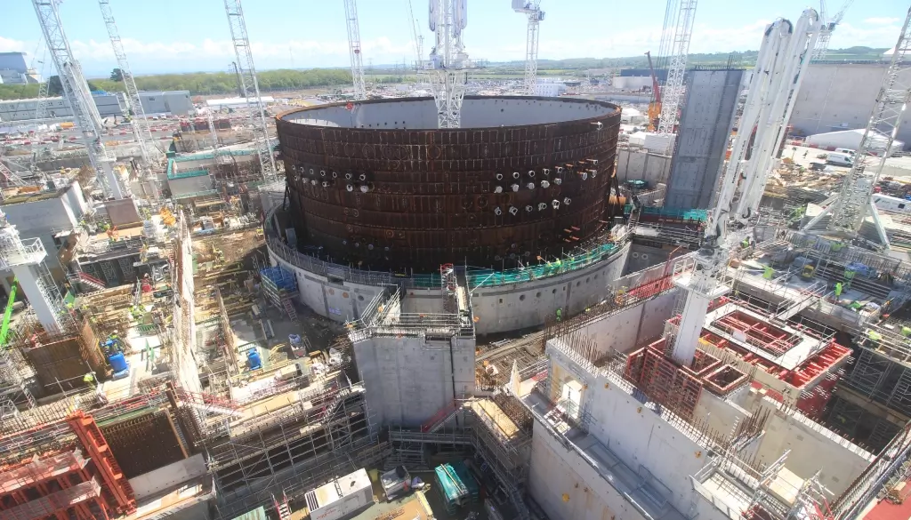
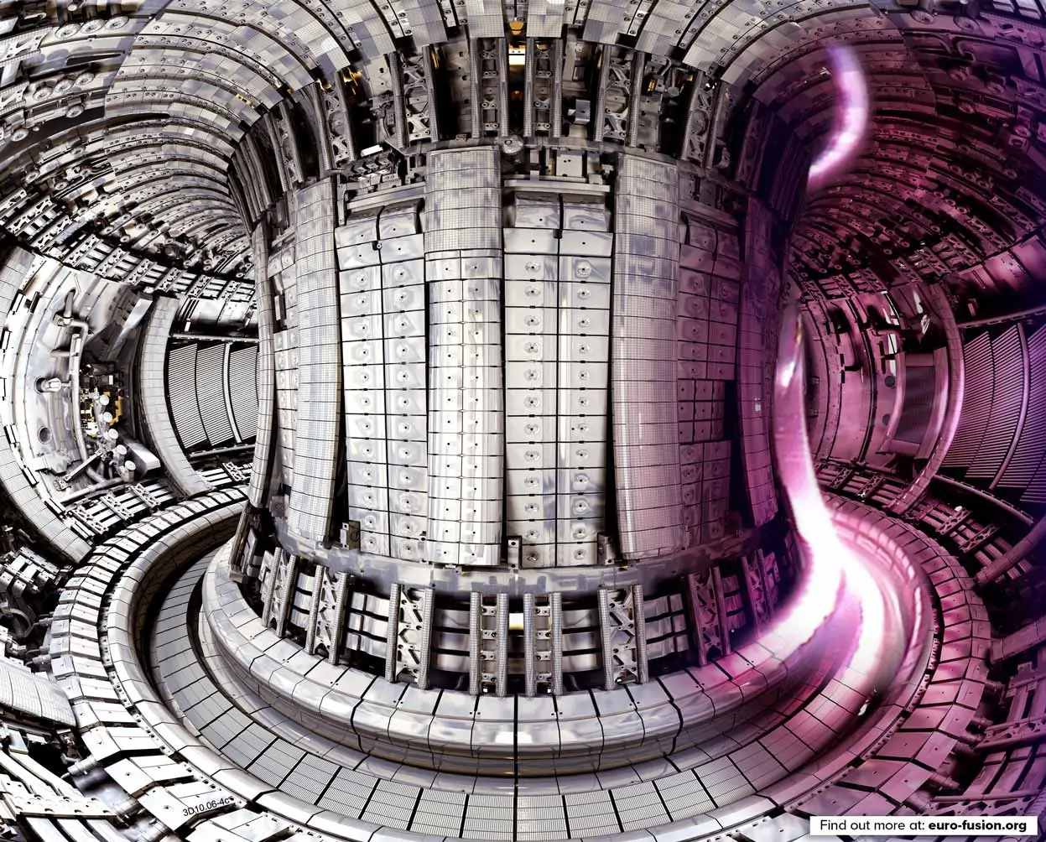
Conclusion 結論
Hinkley point C construction https://www.edfenergy.com/energy/nuclear-new-build-projects/hinkley-point-c/latest-updates (Accessed 22 July 2021)
We would advise the governments in the UK and Japan to... 英国と日本の政府に助言します。
Build new nuclear power plants, in order to phase out fossil fuels. 英国に原子力発電所を増やすことを政府に助言します。
Improve public communication about the dangers (or lack thereof) of nuclear power. 原子力発電の危険性（またはその欠如）に関する一般の人々とのコミュニケーションを改善すること。
Invest in research in new energy sources such as nuclear fusion and generation IV reactors. 核融合や第四世代原子炉などの新エネルギー源の研究に投資すること。
Build underground nuclear waste disposal sites. 英国と日本に地下処分場を設置するための政策的措置を講じることも望ましいです。
The JET fusion laboratory in Oxford
https://ccfe.ukaea.uk/research/joint-european-torus/ (accessed 22 July 2021)
Notes:
Building new nuclear plants will ease the transition into using mostly renewables and being carbon neutral.
Improving public communication, since there is a stigma around nuclear power, and a democracy requires public support.
Investing in research into new reactors will allow us to extract energy at a greater efficiency, and minimise risks even further. This will also allow us to build small reactors, with less upfront cost and fewer barriers to entry.
Building underground waste disposal sites, so we can dispose of high level waste without having to transport it - reducing carbon emissions.
UK government are already discussing many similar policies to these, but are not actually implementing them. This is mainly due to issues of funding.

Slide 15
Bibliography 参考文献
1.Do we Need Nuclear Energy to Stop Climate Change? https://www.youtube.com/watch?v=EhAemz1v7dQ Author: Kurzgesagt- in a nutshell. Date: 13/04/2021
2. University of Sydney’s radiation calculator https://scilearn.sydney.edu.au/fychemistry/calculators/radiation_dose.shtml
3. “How many people did nuclear energy kill?” https://www.youtube.com/watch?v=Jzfpyo-q-RM Author: Kurzgesagt- in a nutshell. Date: 2/2/2021
4.Introduction to radioactive waste management https://www.youtube.com/watch?v=4j_wptct7kA Author: IAEAvideo ,Date:5/7/2019
5.Radioactive Waste- the journey to disposal https://www.iaea.org/newscenter/multimedia/videos/radioactive-waste-journey-disposal Author: Louise Potterton Date: 23/9/2019
6.Videos on GDF (RWM website) https://www.gov.uk/guidance/geological-disposal Author: Radioactive Waste Management. Date:3/11/2020
7. “Is Nuclear Fusion The Answer To Clean Energy?” https://www.youtube.com/watch?v=vPS-epGPJmg Author: CNBC Date: 29/10/2019
8.Electricity map https://www.electricitymap.org/map Author: ElectricityMap date:2021
9.Nuclear Power in Japan https://world-nuclear.org/information-library/country-profiles/countries-g-n/japan-nuclear-power.aspx Date:June 2021 10:State of Japanese policy about nuclear power plant https://www.enecho.meti.go.jp/about/special/johoteikyo/qa_nuclear.html Date:March 2021
11. Comparison of cost per KW https://en.wikipedia.org/wiki/Cost_of_electricity_by_source date:2019
Notes:
Saori:This is bibliography. We got much information from these pages. (now,our group’s presentation finish. Do you have any question?)

Slide 16
Any questions?

