Slide 1
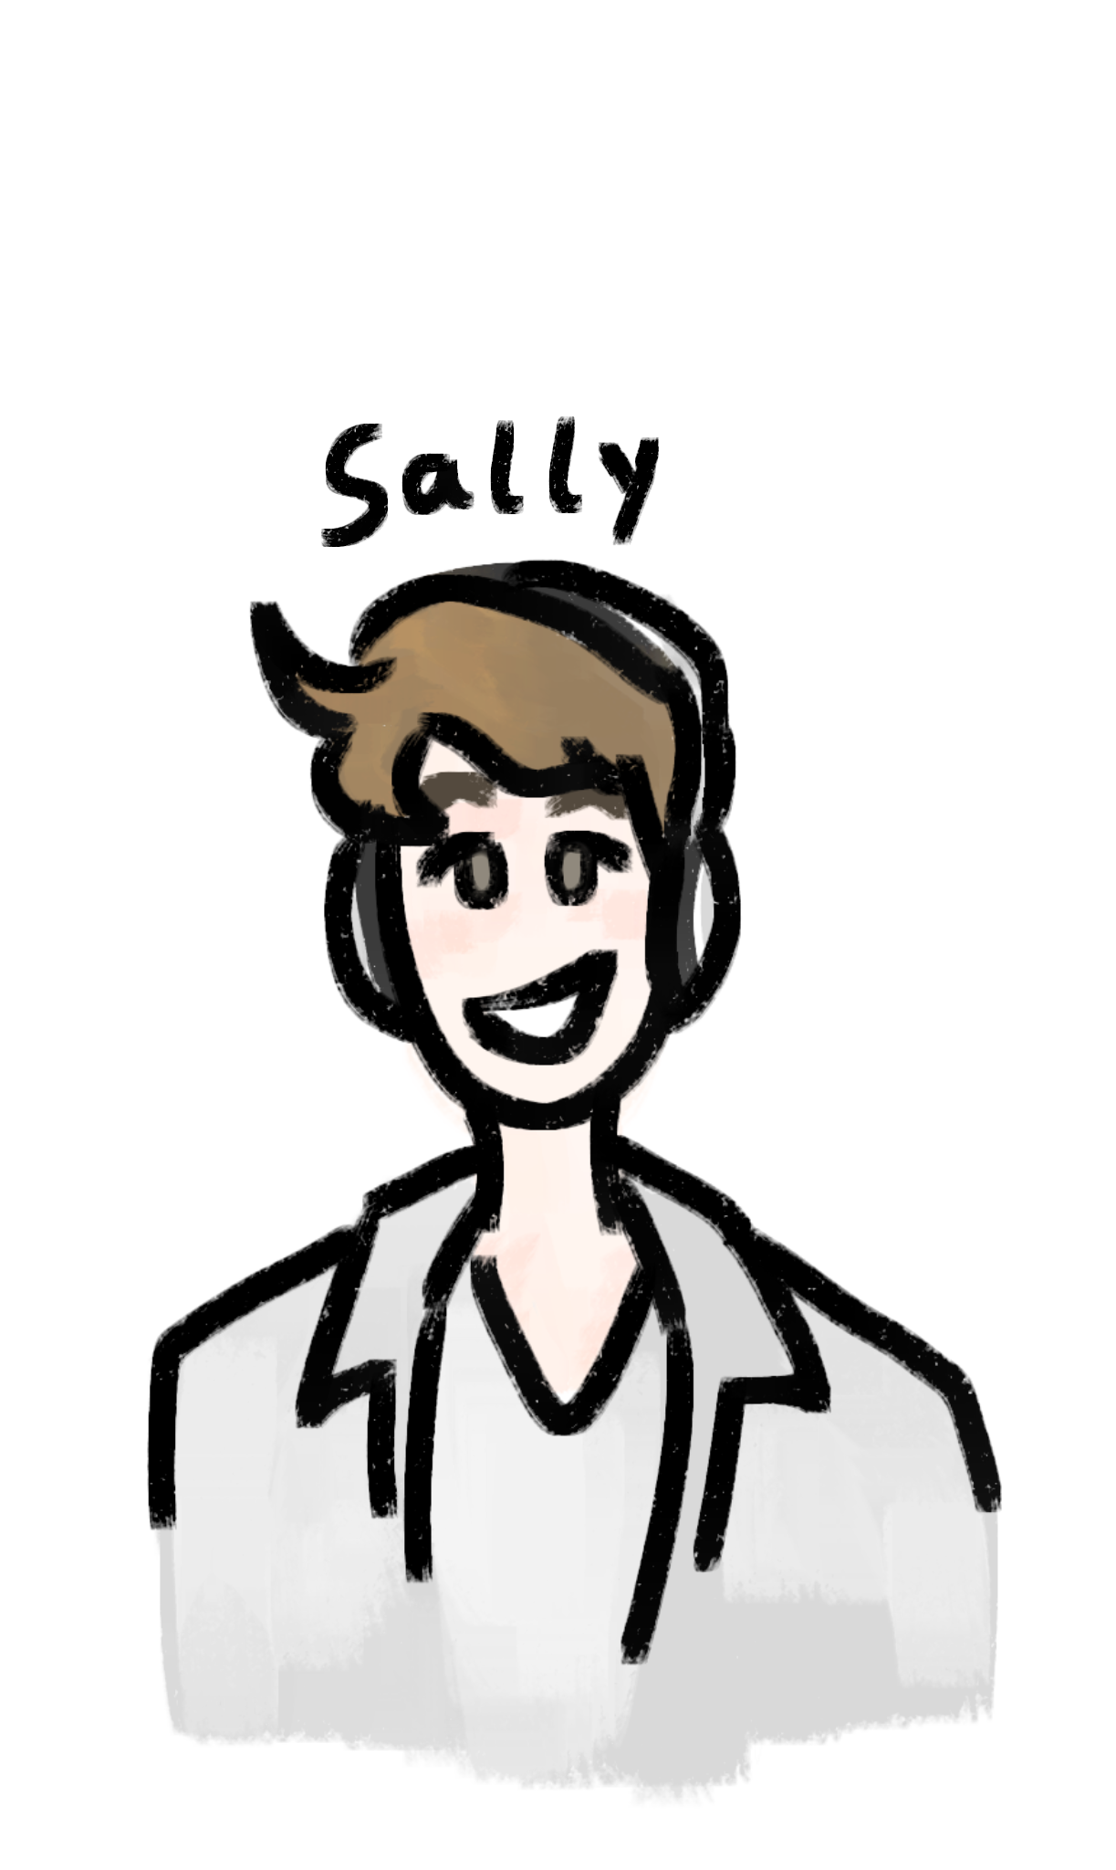
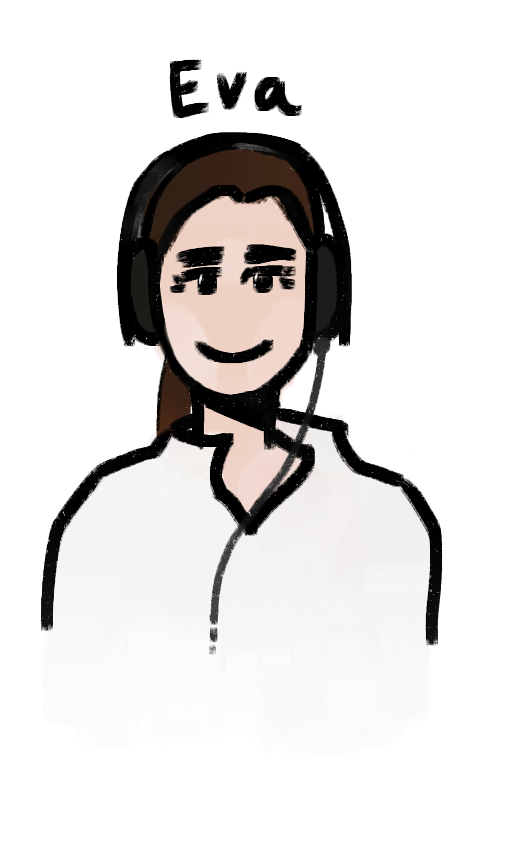
Workshop 5:
Science communication
“Science Communication, Producing a professional podcast of the Workshop"
Dr Sally Le Page
Dr Eva Higginbotham
Notes:
Welcome to the Workshop 5 presentation where we are with the Naked Scientists looking at science communication. Our aim for the week was to create a professional podcast of the workshop

Slide 2
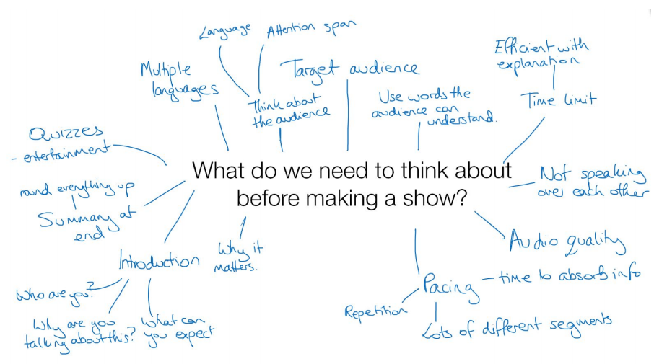
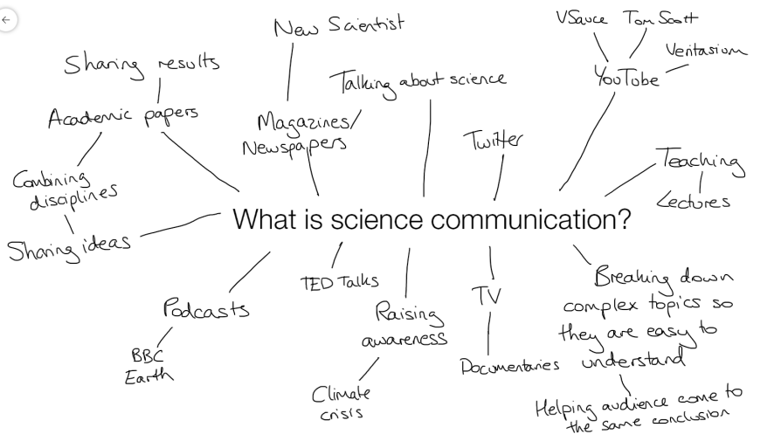
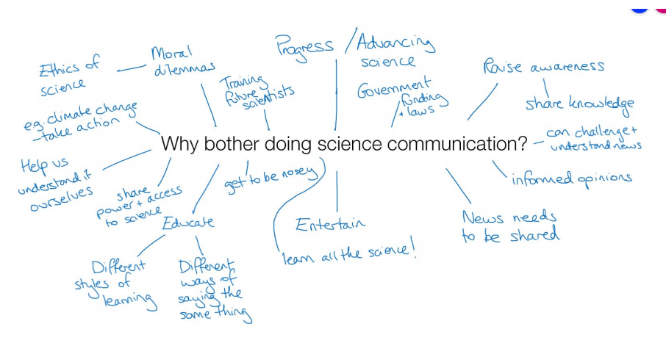
Notes:
Science communication is the practice of informing, educating, raising awareness of science-related topics, and increasing the sense of wonder about scientific discoveries and arguments. This was our study for the week. At the beginning of the workshop, Sally and Eva gave us some questions related to science communication that we, as group, answered, and compiled our answers. Here are a few of them. From then, we were given the task to create our own podcasts after being split into three groups, interviewing four of the other groups. Here are our different groups:

Slide 3
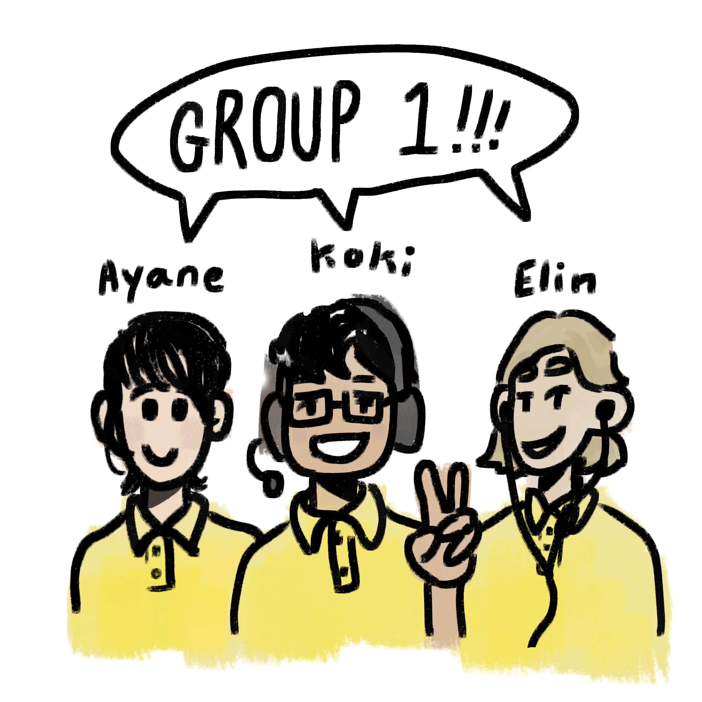
Group 1:
science communication
Ayane, Koki & Elin
drawings by elin~

Slide 4
Group 1: podcast clip

Slide 5
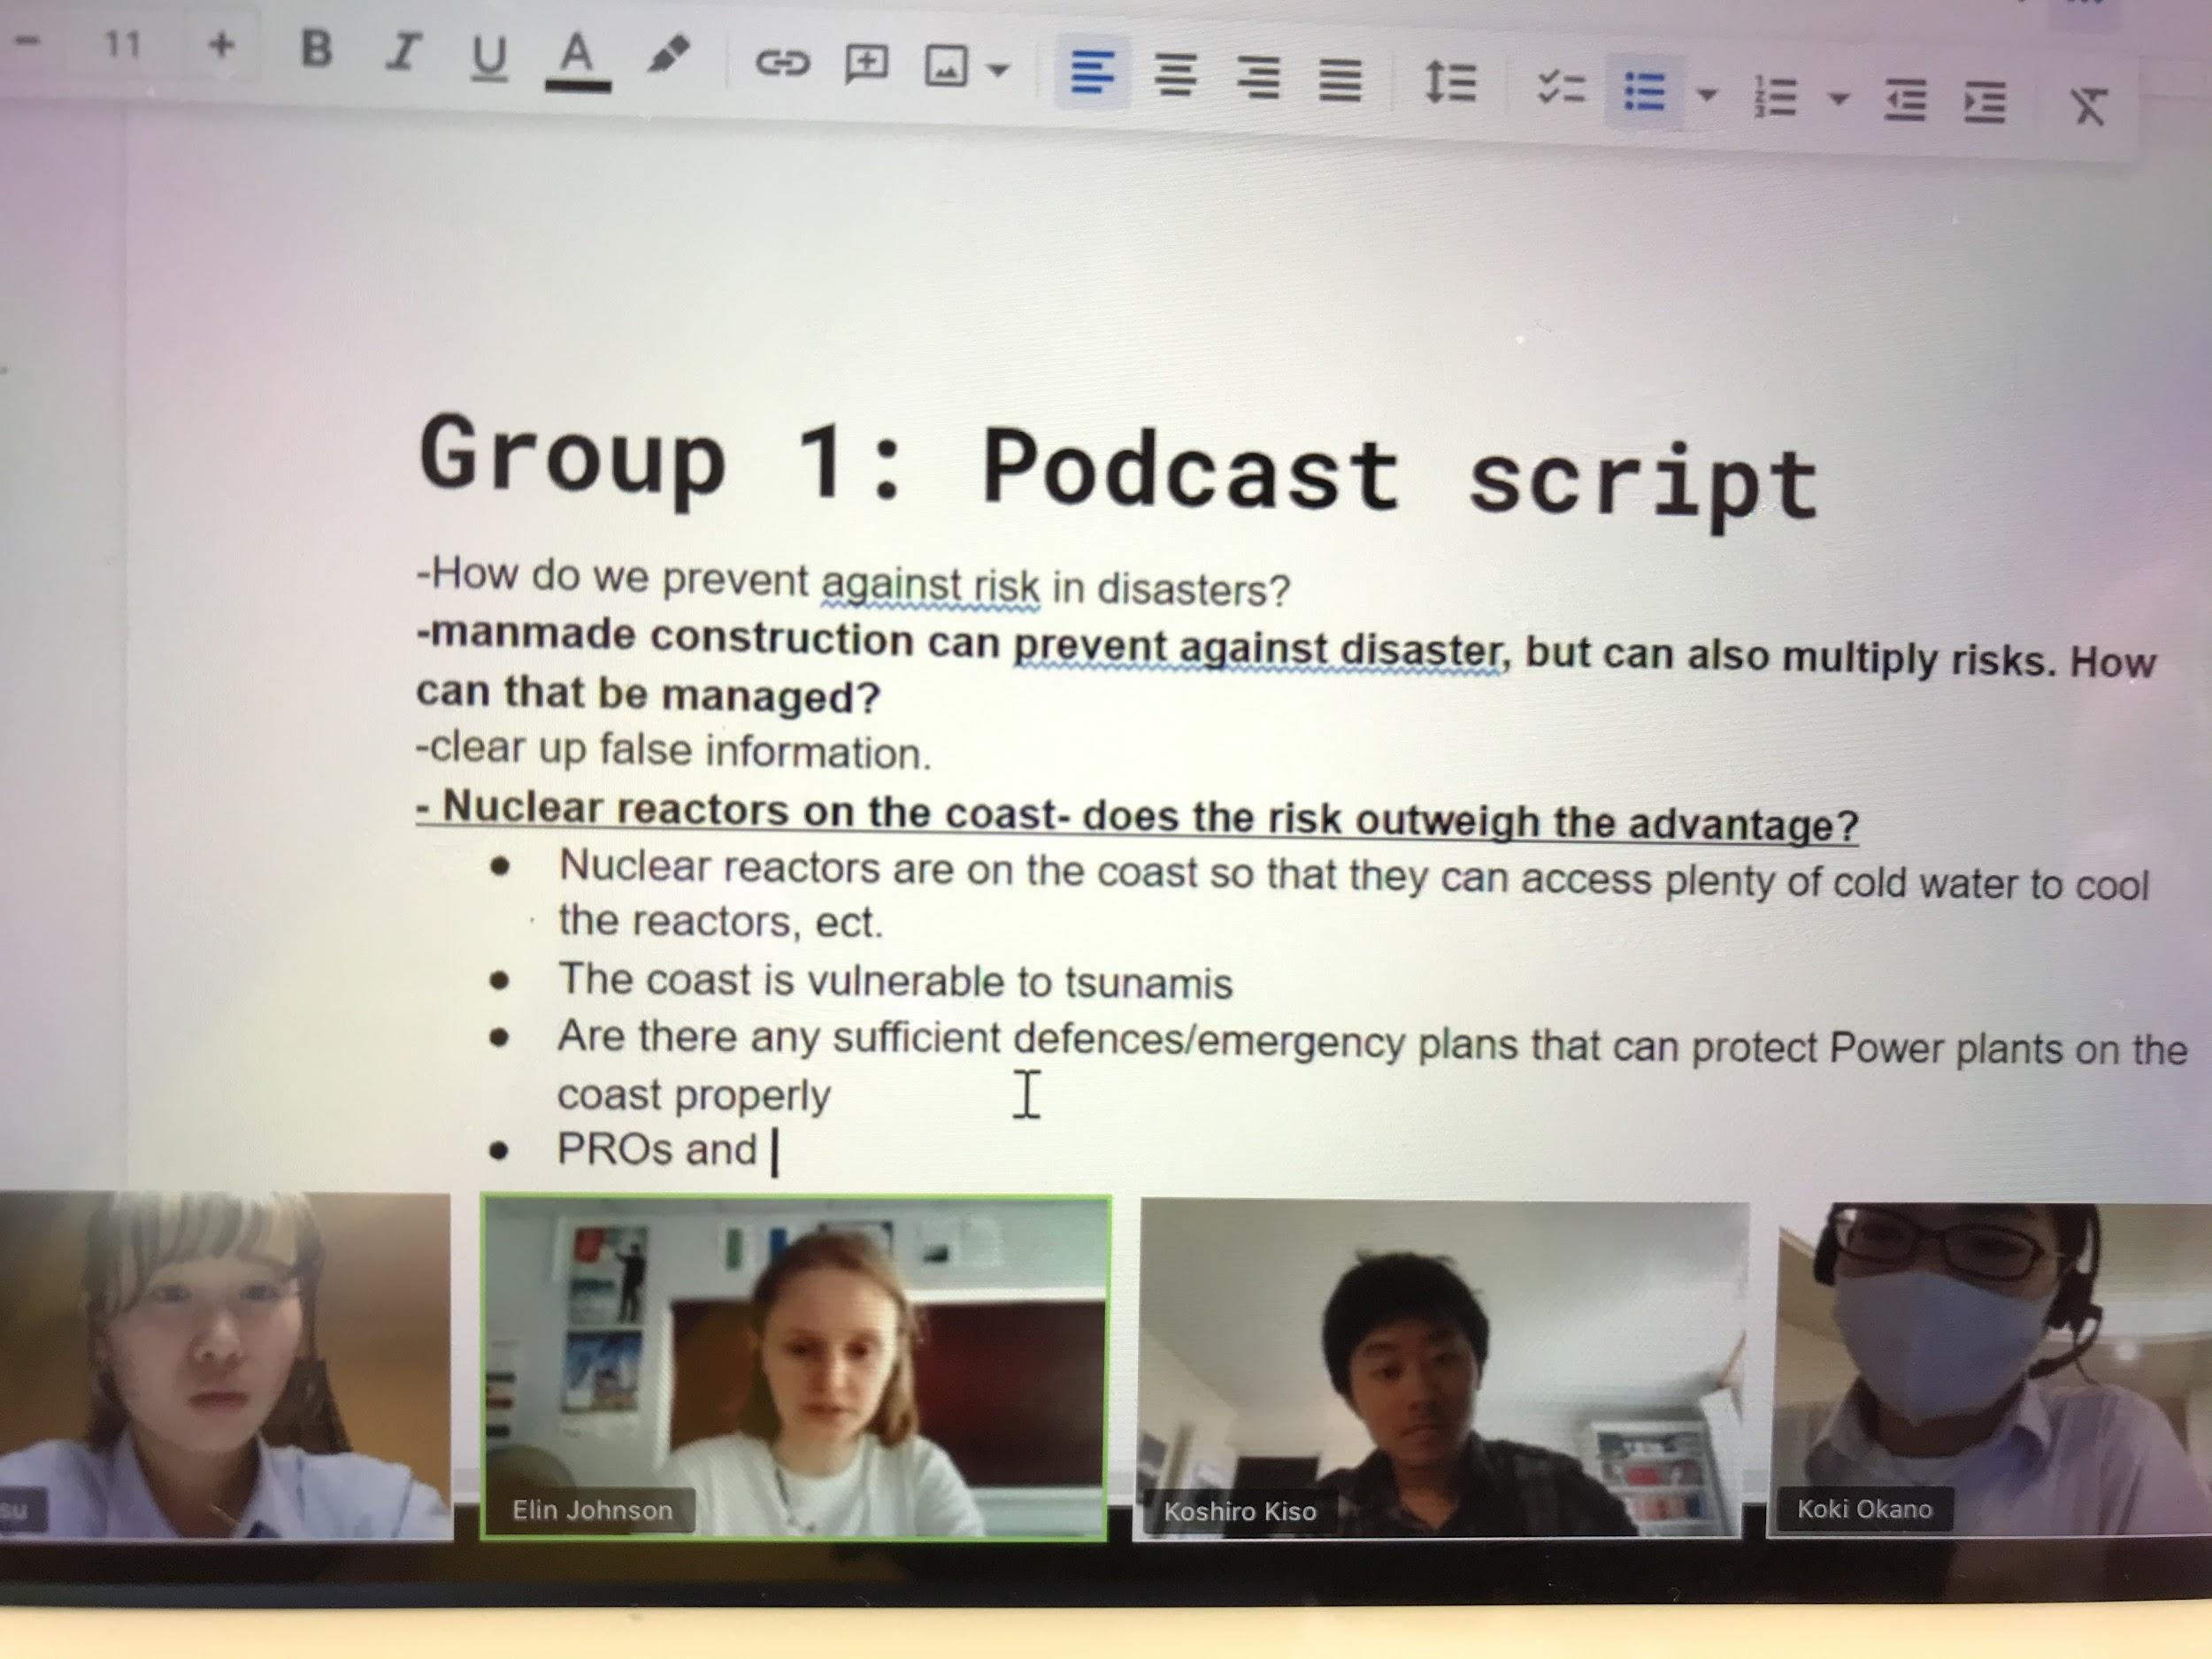
I learnt about omoiyari (being considerate)
Notes:
I learnt about omoiyari (being considerate)

Slide 6
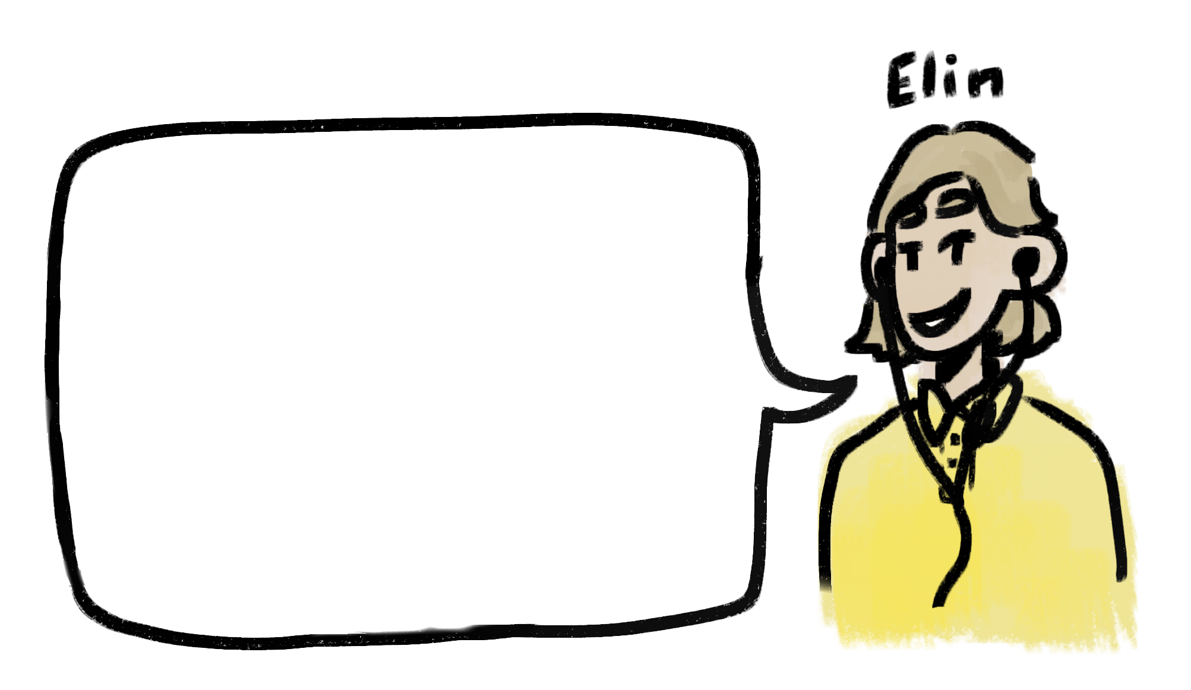
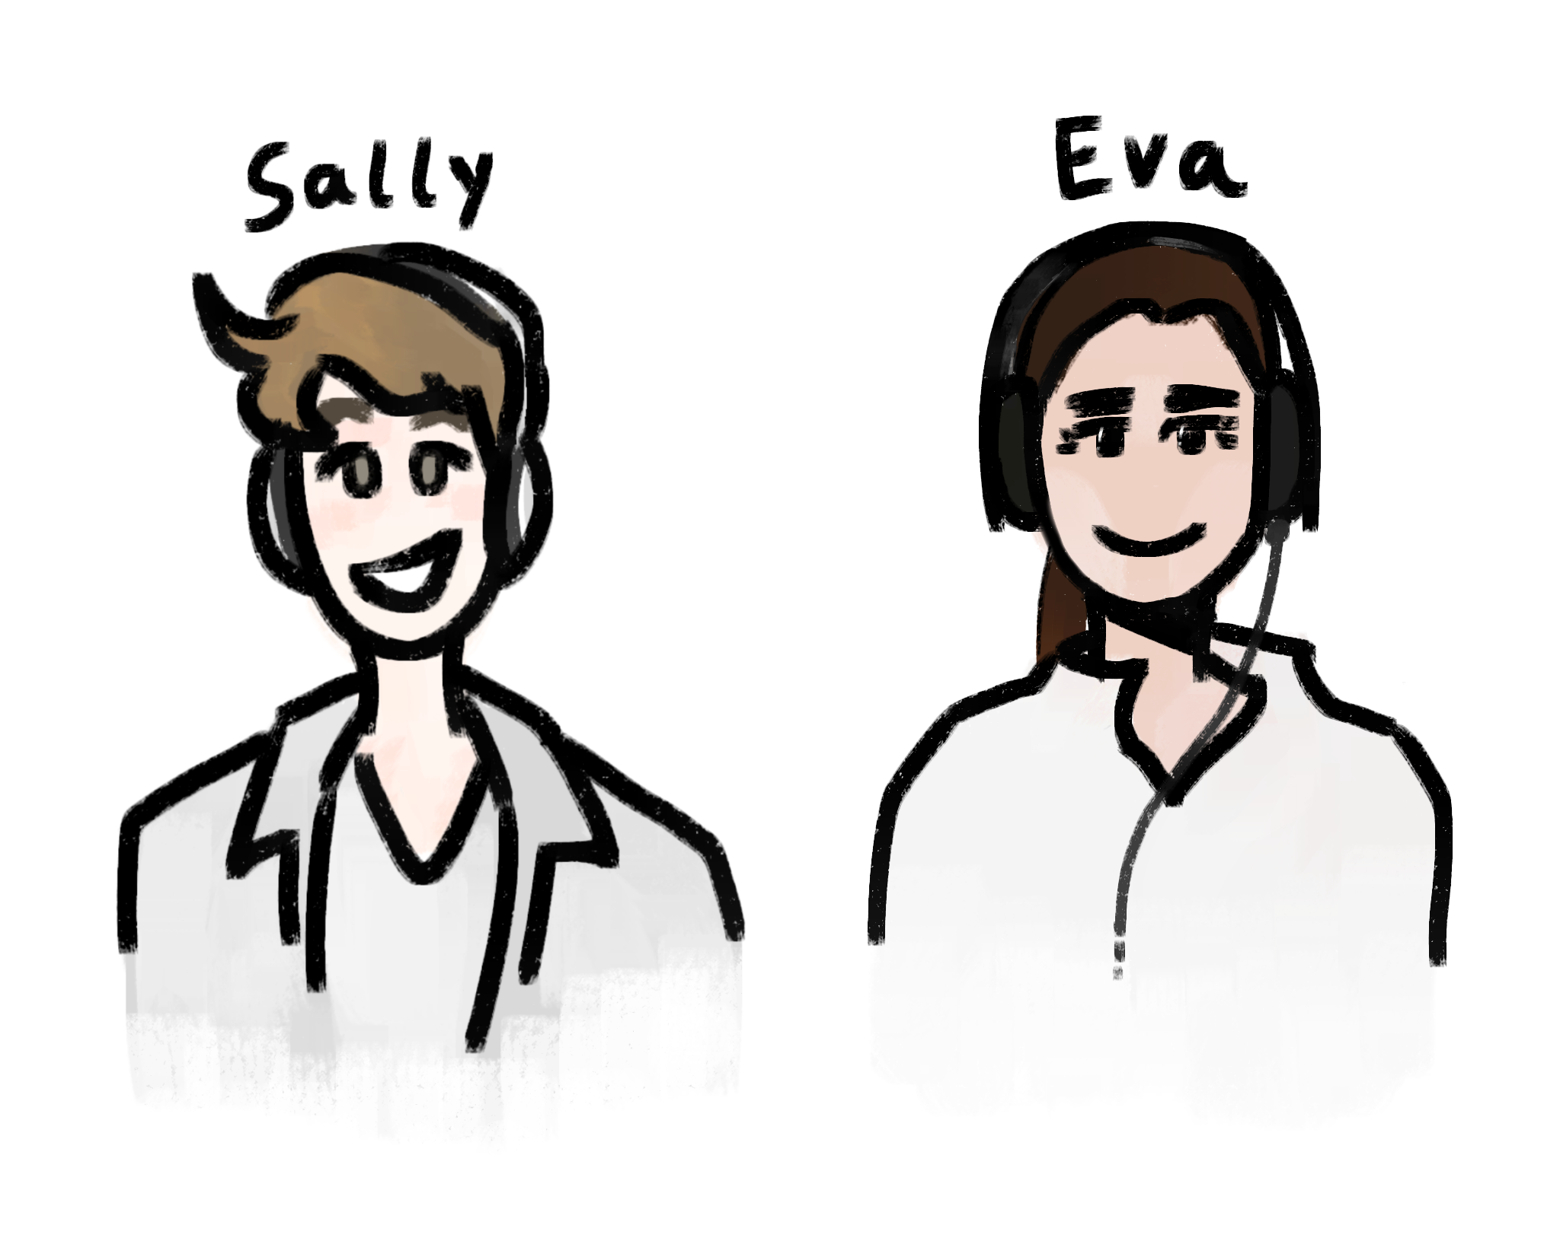
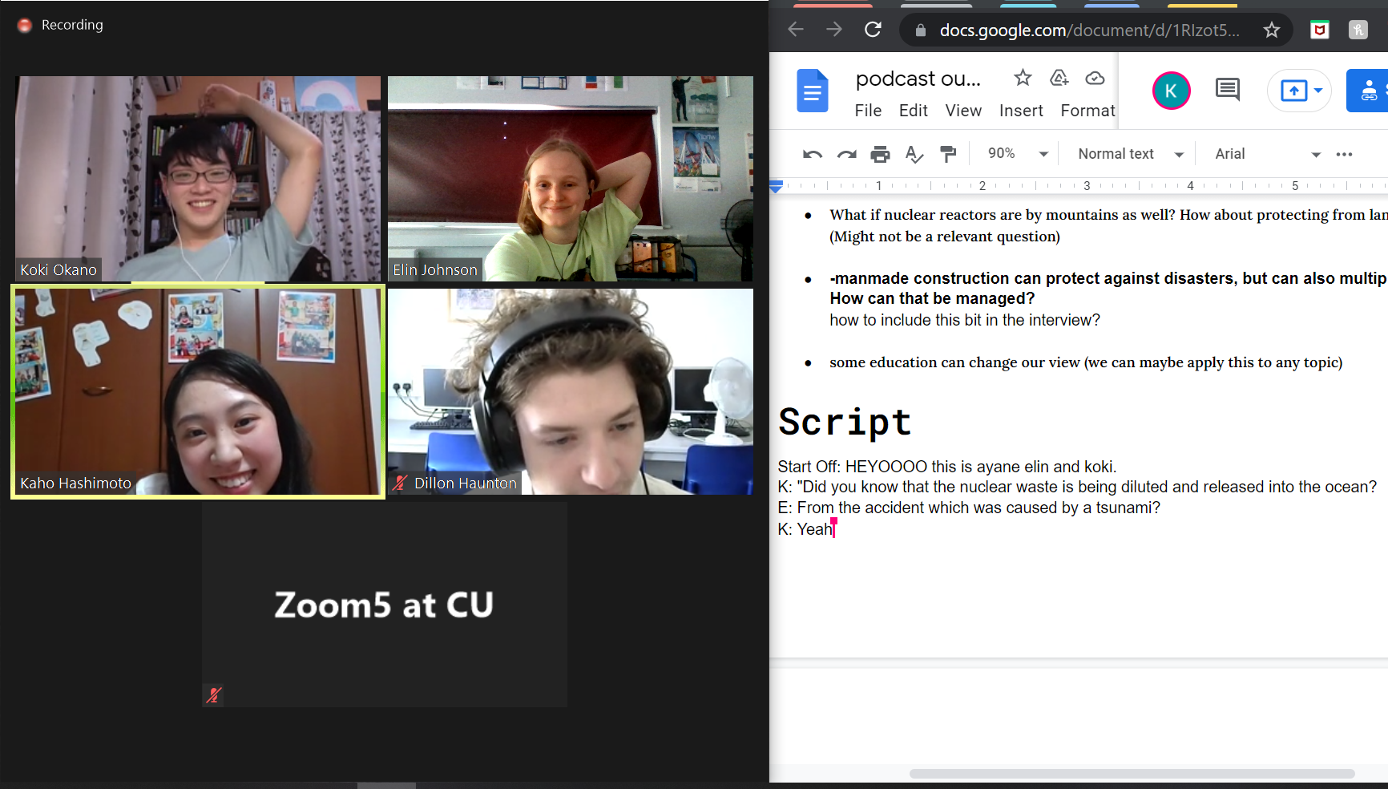
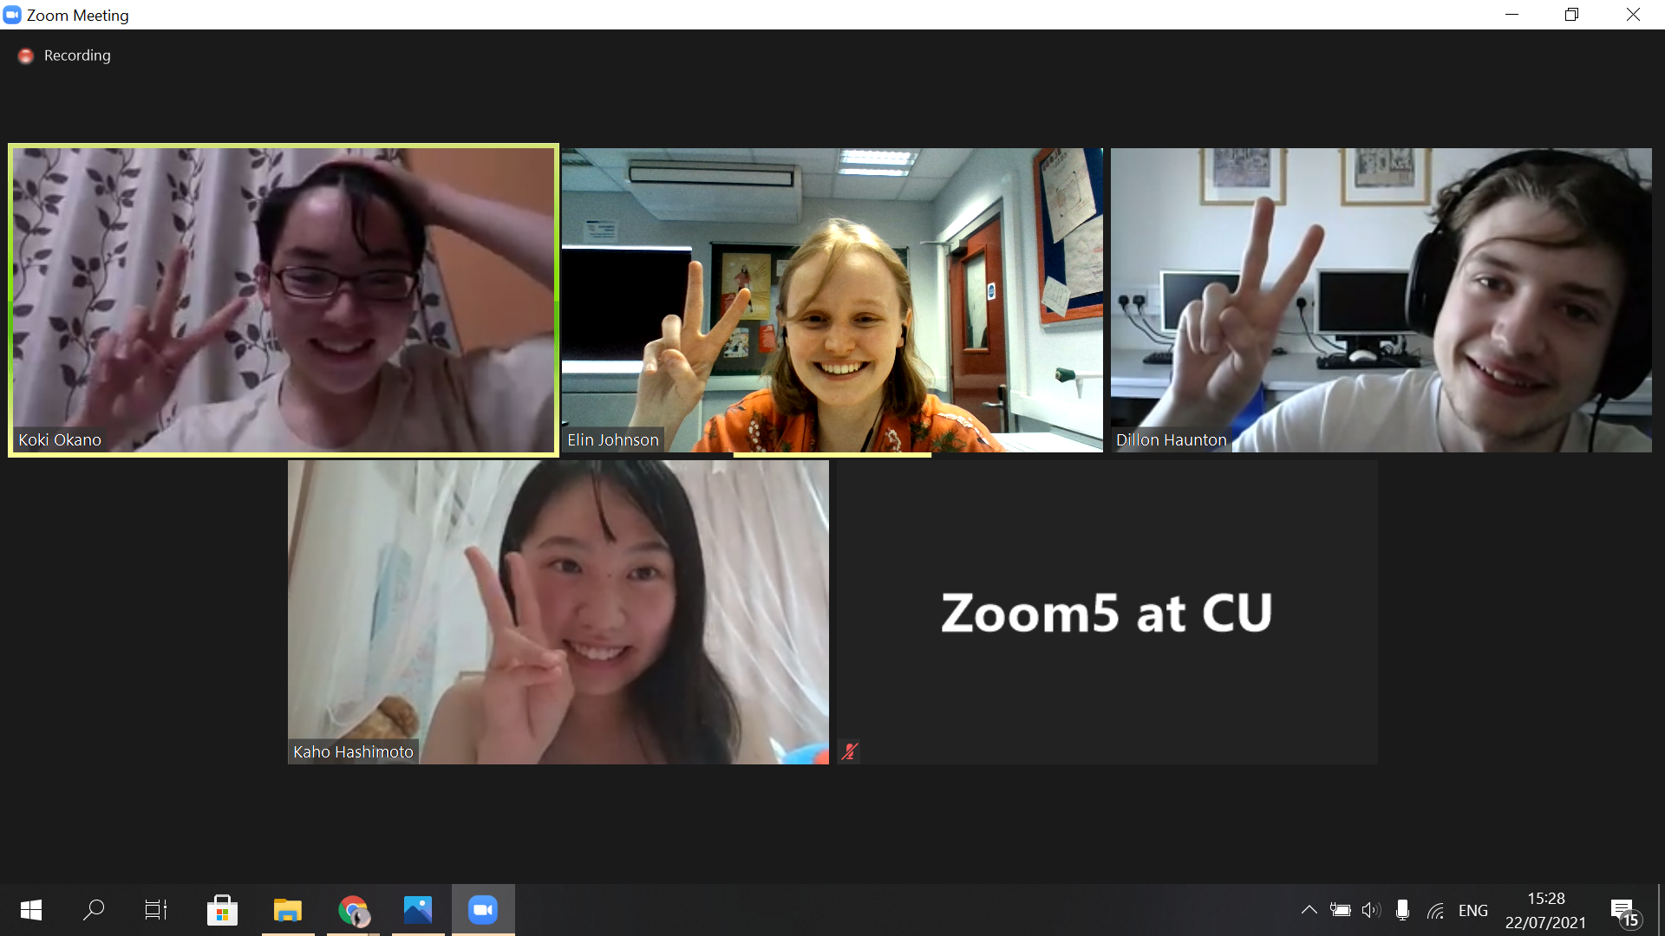
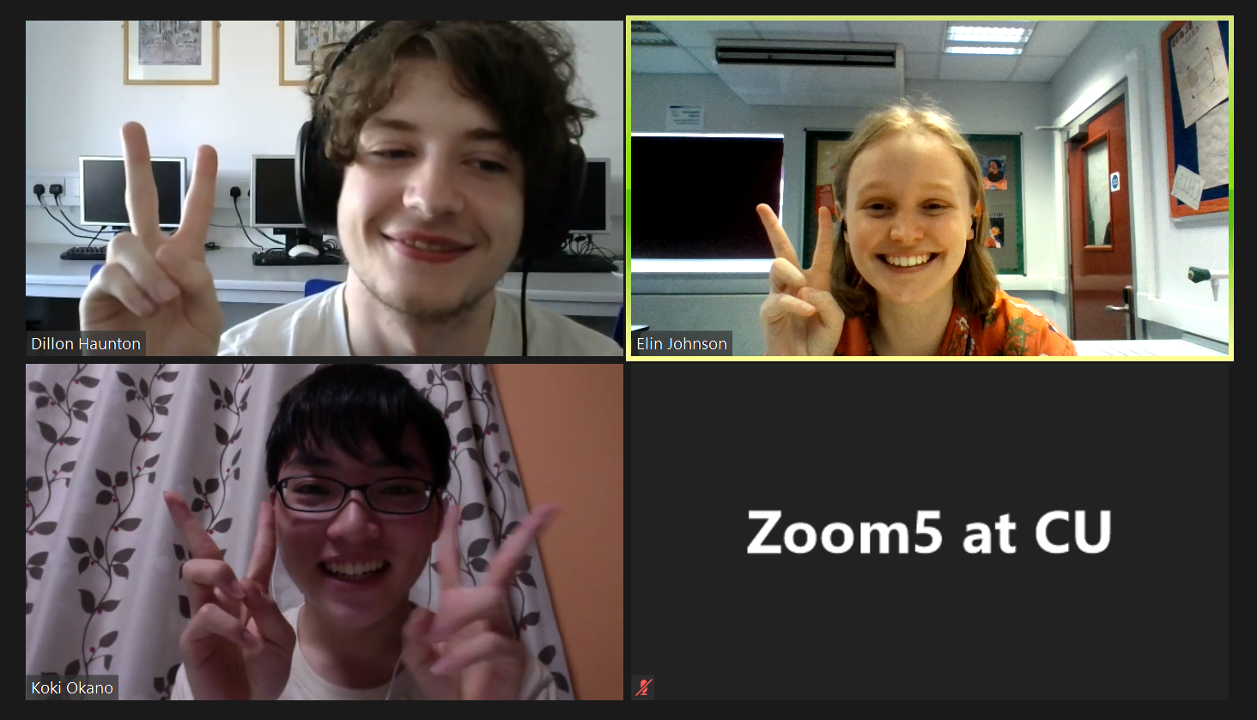
“Science communication is the bridge between people and science.”
科学は人と科学の架け橋です
Notes:
-hi I’m elin johnson from hinchley wood school in surrey,england
-what i learnt about science communication
>>> we need to talk to other people (especially from diff cultures and backgrounds) to discover other view points to advance our opinions
>>> “Science comm is the bridge between people and science.”
>>
-what i learnt from sally & eva (sally and eva were the best!!!!!!)
- science comm project will help me a lot as i want to be an optometrist, which is science that rqs science comm
-what was fun/great about the experience/ my fav part

Slide 7
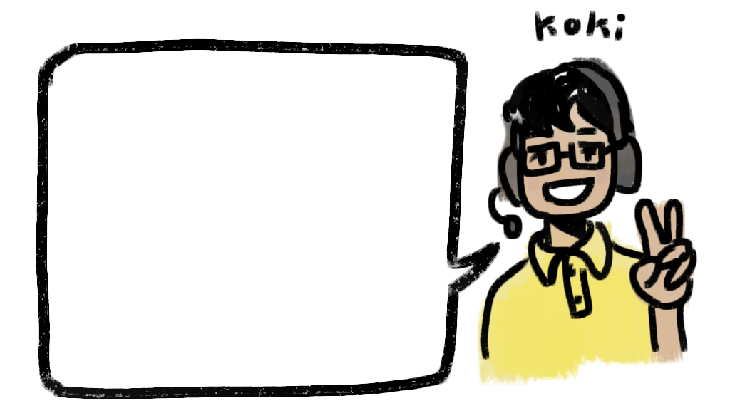
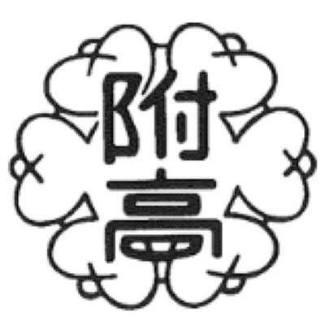
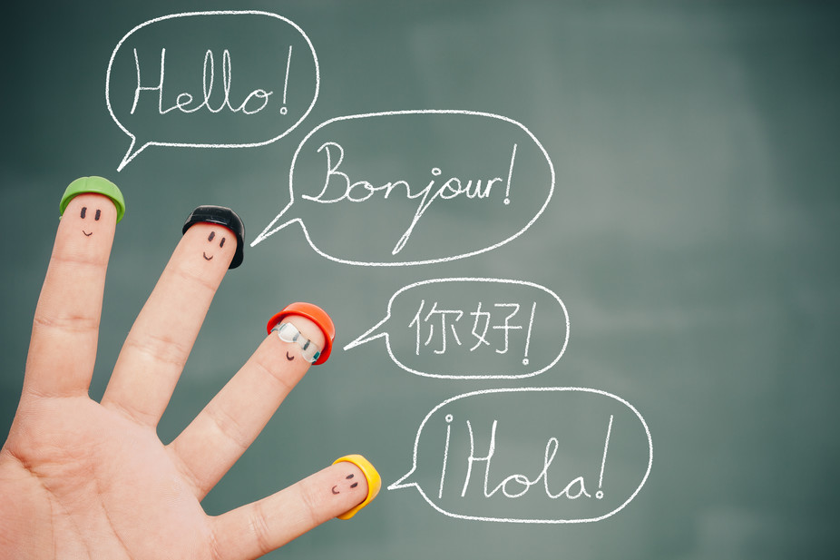
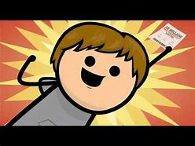
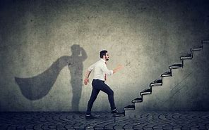
IDEA

Slide 8
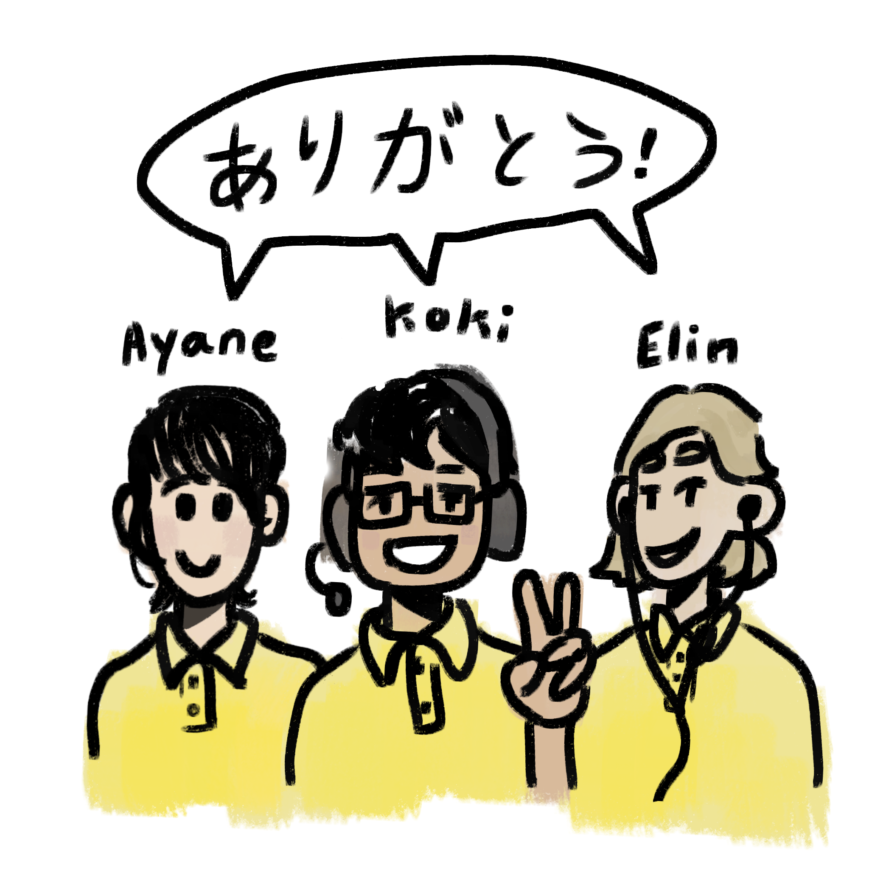

Slide 9
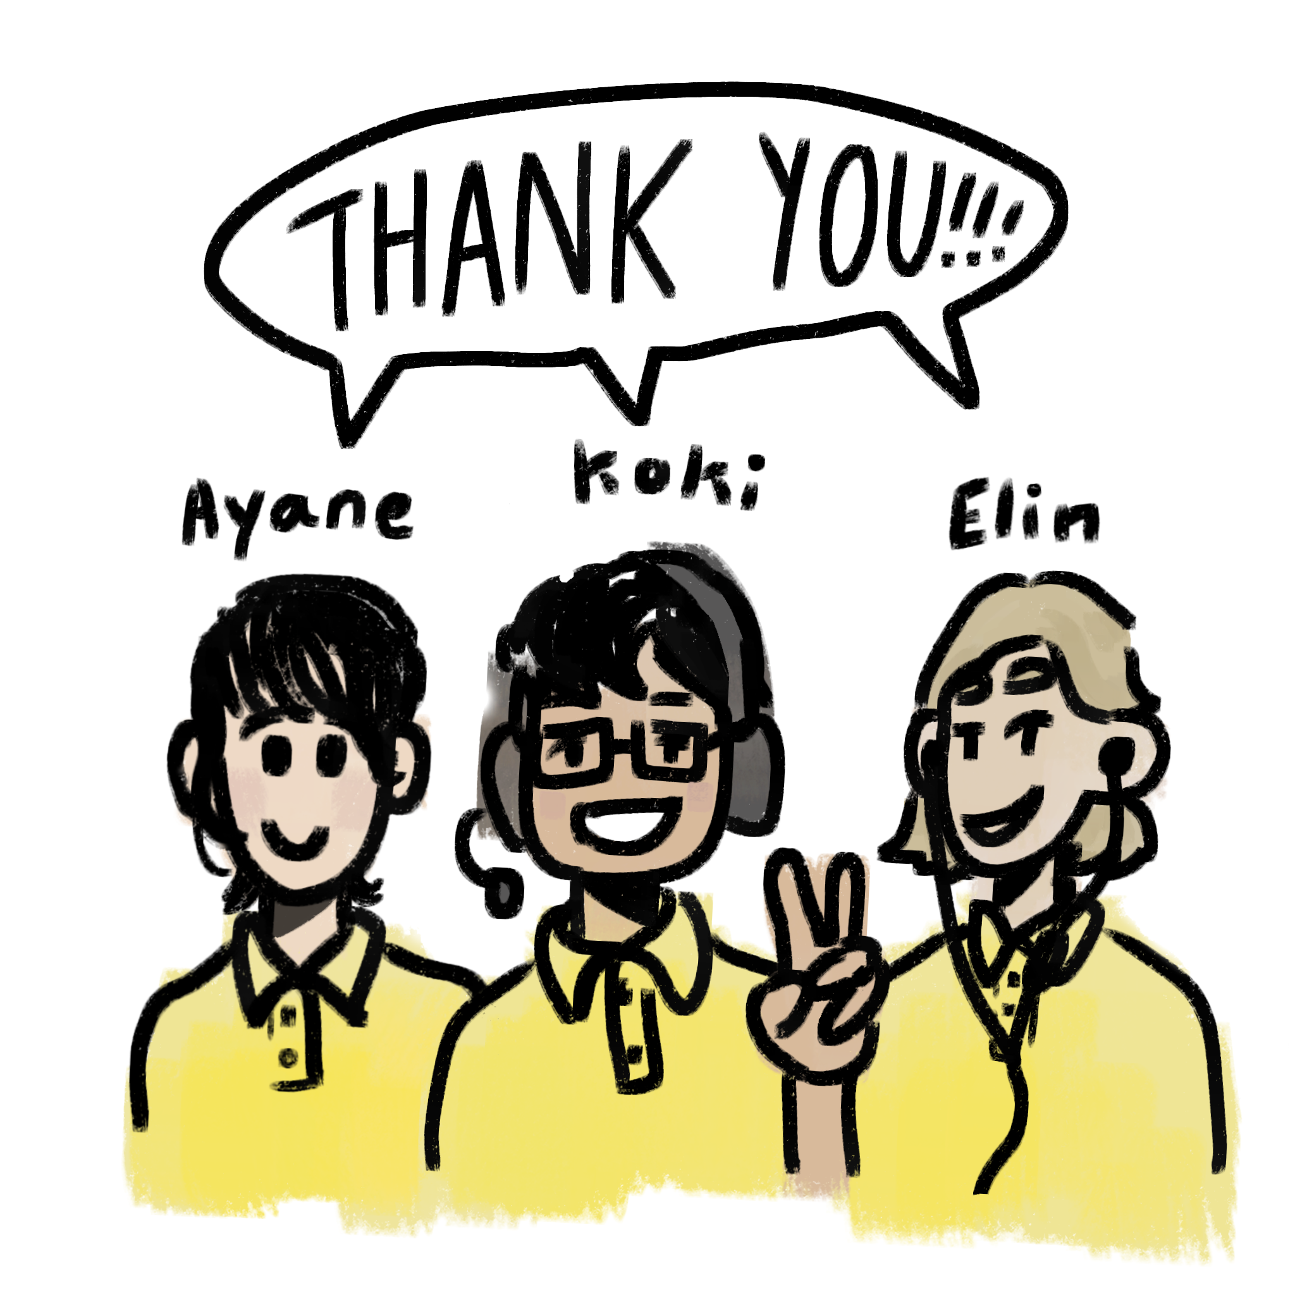

Slide 10
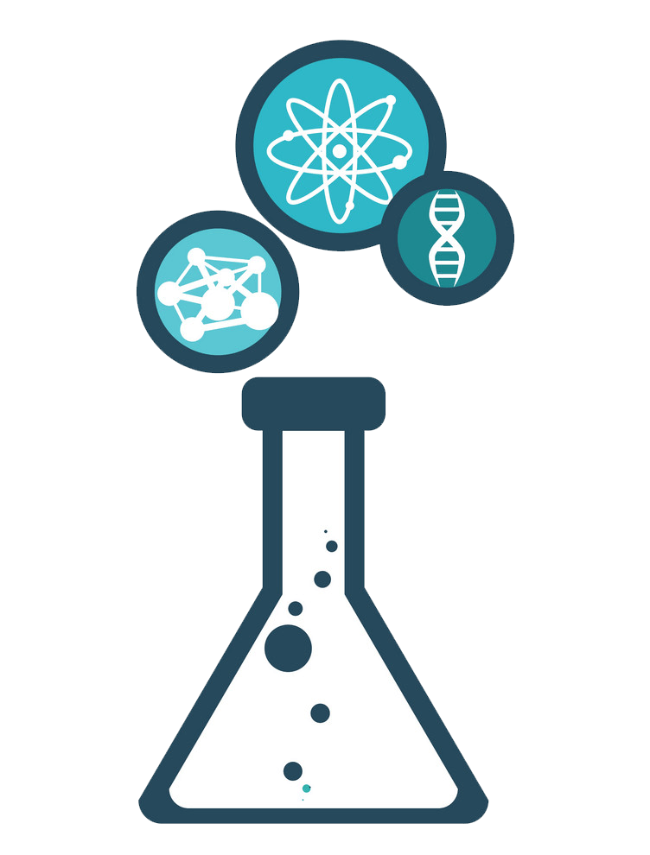
Group 2:
Science communication
Dillon, Rei & Sharon

Slide 11
Group 2: Podcast Clip
Notes:
We as a group decided to do our podcast focusing on the first and second research group, which was Earth Sciences and Nuclear Energy. In Earth Science, we focused on the experiments students had done during the week and the impact of those results. In Nuclear Energy we focused on the study of radiation, from example of different radiation exposed to the health effect of this exposure. Rei and I (Sharon) were given the role of interviewing the lecturers and students of these two groups for our podcast. Here’s a small snippet of what we got:

Slide 12
Dillon’s two cents
(Far more minimal than the slides before)
Communication is key コミュニケーションは重要
You cannot know if you do not ask 聞かないと分からない
Scientists are not scary super-intellectuals (for the most part) 科学者は怖くない
Science isn’t just about results 科学は結果だけではありません
Progress is a universal language 進歩は世界共通の言語です
There are always people who don’t know,
So there must be people who let others know
That is what this project is about (to me, at least)
The help from Sally, Eva and the facilitators definitely got us to understand this and achieve it ourselves
Notes:
In science, communication is key: as there are many different fields one can specialise in, there are a lot of specialists, so communicating ideas between these people is a key part of making the world work for us. A life or death situation can come down to communication, both in the moment and as a preventative measure.
The information you need/want to know is not necessarily going to just be said directly to you. Through questions, we can get answers to the specific things we may need help with, and through asking questions, things can be approached in different ways. Even experts have to ask other experts since they specialise in vastly different fields.
Scientists are, for the most part, very normal people with nothing more than an interest in and passion for science. And they are far from being all-knowing - for a specialist, their knowledge extends to the field they specialise in and they may only have a surface level understanding of other fields.
The process of getting your results in science is an important process in and of itself. To begin, the way you invest yourself in the process influences how good your end results are. The processes in science can also be helpful for other disciplines, as logical methods are applicable anywhere.
No matter what the language or cultural barrier is, progress means the same thing to everyone. And it is because of this that the entire world can collaborate towards a common goal.
Sadly, there is ignorance in the world, by circumstance or by choice, and we are constantly working towards solving this. Information is extremely accessible, as it should be, so there need to be people who can relay that information to those who don’t know.
(70 seconds)

Slide 13
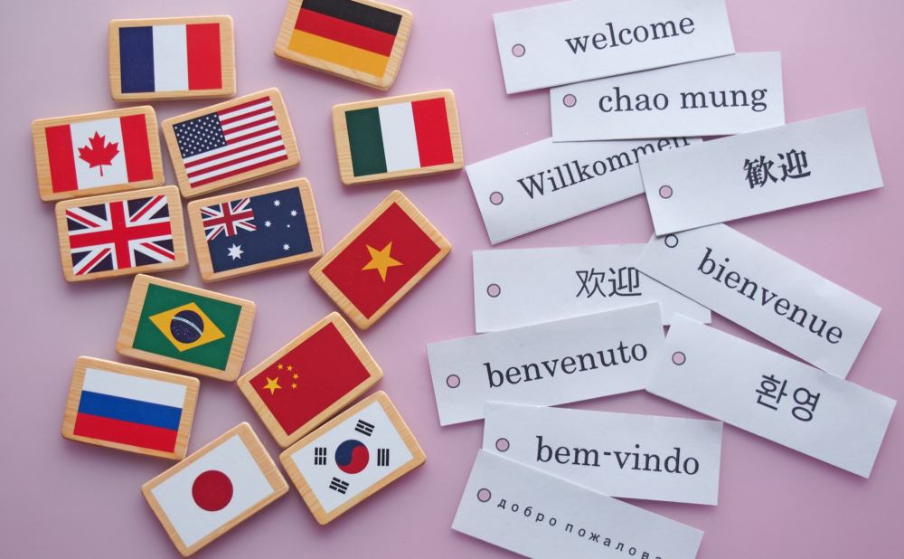
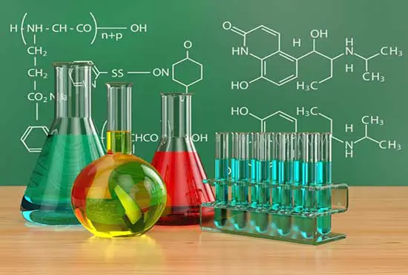
Rei's experience
from Kyoto in Japan.
Key is understanding
Especially about language and science
Ex1:about language
Ex2:about science
But….
Notes:
Hello there! [konnichiwa].My name is Rei Yoshimoto from Kyoto.There is a student from Japan.He doesn't know English

Slide 20
Dealing with myths of mass destruction
Day1 discussing
Day2 research
Day3 research and
interview
Day4 recording
Kaho Hashimoto
What I did and learned in this week

Slide 21
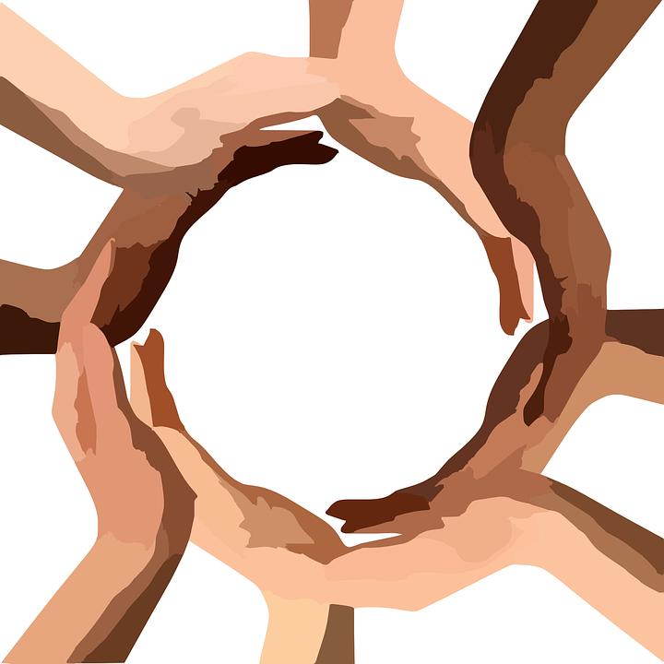
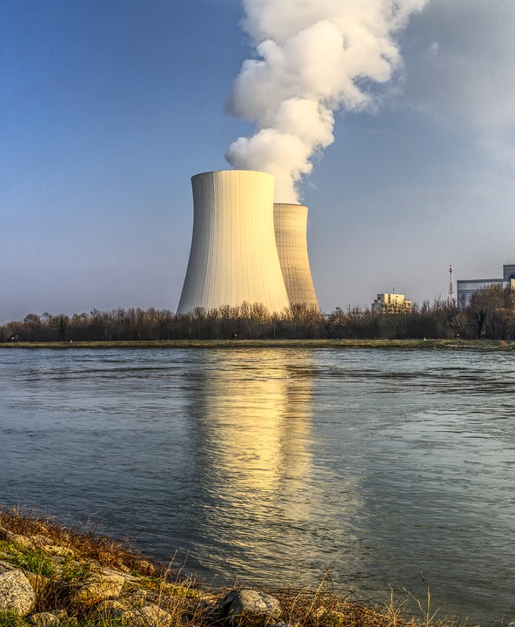
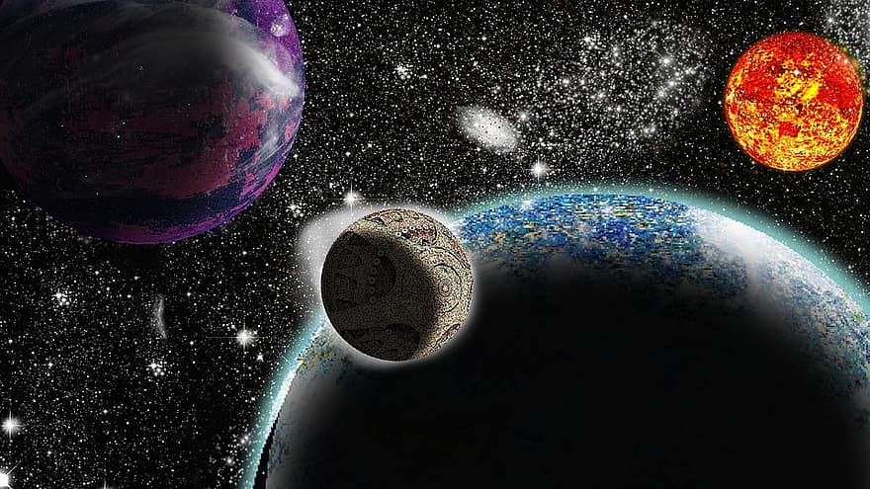
Thank you！！！

Slide 22
A ‘Thank You’ to Eva and Sally
Notes:
We would all like to thank Sally and Eva for their time and hard work in editing the podcasts, organising the interviews and putting up with all of us.

Slide 23
Any Questions?
質問は？

