Slide 1
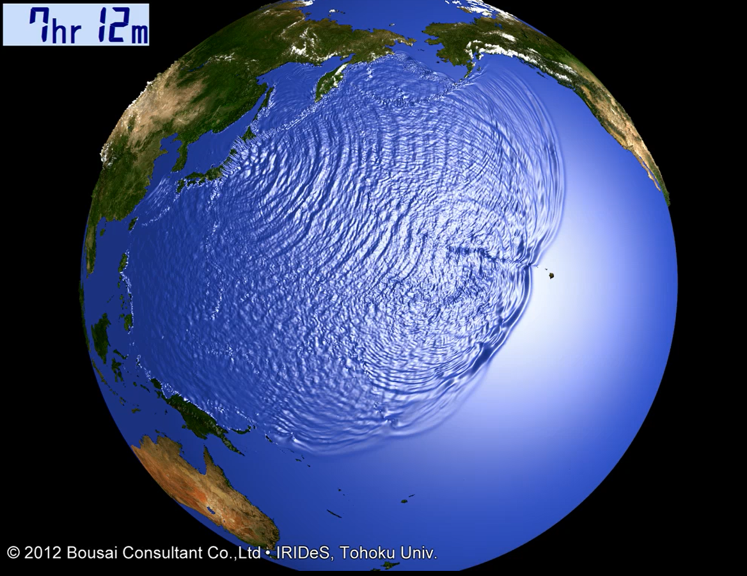
Interdisciplinary perspectives of tsunami for disaster risk management
Anawat Suppasri (Ph.D.)
Associate Professor,
Tsunami Engineering Research Field,
Hazard and Risk Evaluation Research Division,
International Research Institute of Disaster Science (IRIDeS),
Tohoku University

Slide 2
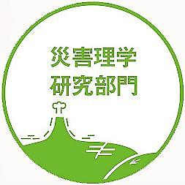
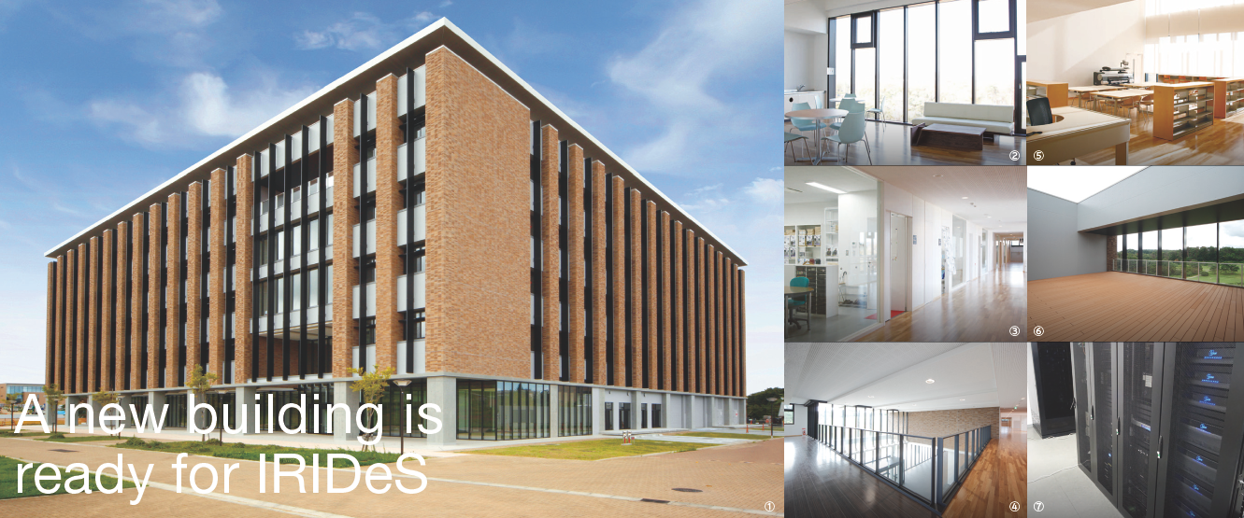
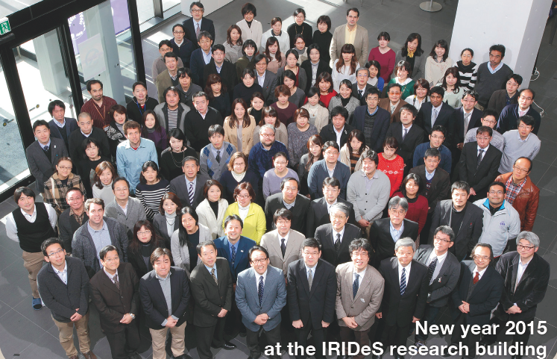
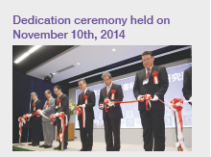
About IRIDeS
Mitigation & Supportology
Spread/extending
Emergency Operation
Hazard/disaster study
Disaster Medical
Generation
Rescue/saving
Interdisciplinary
7 divisions
37 fields
Recovery/
Reconstruction
Disaster Science
Recovery
Tradition/ archives
Notes:
‹#›

Slide 3
Background and future for Disaster Risk Reduction

Slide 4
25 years of international commitment to disaster risk reduction
Notes:
25 YEARS OF INTERNATIONAL AGREEMENTS
HFA MONITOR AND GAR ONLY SINCE 2007
THREE INTERNATIONAL AGREEMENTS IN 2015
IS THE APPROACH TO DISASTER RISK MANAGEMENT FOLLOWED SINCE 1990 FIT FOR PURPOSE TO REDUCE DISASTER RISK AND TO FACILITATE SUSTAINABLE DEVELOPMENT

Slide 5
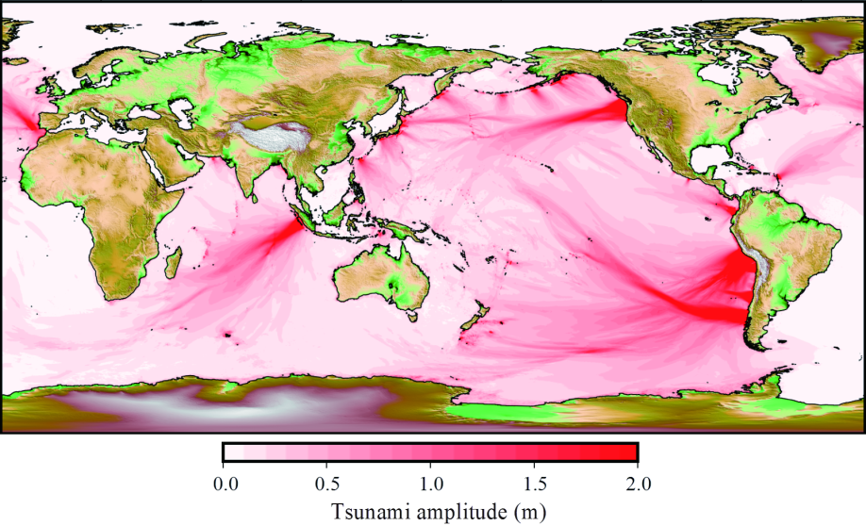
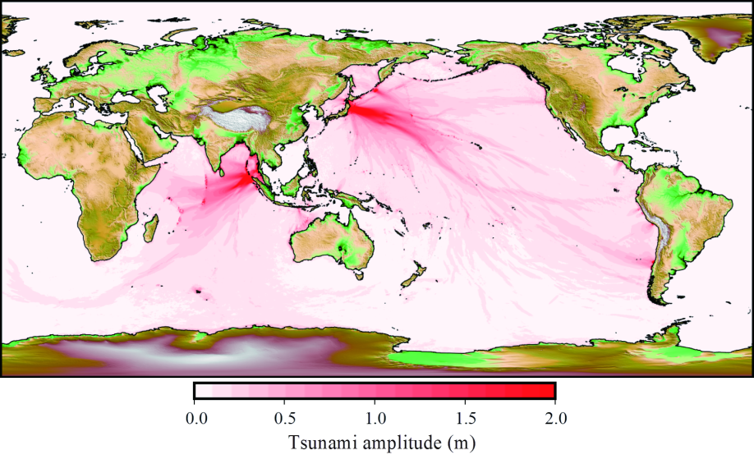
Global tsunami hazard from the last 400 years
1600-1969（64 events）
1970-2016（39 events）
Atlantic Ocean
Alaska-Cascadia
Over 2 m
Damaging tsunamis that exceeded 2 m can be seen virtually everywhere, especially along the Pacific Rim including 1700 Cascadia (M9.0), 1755 Lisbon (M8.5), 1833 SW Sumatra (M8.3), 1868 Peru (M8.3), 1906 Ecuador (M8.8) and 1960 Chile (M9.5).
Only two major events, the 2004 Indian Ocean (M9.3) and Great East Japan (M9.0), classified as recent damaging tsunamis that exceeded 2 m and caused global impact meanwhile no major damaging tsunami in the east Pacific and Atlantic Ocean.
This observation demonstrates the importance of assessing or recognizing the hazards based on historical events beyond recent experiences.
Notes:
そこで，既往研究で評価されていなかった，「アフリカ西部」を例に，詳しく見ていきます

Slide 6
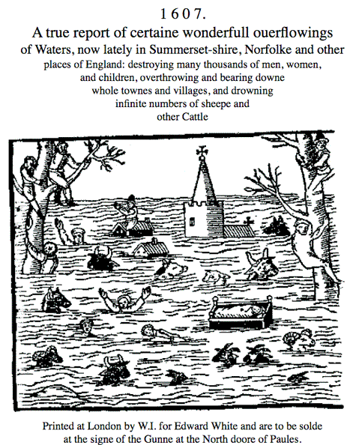
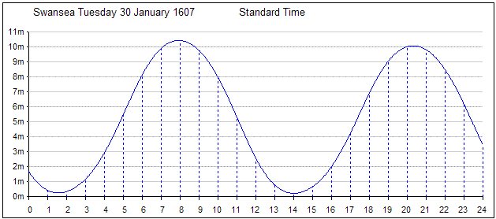
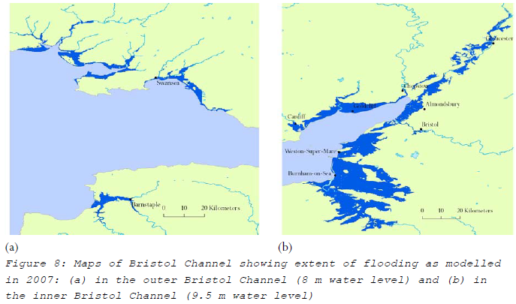
1607 Bristol Floods
Exceptionally high spring tide on the morning of the flood
Caused by TSUNAMI,
FLOOD or
STORM SURGE ??
No M> 7.5 recorded and very less impact by the 1755 Lisbon earthquake felt all Europe
Records said that water was from the sea
Some records mentioned about storm but no wind damage 🡪 wind speed < 100 km/h
Only one record said clear sky 🡪 center of the storm?

Slide 7
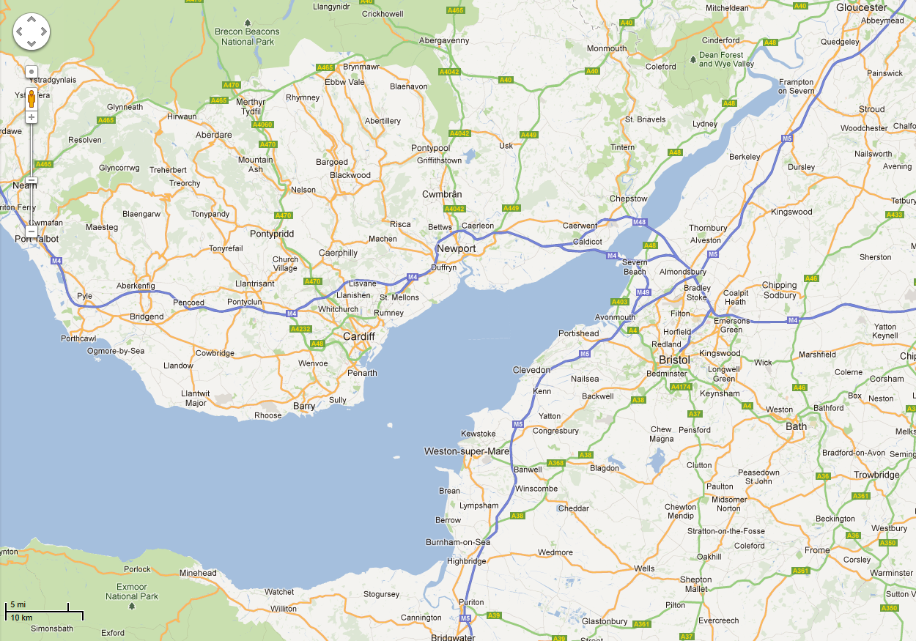
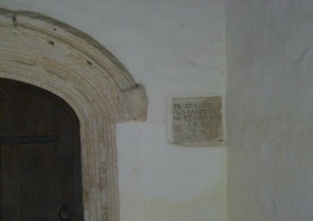
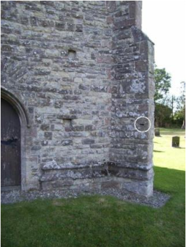
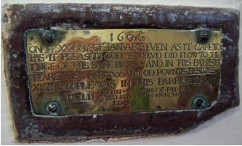
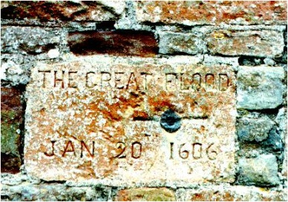
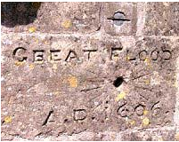
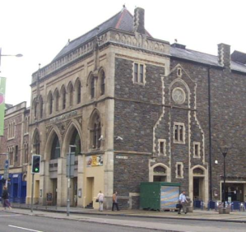
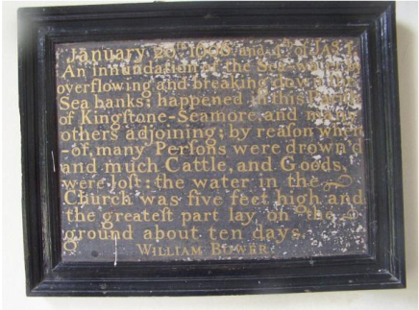
Flood memorial in churches around Bristol Channel
Nash
Redwick
Peterstone/ St. Brides Wentlooge
Goldcliff
Cardiff
Dunraven
Kingston Seymour
Brean

Slide 8
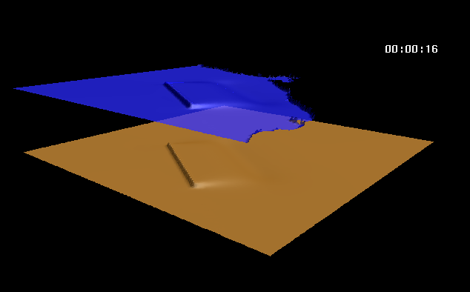
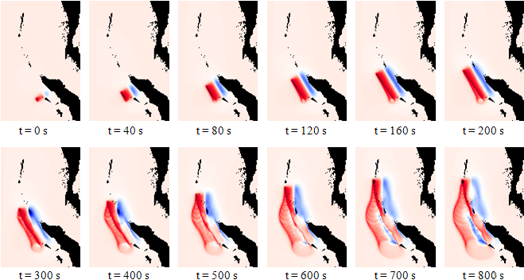
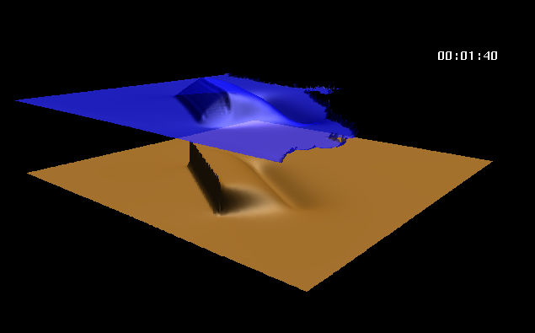
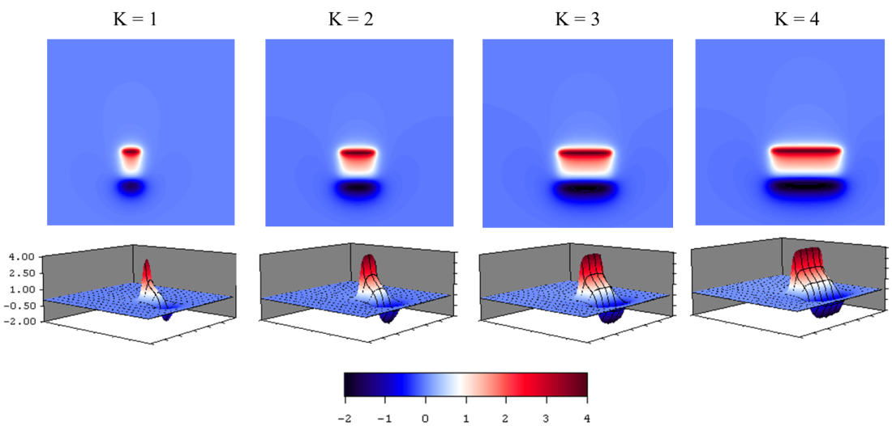
Earthquake generated tsunami
Vertical: fault rising time
Horizontal: fault rupture velocity

Slide 9
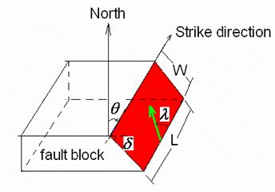
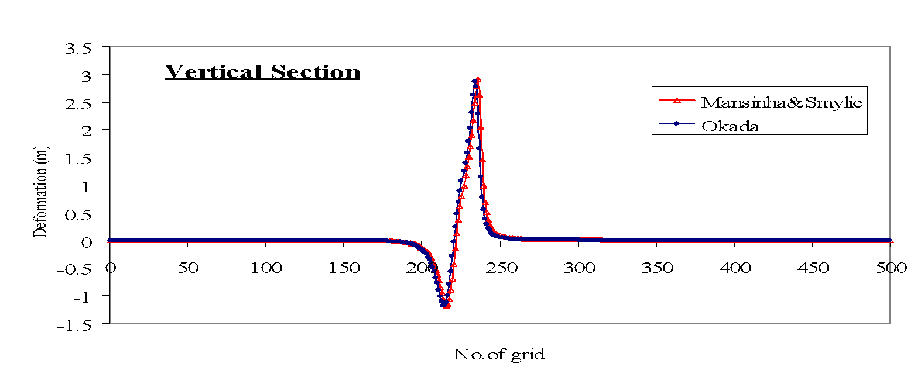
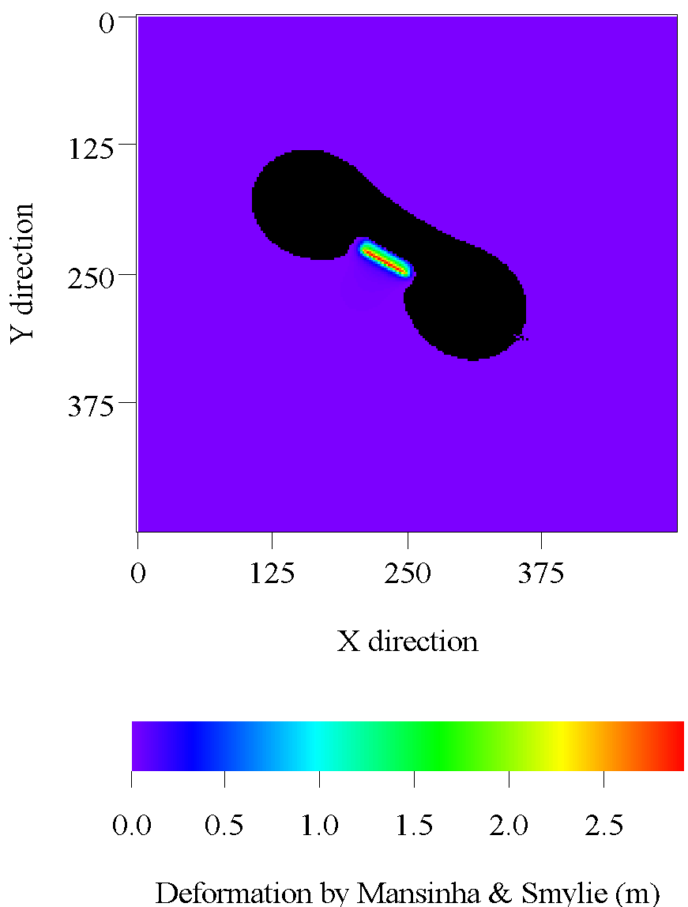
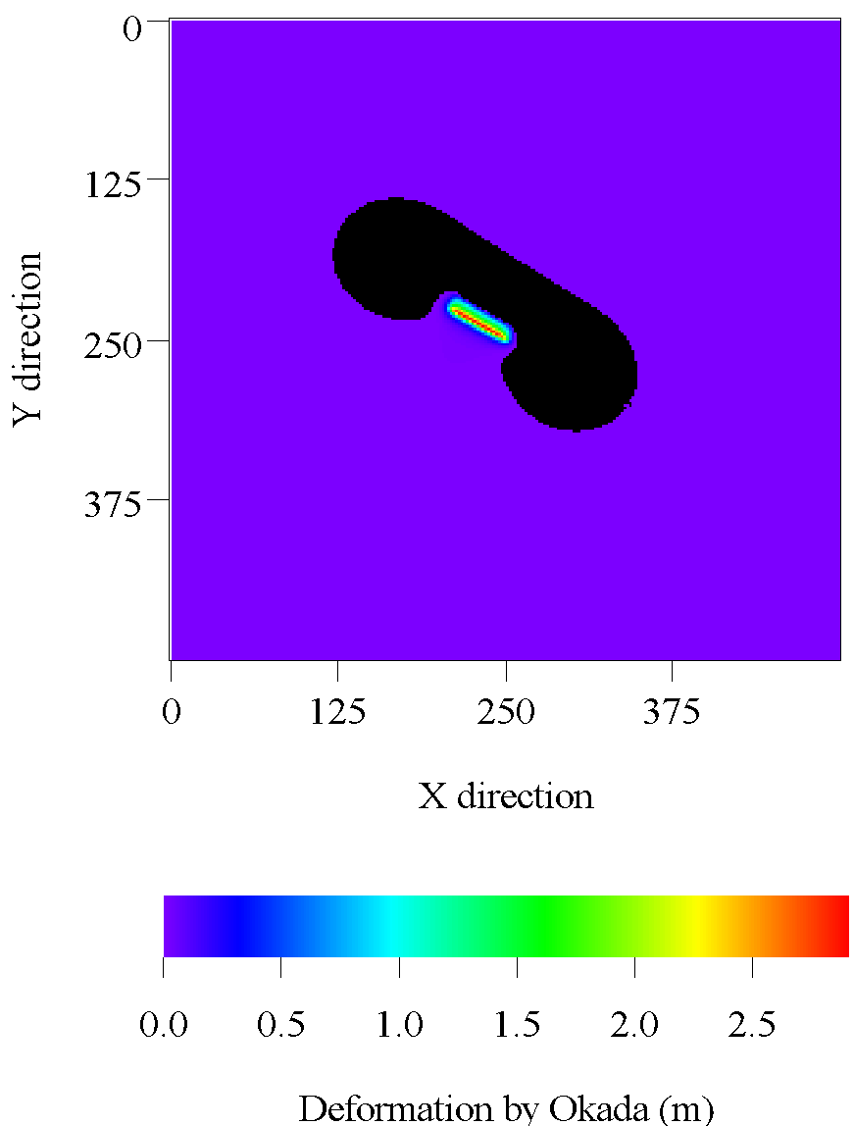
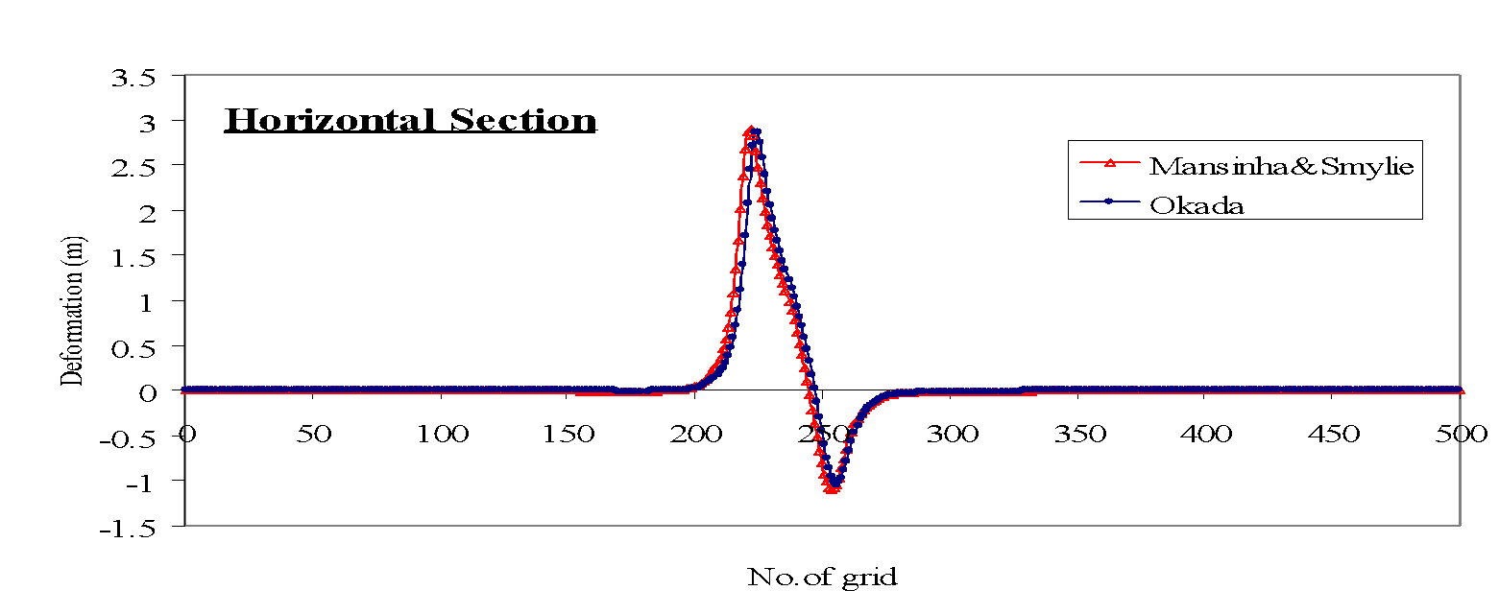
Modeling seafloor and sea surface deformation
Focal depth, D (km)
Fault length, L (km)
Fault width, W (km)
Dislocation, u (m)
Strike angle, θ
Dip angle, δ
Slip angle, λ
Mansinha, L. and Smylie, D. E. (1971) The displacement fields of inclined faults, Bulletin of the Seismological Society of America, 61, 1433–1440.
Okada, Y. (1985) Surface deformation due to shear and tensile faults in a half space. , Bulletin of the Seismological Society of America., 75, 1135-1154.
BA
BA
A
A’
A
A’
BA
B’
B’A
No. of grid
B’A
ABA
A’
No. of grid

Slide 10
The TIME (Tsunami Inundation Modeling Exchange) project
This manual is based on “TSUNAMI NUMERICAL SIMULATION with the staggered leap-frog scheme (Numerical code of TUNAMI-N1)” of Dr. Fumihiko Imamura, Prof. of Tsunami Engineering School of Civil Engineering, Asian Inst. Tech. and Disaster Control Research Center, Tohoku University prepared in June, 1995 for TIME project. The TIME (Tsunami Inundation Modeling Exchange) started in 1991 as a joint effort of IUGG and IOC/UNESCO during IDNDR. The Disaster Control Research Center (DCRC), Tohoku University, Japan has been acting as the center of TIME, to transfer numerical technique of tsunami simulation to the countries which suffered or will suffer tsunami hazards. Fifteen institutions of twelve countries obtained the computer programs and manuals developed and prepared by DCRC through mails or by training directly from DCRC. Four institutions of four countries obtained the technique through Mr. Ortiz, one of the trainees of the TIME project. As of 2003, the TUNAMI code was transferred to nineteen institutions of fifteen countries.

Slide 11
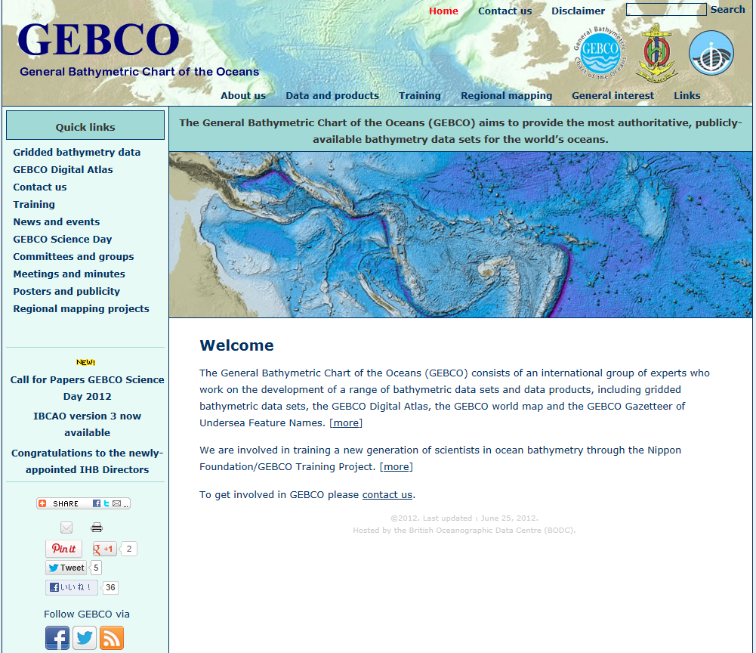
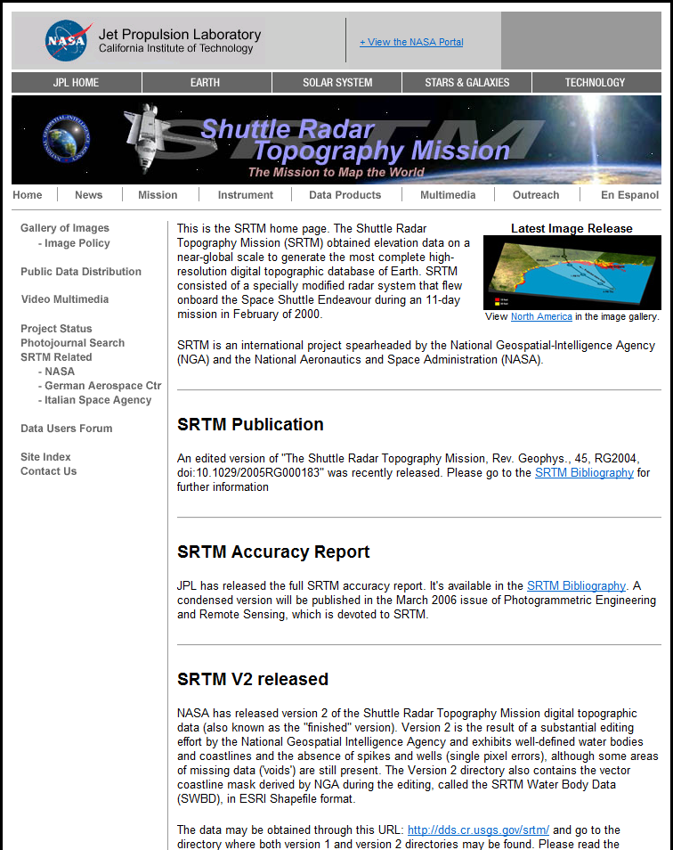
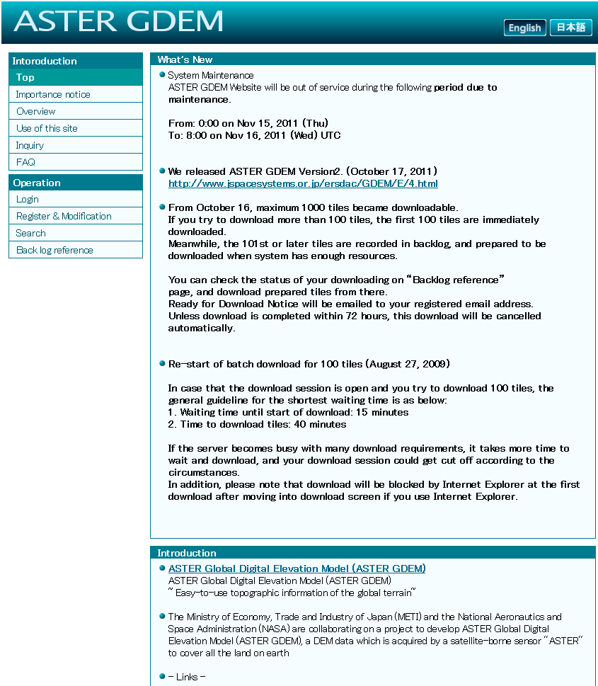
Global bathymetry and topography data
GEBCO: Both bathymetry and topography data with 15 arc second (500 m)
SRTM: Only topography data with 3 arc second (90 m)
ASTER: Only topography data with 1 arc second (30 m)

Slide 12
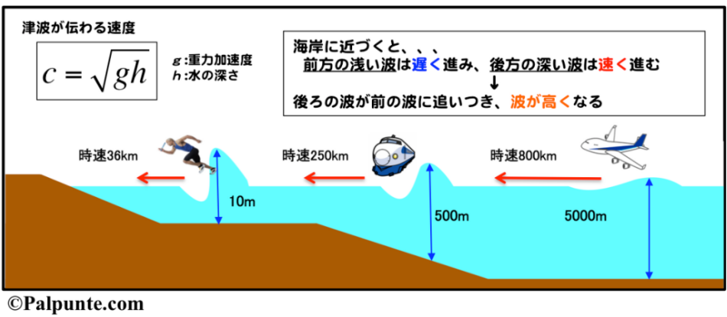
Assignment 1: Estimate tsunami arrival time
Tsunami travel faster in deeper sea!
c = tsunami propagation speed
g = gravitational acceleration 9.81 m/s²
h = sea depth (m)
http://www.science-palpunte.sakura.ne.jp/2016/04/29/tsunami_from_chile/4/

Slide 13
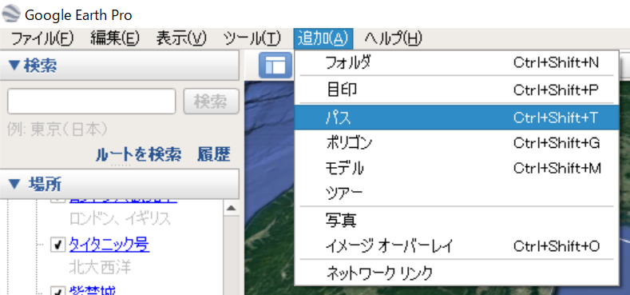
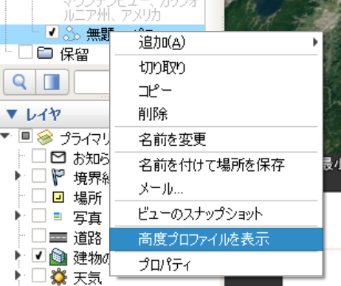
Assignment 1: Estimate tsunami arrival time
Let`s use Google Earth to estimate tsunami arrival time!

Slide 14
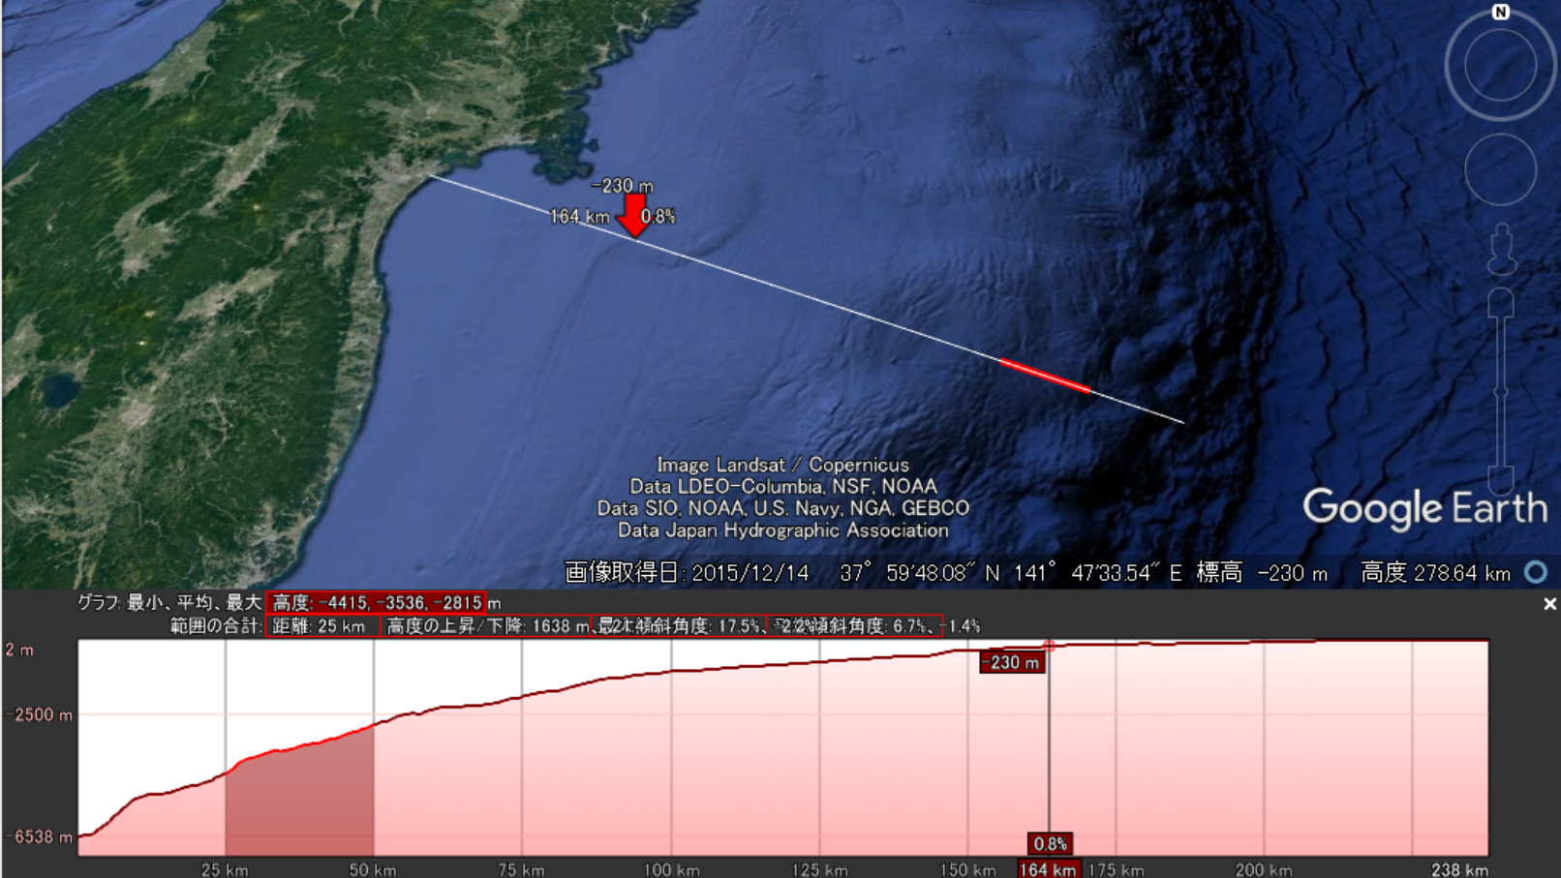
Assignment 1: Estimate tsunami arrival time
Let`s use Google Earth to estimate tsunami arrival time!
Interval = 25 km
Average sea depth = 3,500 m
Time = 25*1,000 / [sqrt (9.81*3,500)]

Slide 15
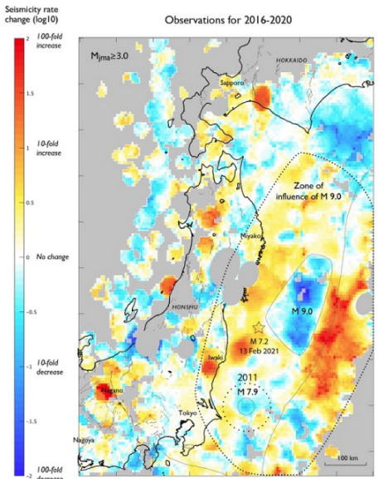
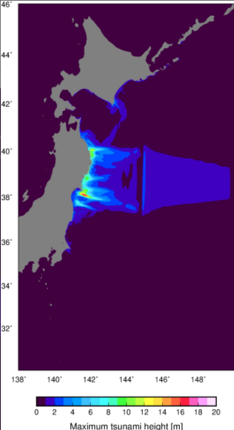
Assignment 1: Estimate tsunami arrival time
Case 1: Outer-rise earthquake 🡪 Epicenter = 38°N 144°E

Slide 16
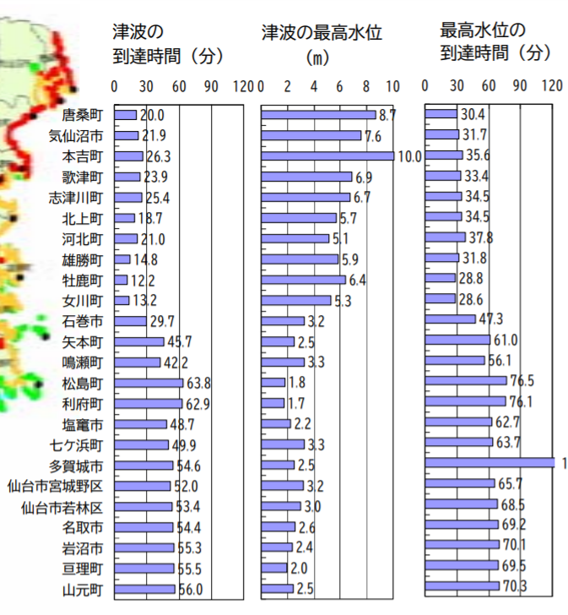
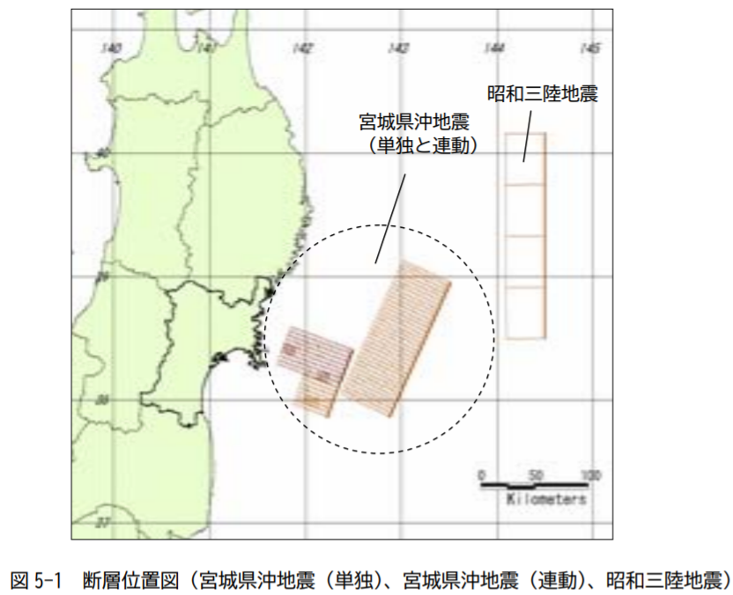
Assignment 1: Estimate tsunami arrival time
Case 2: Miyagi earthquake 🡪 Epicenter = 38.5°N 142°E
Arrival time (min)
Maximum tsunami (m)
Outer-rise (Showa Sanriku)
https://www.pref.miyagi.jp/soshiki/bousai/ks-sanzihigai-houkoku.html

Slide 17
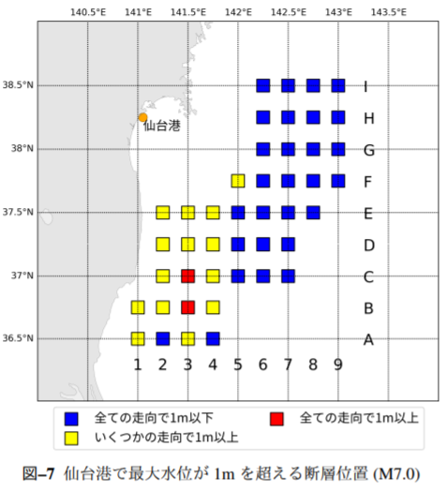
Assignment 1: Estimate tsunami arrival time
Case 3: Fukushima earthquake 🡪 Epicenter = 37°N 141.5°E
For M7.0 earthquake
All strike values generate tsunami < 1m
Some strike values generate tsunami > 1 m
All strike values generate > 1 m of tsunami

Slide 18
Assignment 1: Estimate tsunami arrival time
Estimate tsunami arrival time from these earthquakes using different interval distance
(i.e. 25 km, 50 km and 100 km)
Case 1: Outer-rise earthquake 🡪 Epicenter = 38°N 144°E
Case 2: Miyagi earthquake 🡪 Epicenter = 38.5°N 142°E
Case 3: Fukushima earthquake 🡪 Epicenter = 37°N 141.5°E

Slide 19
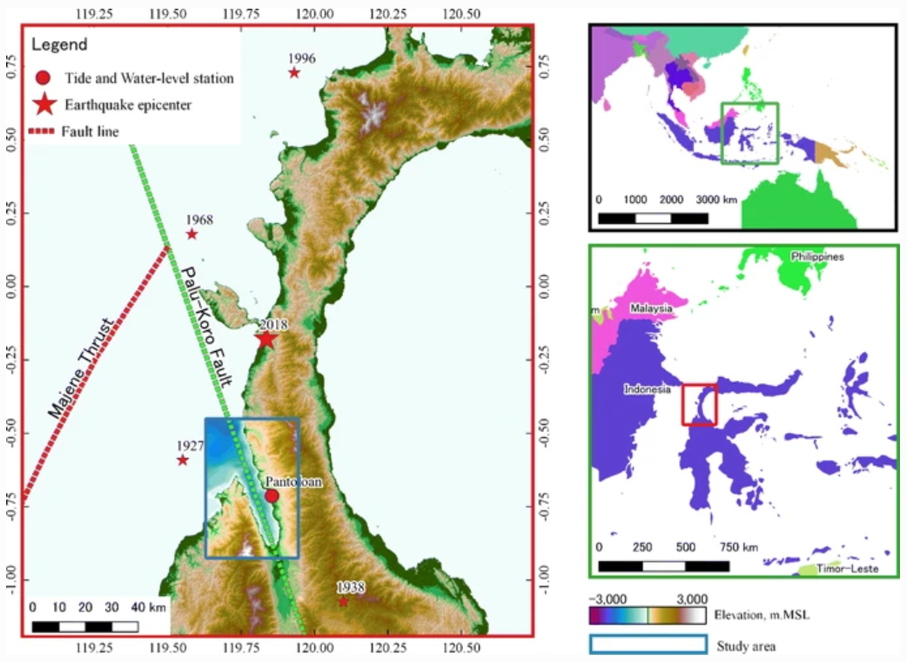
2018 Sulawesi Island (Palu) tsunami
Landslide generated tsunami
Pakoksung et al., 2019

Slide 20
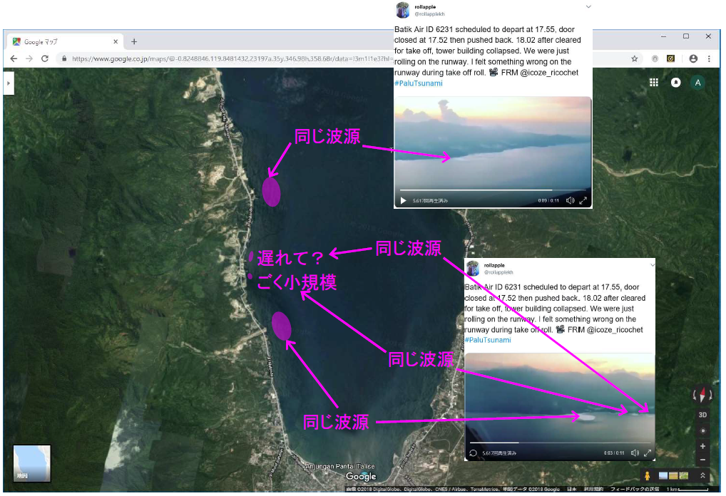
Eyewitness of local tsunami sources

Slide 21
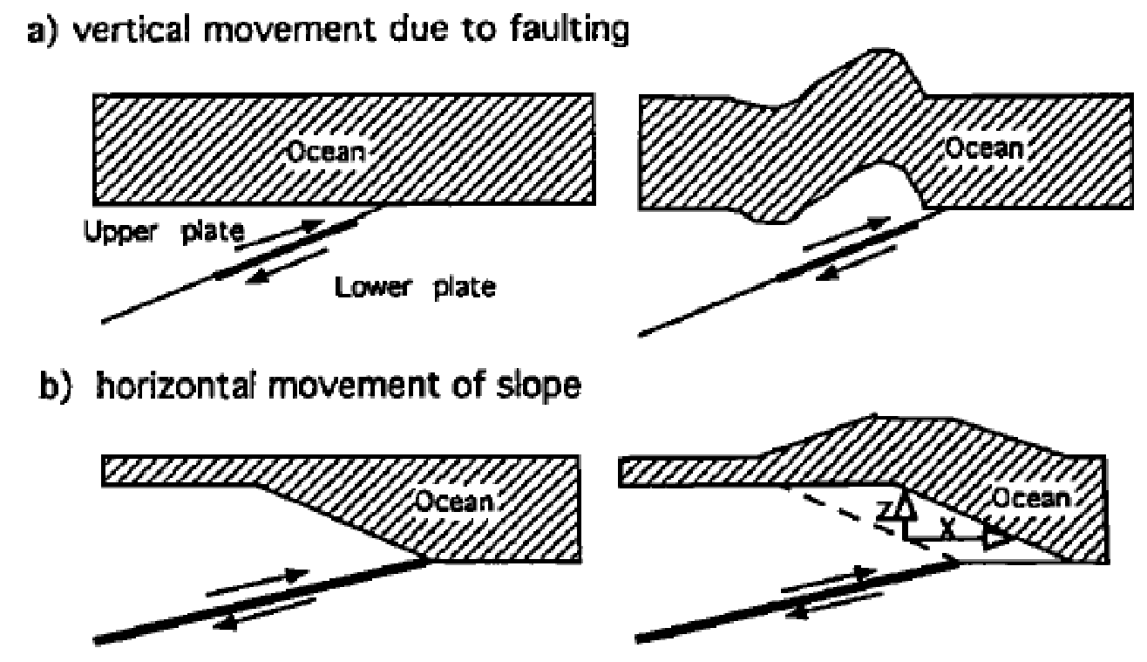
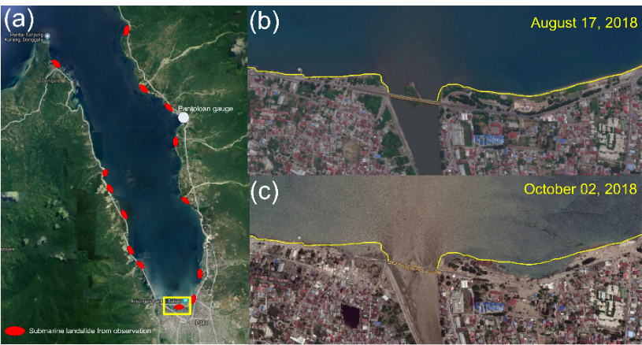
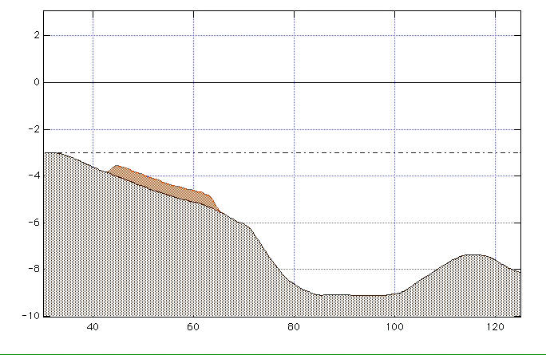
Possible reasons for local tsunamis
1) Horizonal movement of slope (Tanioka and Satake, 1996)
3) Shoreline subsidence or liquefaction (Carvajal et al., 2019)
2) Aerial or submarine landslide (Imamura et al., 2001)
Reproduction of the 2018 Palu tsunami

Slide 22
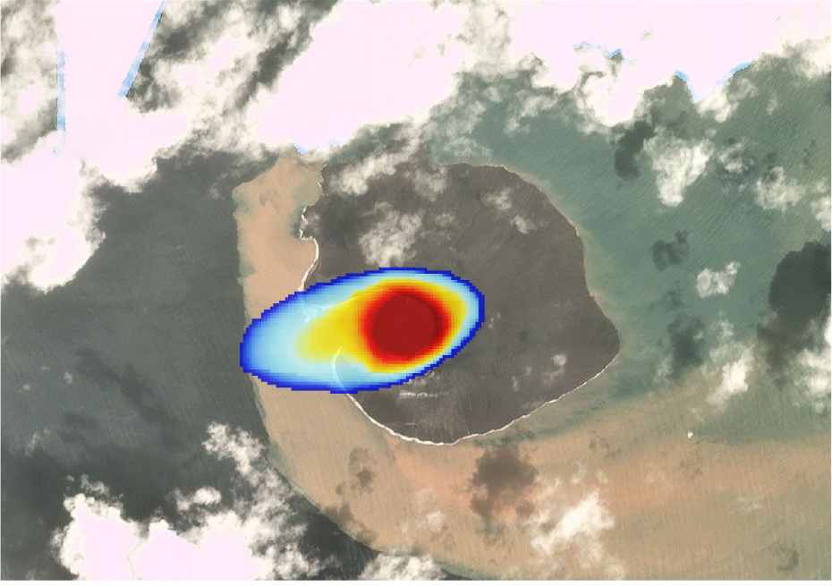
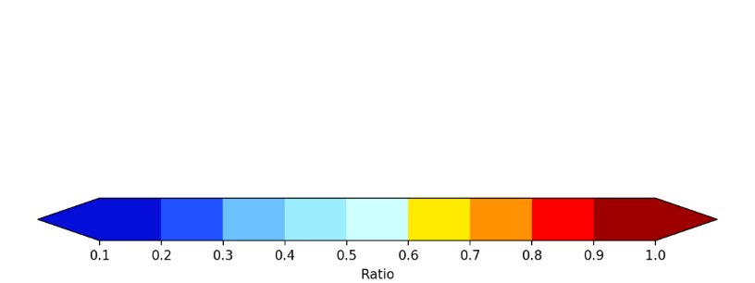
Volcanic eruption generated tsunami
Modeling of landslide generated by the Krakatau eruption is based on the satellite image in before and after the eruption
Two unknown parameters:
landslide depth (volume), sliding time
Land slide for the 2018 Anuk Krakatau volcano eruption model can be detected by the 3D ellipsoid shape from change detection of the satellite image.
image on December 17, 2019
image on December 30, 2018
Images from Google Earth

Slide 23
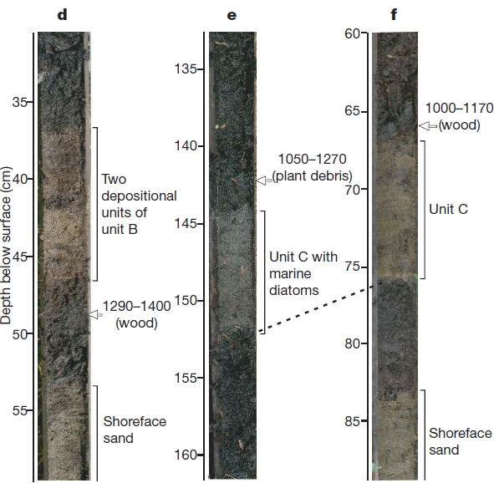
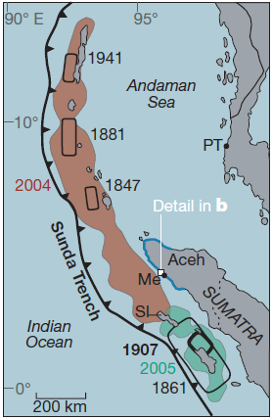
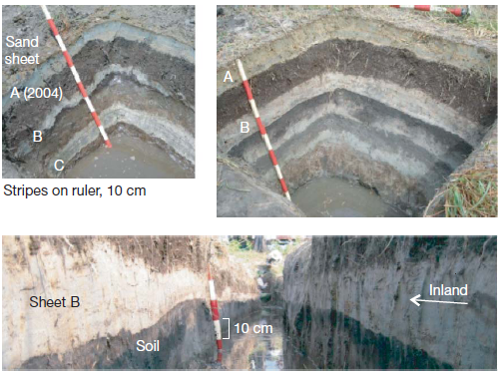
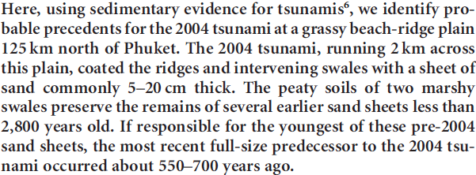
Determination of tsunami recurrence (earthquake source)
Monecke et al., 2008 (Nature)
Jankaew et al., 2008 (Nature)

Slide 24
869 Jogan tsunami
Source: IRIDeS tsunami field guide
Namegaya and Satake (2014)

Slide 25
1611 Keicho Sanriku tsunami
History
Geological science
Engineering

Slide 26
Learning step by step from historical tsunamis in Japan
Early period:
🡪 Felt a shake = tsunami is coming & No tsunami in Japan Sea side
1896 Meiji Sanriku tsunami: tsunami-earthquake type
🡪 Small shake but large tsunami (38.2 m / 22,000 deaths)
1933 Showa Sanriku tsunami: Outer-rise earthquake
🡪 Large shake and large tsunami (28.7 m / 3,000 deaths)
1960 Chile tsunami: Far-field tsunami from M9.5 earthquake
🡪 No shake but large tsunami (10.7 m / 142 deaths)
1983 Japan Sea tsunami: The first recent tsunami in Japan Sea
🡪 Warning after 14 mins but tsunami arrived after 12 min (14.9 m / 104 deaths)
1933 Okushiri tsunami: Just 10 years after the 1983 event
🡪 Waning after 5 mins but tsunami arrived after 2-7 min (32.0 m / 230 deaths)
2011 Tohoku tsunami: M9.0 never record in Japan
🡪 Large shake and large tsunami (40.5 m / 19,000 deaths)
 | 1923 Great Kanto | 1995 Great Hanshin | 2011 Great East Japan
M_{w} | 7.9 | 6.8 | 9.0
Time | 11:58 | 05:46 | 14:46
Casualty | 105,385 | 6,434 | 18,579
 | Fire = 87.1% | Shake = 83.3 % | Tsunami = 92.4 %
 | Shake = 10.5 % | Fire = 12.8 % | Shake = 4.4 %

Slide 27
Comparison of fatality ratio among historical tsunamis
(1)
Tsunamis in Japan
（1） 240 years ago
（2） 100 years ago
（3） 37 years after prior event
（4） 400 years no tsunami
（5） 10 years after prior event
(2)
(4)
(3)
(5)
(1)
Tsunamis in Indian Ocean
（1） Banda Aceh
（2） －
（3）・（4）・（5） Java & Mentawai
(2)
(4)
(3)
(5)
Suppasri, A., Koshimura, S., Imai, K., Mas, E., Gokon, H., Muhari, A., and Imamura, F. (2012) Damage characteristic and field survey of the 2011 Great East Japan tsunami in Miyagi prefecture, Coastal Engineering Journal, 54(1), 1250005

Slide 28
Tsunami warning systems in Japan
Assumed faults around Japan
Numerical simulation results stored in database
Source: JMA
Seismic Network
Sea Level Network
1983 tsunami
arrived 7 min
100 casualties
1993 tsunami
arrived < 5 min
230 casualties

Slide 29
Historical tsunamis and the 2011 Tohoku tsunami
1896
M8.5
1933
M8.1
Iwate
1611
M8.1
Miyagi Oki M7.5 - 8.0
869
M8.3
Miyagi
2011M9.0
1896
2011
Miyagi Sea earthquake
2011M9.0
1793M8.2
1835M7.3
1861M7.4
1897M7.4
1936M7.4
1978M7.4

Slide 30
Tsunami warnings during the 2011 tsunami
Local Event Information
-----------------------------------------------------------------------------------------------------
14:46 Earthquake
14:49 Mjma = 7.9 Major Tsunami Warning -
Iwate, Miyagi and Fukushima
14:50 Tsunami Information -
Iwate: 3m, Miyagi: 6m,
Fukushima: 3m, etc.
Only up to M8.0 in the database
15:10 GPS buoys > 3m
15:14 Tsunami Warnings/Advisories extended
15:14 Tsunami Information -
Iwate: 6m, Miyagi: over 10m,
Fukushima: 6m, etc.
Tsunami hit the nearest coast
15:21 Tide gauges at Kamaishi (Iwate) > 4.1m (scale out)
15:30 Tsunami Warning extended
15:31 Tsunami Information-
Iwate, Miyagi, Fukushima: over 10m, etc.
16:00 Mjma = 8.4
17:30 Mw = 8.8
13th May Mw = 9.0
Hayashi et al (2011) and http://www.jma.go.jp/jma/en/2011_Earthquake.html

Slide 31
Observed tsunami waveforms
http://www.pari.go.jp/info/tohoku-eq/

Slide 32
Seafloor and sea surface deformation
Uplift
Subsidence
Japan trench
Land
Sea
1933 Showa Sanriku
(Outter-rise)
Pacific Plate
1896 Meiji Sanriku
(Tsunami earthquake)
869 Jogan tsunami
(Typical interplate)

Slide 33
Improved tsunami warning category
Tsunami warning and watch |  | Previous system (8 levels) | Present system (5 levels)
 |  | Announce tsunami height | Number | Message | Estimated tsunami height
Warning | Major tsunami | > 10 m | > 10 m | Major | > 10 m
 |  | 8 m, 6 m | 10 m |  | 5 m - 10 m
 |  | 4 m, 3 m | 5 m |  | 3 m - 5 m
 | Tsunami | 2 m, 1 m | 3 m | High | 1 m - 3 m
Advisory | Tsunami advisory | 0.5 m | 1 m | - | 20 cm - 1m
Source: JMA

Slide 34
Improved real-time observation technology
http://www.jamstec.go.jp/jamstec-e/maritec/donet/index.html
http://www.bosai.go.jp/activity_special/the_third/ev/earthvol-04.html

Slide 35
The 2016 Fukushima tsunami
Tsunami propagation to Sendai Bay

Slide 36
The 2016 Fukushima tsunami
Tsunami threat level was elevated from “advisory” to “warning”
Miyagi Prefecture
Tsunami warning
Fukushima Prefecture
Tsunami warning
Ibaraki Prefecture
Tsunami advisory
Tsunami warning

Slide 37
Assignment 2: Estimate tsunami amplitude
Green`s law

Slide 38
Assignment 2: Estimate tsunami amplitude
The 2011 Great East Japan Earthquake and Tsunami
Sea depth = 1,600m
Sea depth
= 1,000m
Sea depth
= 200m
Sea depth
= 1 m
https://www.u-tokyo.ac.jp/focus/ja/features/f_00074.html
Case 1
Estimate ideal tsunami amplitude at each station
https://www.spf.org/opri/newsletter/269_1.html

Slide 39
Assignment 2: Estimate tsunami amplitude
The 2016 Fukushima Earthquake and Tsunami
Observed tsunami at Sendai Port
Amplitude = ??
Sea depth = 1 m
Amplitude = ??
Sea depth = 102 m
Amplitude = 0.4 m
Sea depth = 212 m
Case 2
Estimate ideal tsunami amplitude at each station
https://www.seafloor.bosai.go.jp/topics/fukushima_20161122/

Slide 40
Assignment 2: Estimate tsunami amplitude
Case 3
Estimate amplification ratio tsunami amplitude arrive at points N.S3N26 and N.S2N01 to Sendai port
https://www.seafloor.bosai.go.jp/topics/fukushima_20161122/

Slide 41
Breakwater: Kamaishi
Water gate: Fudai
Structural tsunami countermeasure
Seawall: Taro
Sea
Control forest: Rikuzenakata
Land
Highland residence: Toni-hongo
川

Slide 42
Tsunami countermeasures in Japan
1896 Meiji-Sanriku tsunami: by individual
Moving high ground
1933 Showa-Sanriku tsunami: by country and prefecture
Moving high ground + Seawall in some areas
1960 Chile tsunami: Structural measures
Seawalls, breakwaters and tsunami gates
1993 Okushiri tsunami:
Structural measures, town planning and combination with soft measures
2011 Great East Japan tsunami:
Prevention 🡪 Reduction

Slide 43
The 2011 tsunami:
Large different in tsunami hazard map
Taro
Ofunato
Red: 2011 tsunami inundation area
Blue: Predicted inundation area
Ishinomaki
Sendai

Slide 44
Questionnaire survey related to tsunami evacuation (1)
Source: Cabinet office of Japan
By Cabinet Office, Fire Agency and Japan Meteorological Agency
Total answers: 870 (Iwate = 391, Miyagi = 385 and Fukushima = 94), period: During July 2011
A: Soon evacuated (57%), B: Evacuated after some actions (31%), C: Tsunami came during doing some actions (11%) and D: Did not evacuated (they were already in high ground) (1%)
[A+B] Main reasons for starting evacuation: large shaking (48%), were asked to evacuate by family or surrounding people (20%) and surrounding people start their evacuation (15%)
🡪 Less amount of calling out for evacuation
[B+C] Why they did not evacuated as soon as possible: Went back home (22%), looking for family or picking up family (21%), tsunami did not come in the past (11%) and did not think about tsunami coming (9%)
🡪 Have to reduce the amount of people going back home or seeking family
Condition of evacuation shelter
C has the highest ratio of people who were inside the inundation area (38%)
A and B are both mostly evacuated to designated evacuation shelters but C is large on the highest floor of the same building
Evacuation method
In general, about 57% of people evacuated using car.
Reason for using car: Not enough time without using car (34%), wanted to evacuate together with family (32%), far from safe place (20%)
About 34% of them were trapped in the serious traffic.
In general, limit distance for evacuation by walking was about 500 m and by car was 2 km.
A: Soon evacuated
B: Evacuated after something done
C: Last minute evacuated
Tsunami hazard map
Number of people who had seen tsunami hazard map or had hazard map in their house was less than 20%
Blue = outside inundation area
Red = inside inundation area
Green = could not identify

Slide 45
Questionnaire survey related to tsunami evacuation (2)
By Weathernews
Target area: Hokkaido, Aomori, Iwate, Miyagi, Fukushima, Ibaraki and Chiba
Total answers: 5,296 (3,298 from survivors and 1,998 related to people who were casualty)
1) Time from earthquake generation to starting evacuation
- Survivor = 19 min and casualty = 21 min
Reason for starting evacuation
- Major tsunami warning or tsunami warning and only 28 % of the survivors soon evacuated
Evacuation condition
- Reason for not evacuated was they believe they were safe and 20% of victim could not evacuated
Selected evacuation place
- 75% of survivor could evacuated to safe place while 75% of victim could not
- 40% could not evacuate to high ground and 50% evacuated to non-designated evacuation place
Why they could not evacuate from the tsunami
- 18% of victim was because they were obstructed during their evacuation
Evacuated elevation from tsunami
- Approximately 2.9th floor for survivor and 1.7th floor for victim
Moving from evacuation place
- 60% of victim moved to tsunami inundation zone again
Reason for moving from evacuation place
- Looking for their family was the main reason

Slide 46
New consideration of tsunami size and countermeasure
Level 1:
High frequency (30-200 years) but small to moderate tsunami.
Community should be mostly protected by coastal defense structures.
Height of coastal structures were decided by past Level 1 tsunami events
Level 2:
Low frequency (200-1,000 years) but very high tsunami.
Forget about properties but secure evacuation routes for safe evacuation.
Coastal structures should be strong enough even in case of the overtopping.
Level 1
Level 2
http://www.bousai.go.jp/kaigirep/chousakai/tohokukyokun/4/pdf/2-2.pdf
http://www.pa.thr.mlit.go.jp/kakyoin/PDF/sankou.pdf

Slide 47
Reconstruction plan of Miyagi prefecture
http://www.pref.miyagi.jp/seisaku/sinsaihukkou/keikaku/index.htm

Slide 48
Sendai city plan: land use management
The 2011 tsunami
Increase road level = 6 m
http://www.city.sendai.jp/fukko/1198749_2757.html

Slide 49
Experience from past tsunamis help decreasing disaster impact
Towns and villages in Edo period (1603-1868) were located outside inundation area
Hirakawa、2011

Slide 50
Assignment 3: Estimate inundation extent
Inundation extent of the 2011 tsunami
http://www.jsgi-map.org/tsunami/

Slide 51
Assignment 3: Estimate inundation extent
Inundation height of the 2011 tsunami
https://coastal.jp/ttjt/

Slide 52
Assignment 3: Estimate inundation extent

Slide 53
Assignment 3: Estimate inundation extent

Slide 54
Performance of the structural tsunami countermeasures
Otsuchi
Kamaishi
Before tsunami
Ofunato
Before tsunami
Kamaishi
After tsunami
Ofunato
After tsunami
Yamada
Minami Sanriku
Fudai
Breakwaters and Tsunami gate
Suppasri et al., 2013
2011
2007

Slide 55
Ishinomaki
Performance of the structural tsunami countermeasures
Seawalls and control forests
Taro
Higashi-Matsushima
2010
Rikuzen-Takata
2011
2008
2010
Suppasri et al., 2013

Slide 56
2011 Tohoku tsunami
Performance of black pine forests
Shuto (1985)
LV 1
Inclined
Results from historical tsunamis in Japan
= Damage and non-effective when tsunami > 3 m
= Totally damaged when tsunami > 5 m
LV 2
Cut off
Depth (m) | Sum | LV 0 | LV 1 | LV 2 | LV 3
2 | 142 | 103 | 13 | 24 | 2
3 | 84 | 0 | 16 | 58 | 10
4 | 179 | 40 | 51 | 17 | 71
5 | 737 | 304 | 83 | 254 | 96
6 | 65 | 0 | 34 | 13 | 18
7 | 731 | 103 | 213 | 144 | 271
LV 3
Uprooted
Source: Surveyed 2,000 pine trees by MLIT (Ishinomaki, Sendai, Natori, Iwanuma)

Slide 57
Building damage
Inundation depth = 4 m
Before tsunami
After tsunami

Slide 58
Overturned buildings by the 2011 tsunami
Onagawa town 女川町
Max. inundation depth = 18 m
最大津波浸水深＝18 m 程度
Suppasri et al., 2012

Slide 59
Preservation of buildings and other facilities destroyed by the tsunami
Several memorial in rocks, stones, shrines and temples before the 2011 event…
But…no preservation of damaged structures after the 2004 event
Thailand
Indonesia

Slide 60
World Tsunami Awareness Day
In December 2015, the UN General Assembly designated 5 November as World Tsunami Awareness Day.
World Tsunami Awareness Day was the brainchild of Japan, which due to its repeated, bitter experience has over the years built up major expertise in areas such as tsunami early warning, public action and building back better after a disaster to reduce future impacts.
The date for the annual celebration was chosen in honor of the Japanese story of “Inamura-no-hi”, meaning the “burning of the rice sheaves”. During an 1854 earthquake a farmer saw the tide receding, a sign of a looming tsunami. He set fire to his entire harvest to warn villagers, who fled to high ground. Afterwards, he built an embankment and planted trees as a buffer against future waves.
Seawalls
1854 tsunami
1946 tsunami

Slide 61
Assignment 4: Emergency planning for Sendai Port
Future tsunami from Japan Trench
http://www.bousai.go.jp/jishin/nihonkaiko_chishima/model/pdf/miyagi.pdf

Slide 62
Assignment 4: Emergency planning for Sendai Port
Off-Miyagi
Arrival time (min)
Maximum tsunami (m)
Outer-rise (Showa Sanriku)
https://www.pref.miyagi.jp/soshiki/bousai/ks-sanzihigai-houkoku.html

Slide 63
Assignment 4: Emergency planning for Sendai Port
Off-Fukushima
For M7.0 earthquake
All strike values generate tsunami < 1m
Some strike values generate tsunami > 1 m
All strike values generate > 1 m of tsunami

Slide 64
Assignment 4: Emergency planning for Sendai Port
Types of industries in Sendai Port
http://www.pa.thr.mlit.go.jp/shiogama/introduction/sendai/img/img_planning-drawing_sendai.jpg

Slide 65
Assignment 4: Emergency planning for Sendai Port
Type of port industries
https://nhess.copernicus.org/articles/21/1887/2021/
Construction materials
Food
Concrete and cement manufacturing, asphalt and wood processing
Seafood processing
Manufacturing
Chemical
Metal and alloy products, feed manufacturing, plywood and paper products
Bulk chemical production e.g. propane and fertilisers
Cargo handling facilities
Petrochemical
Container terminals. Stacking and transport facilities such as cranes and lift-on/lift-offs
Oil depots and reserves, and oil refineries
Warehouse & distribution
Energy-related
Includes cold storage, warehouse and logistics support
Coal and electric

Slide 66
Assignment 4: Emergency planning for Sendai Port
Damage scale
https://nhess.copernicus.org/articles/21/1887/2021/
Increasing damage

Slide 67
Assignment 4: Emergency planning for Sendai Port
Damage functions
https://nhess.copernicus.org/articles/21/1887/2021/

Slide 68
Assignment 4: Emergency planning for Sendai Port
Tsunami evacuation facilities
http://www.city.sendai.jp/hinan/kurashi/anzen/saigaitaisaku/jishintsunami/documents/tsunamitebiki-chizu-english.pdf

Slide 69
Assignment 4: Emergency planning for Sendai Port
Estimated tsunami flow depth from future tsunami
Tsunami evacuation facilities

Slide 70
Assignment 4: Emergency planning for Sendai Port
「Japan Trench」
Maximum M9 class
The first wave (4.4 m) arrive after 77 min
「Off-Miyagi」
M7.5-8.0
Arrival time 50 min / height 3.2m
[Off-Fukushima]
M7.5
Arrival time 50 min / height 2-3 m
「Outer-rise」
M8.7
Arrival time > 70 min / height 3-4 m
「Sendai bay」
M7.0-7.5?
Arrival time < 1m / height < 1 m
「Distant tsunami 」
Arrival time > 2 hours
Japan Trench
Outer-rise
Off-Miyagi
Sendai bay
Off-Fukushima

Slide 71
About your presentation on Friday

Slide 72
About your presentation on Friday
Time allocation for each group = 20 min
Proposed presentation time 12 min (max. 15 min)
Questions and answers = 5-8 min
Presentation structure (10 – 12 slides)
Introduction: What is tsunami, local and regional impacts
Objectives, outline of presentation
Physics of tsunami: Arrival time, amplitude, inundation extent
Arrival time: From each earthquake region, grid sizes, compare with simulation
Amplitude: Compare with real observation
Risk components: Hazards, exposure and vulnerability
Emergency planning: For Sendai Port and neighboring residential areas from each earthquake region
Summary / limitations / future works

